Slide 1


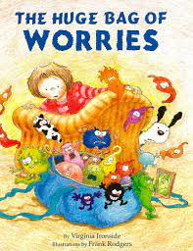
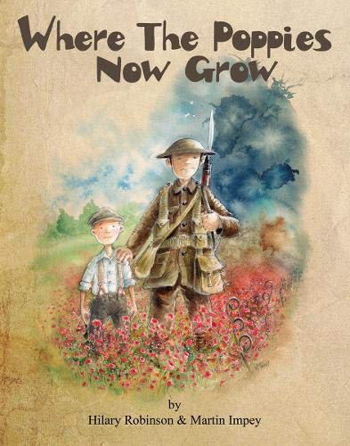
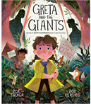

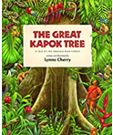
Ready Respectful Safe
Responsibility Progression Map
Responsibility is doing the things we are expected to do and accepting the consequences (results) of your actions
We have a few different ways that we talk about responsibility at our school. There’s being responsible, taking responsibility, acting responsibly, and having responsibilities. They are all related to doing the things we are supposed to do, and accepting the positive or negative outcome of our actions. We are responsible for ourselves, our responses, our relationships, our mistakes, our education and careers, our health and well-being. But our overarching goal is to teach the pupils at Muscliff to be responsible for themselves.
Whole School Assembly Books
We use KS1 and KS2 assemblies to highlight the value. At the end of the assembly, children reflect on how the lesson in the story is relevant to them.
These are all of the books across the whole school that we use to teach the underpinning value of responsibility. We have chosen these books specifically because they illustrate the value within a context that the children understand and can relate to. We also use these books as a vehicle to deliver the content of the National Curriculum.

Slide 2
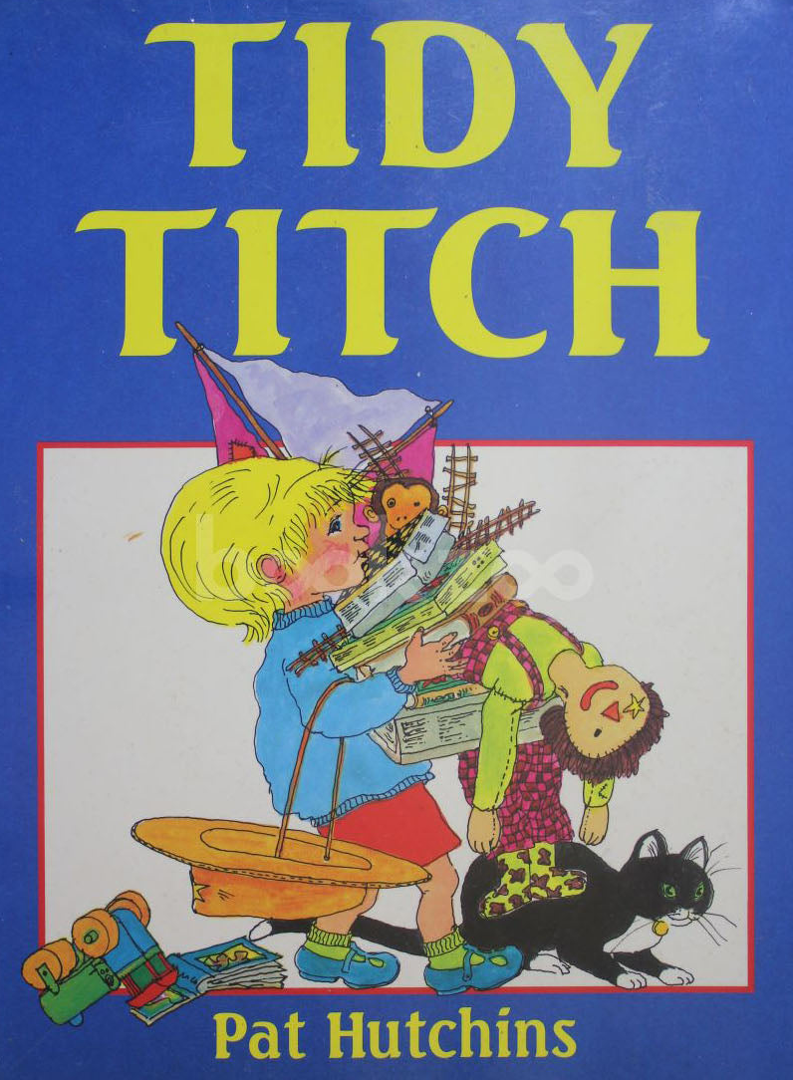




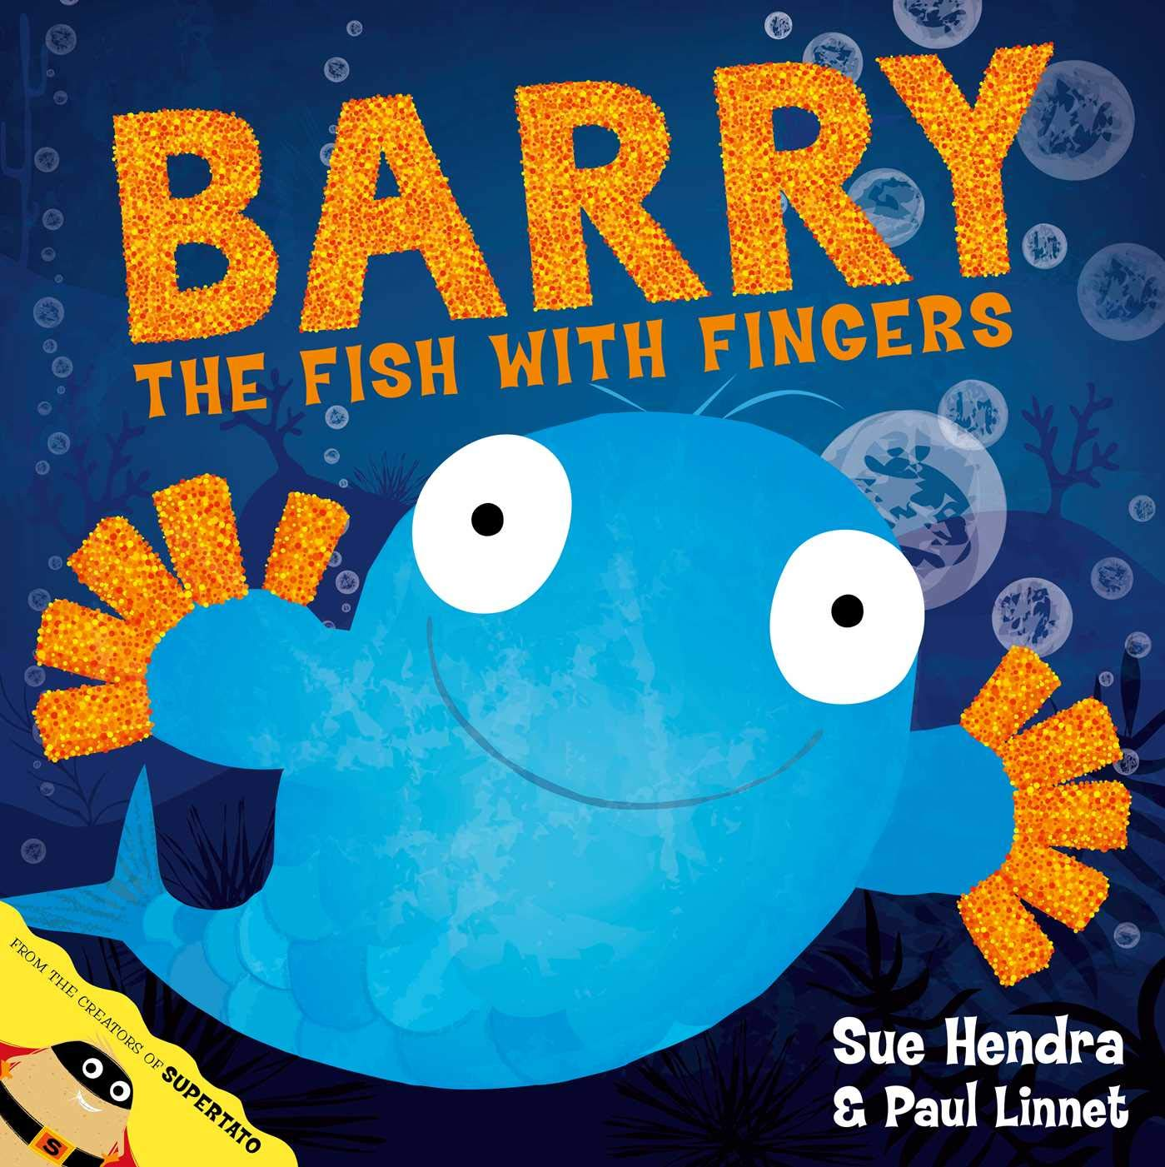

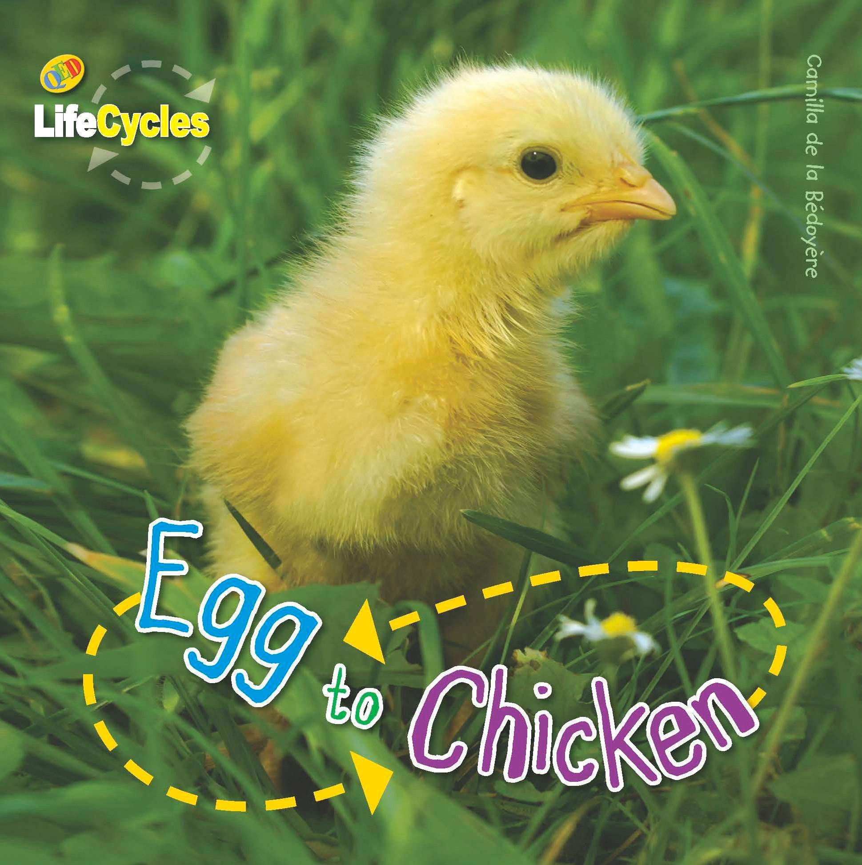




Ready Respectful Safe
Reception
I know that our school rules are Ready, Respectful, Safe and can recite this phrase.
I am beginning to manage my self-routine – I put my snack box and book bag in the correct place when I arrive.
I can self-register.
When told to do so by an adult, I can apologise when I’ve done something wrong.
I tidy the classroom, including items that might not be mine.
I use the role play area respectfully.
I understand the expression, ‘kind hands.’
I move around the school in the ‘Muscliff Way.’
I hold the doors open for adults.
Progress check:
Why would we like Titch to be part of Muscliff Primary School?
Year 1
I can identify when I am and when I am not being Ready, Respectful, Safe.
I am responsible for putting letters in and taking letters out of my book bag.
I chose my own colour-banded book to take home.
I can use a cloakroom and toilet sensibly that is not situated in my classroom.
I change for PE by myself.
I go to first aid if I am hurt at playtime.
I apologise when prompted and sometimes without being told to.
I work with a learning partner.
I can tell a teacher if a friend needs help.
Progress check:
How does looking after someone or something show responsibility?

Slide 3
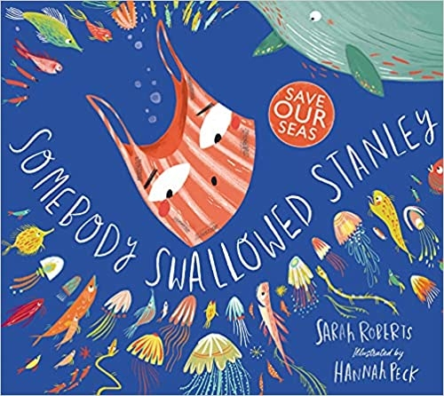
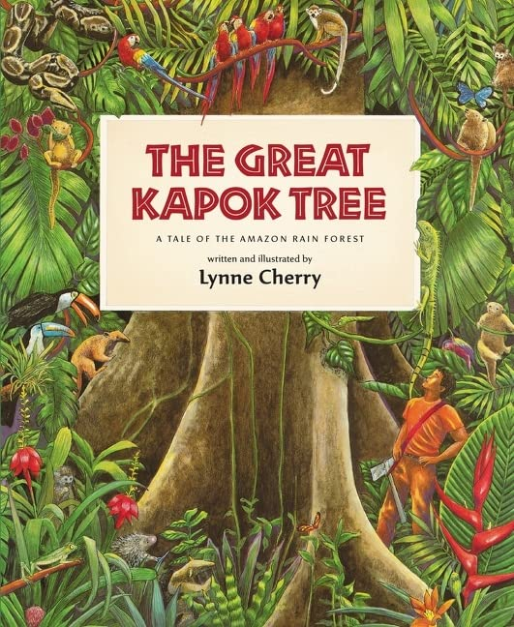
Ready Respectful Safe
Year 2
I can give examples that support Ready, Respectful, Safe.
I complete my morning jobs when I arrive.
Routines are established and I need very little reminders – book bags, changing colour-banded books, snack.
I apologise automatically when I know that I have made a mistake.
I am a considerate friend and treats others how I would like to be treated myself.
I can think about how I might help myself before going to an adult.
I can tidy the tables at the end of a session.
As I am the oldest in the playground/ assembly/lunch hall – I am able to set an example to younger children
I am aware of the environment – plastic in ocean and can say how I might help.
Progress check:
What does Somebody Swallowed Stanley teach us about looking after our school and the local area around Muscliff ?
Year 3
My understanding of Ready, Respectful, Safe is developing and I can talk about our school rules with a growing understanding.
I remember when to bring my reading record to school.
With adults at home, I remember to complete my homework
The presentation in books is as good as I can make it.
I have my PE kit in school and am responsible for the contents of my PE bag.
I can always relay letters to and from home.
I use classroom resources and am beginning to select them on my own.
I can show self-regulation and work independently for short periods of time.
I begin to edit my work and use a dictionary/ thesaurus.
I freely offer peer support.
I can understand the feelings of others through their body language.
I begin to understand that how I act can affect other children.
I have an awareness that some children are different to me.
I have an awareness of what it means to live in the UK and that some children are not as fortunate as us.
Progress check:
How does The Great Kapok show the reader the beauty of the world and teach us how to preserve this beauty?

Slide 4
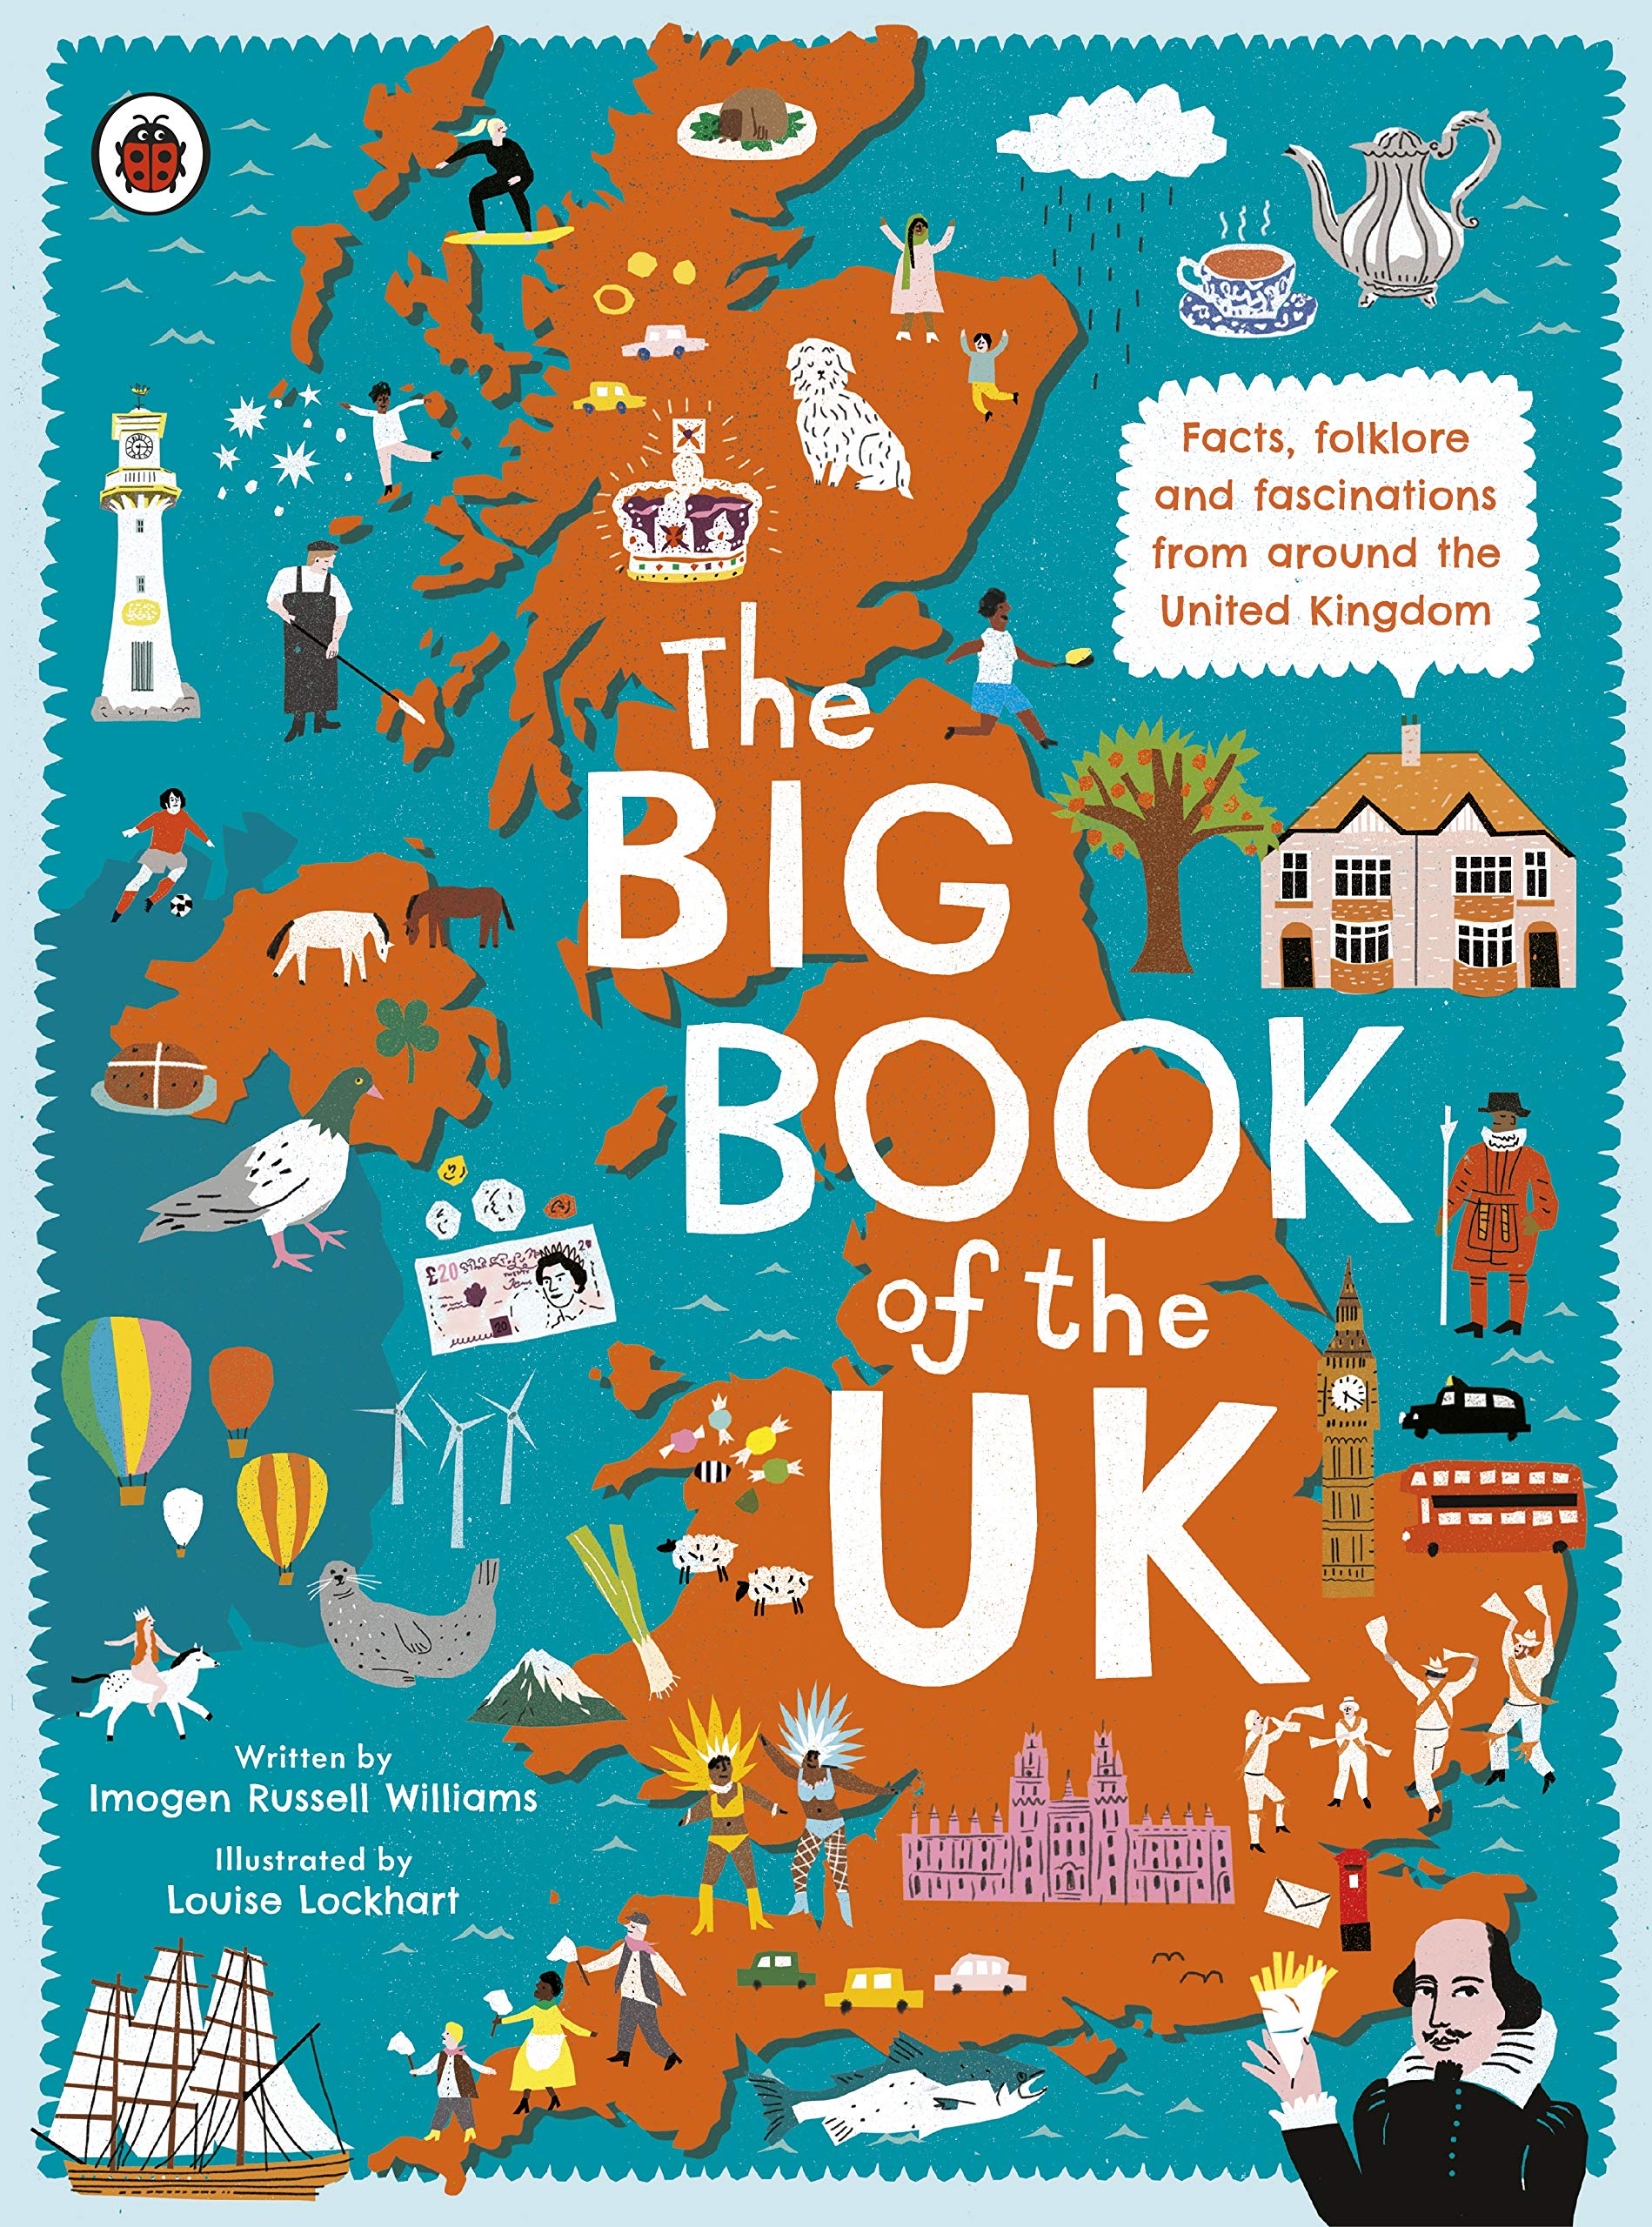
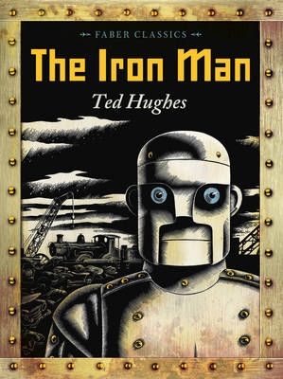
Ready Respectful Safe
Year 4
My understanding of Ready, Respectful, Safe is developed and I can talk about our school rules with a good understanding. I appreciate why Ready, Respectful, Safe is important.
I seek help when needed in lessons.
I can edit my work and use a dictionary/ thesaurus.
I can use classroom resources without being prompted.
I am responsible for homework, including reading.
I can respond to verbal feedback and make changes to my work.
I have an understanding (rather than tolerance) that some children behave differently and this may affect them and me.
I have an awareness that children in school come from different social/ economic backgrounds.
Progress check:
Britain is built on freedom and equality where everyone is aware of their rights and responsibilities. How do the facts in The Big Book of the UK help us to understand that the people of Britain can be different in many ways?
Year 5
I fully understand Ready, Respectful, Safe and I understand that our school rules emulate the rules of society.
Homework is my responsibility.
I accept and understand consequences with growing maturity.
I can change for swimming and manage my belongings.
I manage my feelings and can deal with complex emotions through puberty
I can walk home/ cross roads/ and have stranger awareness
I am aware of peer pressure and what this means.
Mental health –I begin to understand when help is needed.
I show sportsmanship at break time – football.
I am a role model for my buddy in YR.
I set an example with uniform by wearing a tie.
I ask questions about current affairs, e.g Newsround
Safeguarding – I know when to tell a teacher if I have a concern about a friend.
I am honest and open on subjects such as e-safety: YouTube, online gaming, social media.
Progress check:
The Iron Man was responsible for stealing and destroying all the metal so he should accept the consequences of his actions. The people decided the punishment together and that punishment was right as the Iron Man broke the rules and laws. Do you agree?

Slide 5
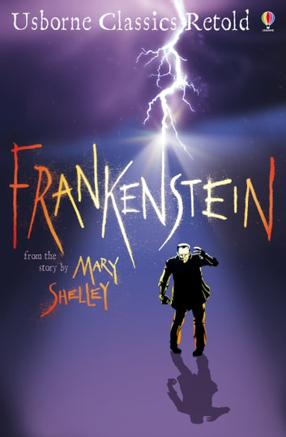
Ready Respectful Safe
Year 6
I can relate Ready, Respectful, Safe to democracy and freedom in the wider world.
I begin to understand that learning/ homework is an investment in myself.
I have self-motivation.
I might become a House Captain.
I care for my own personal hygiene.
I chose healthy lifestyles if I make my own lunchbox choices.
I walk home/ to school/ to shops safely on my own.
I make the right friendship choices.
I show sensitively towards changes of opposite sex during puberty.
I actively seek out more information of current affairs
I have a growing awareness of politics.
I understand the permanence of what I create online.
I use social media responsibly. I recognise that my behaviour online is a reflection of me.
Progress check:
How was Victor responsible for the deaths of all of his loved ones?
Did Victor ultimately accept responsibility for his actions?
Who was more of a monster – Victor or the creation?
Victor’s lifestyle, caused by his obsession by science, was unhealthy and led to a deterioration in his mental health. Identify in the story when he needed to show responsibility and ask for help. Was Henry a responsible friend?

