Slide 1



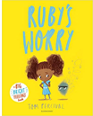




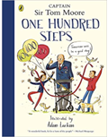


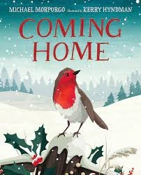

Ready Respectful Safe
Resilience Progression Map
Resilience supports us to work through challenges. Having resilience means that when we face a challenge, we use our inner voice and our body to overcome it. To thrive, Muscliff children are shown how to make the transition from the negative, “I can’t,” to the proactive, “How can I?” To do this, we support children to think about their own thinking (metacognition), to talk about their mental well-being and articulate their feelings towards a challenge and adapt their growth mindset. Reflecting on our own thoughts is how we gain insight into our feelings, needs, and behaviours — and how we learn, manage, and adapt to new experiences, challenges, and emotional set backs. We aim for all Muscliff children to grow in resilience so that they are prepared for life beyond Muscliff.
Whole School Assembly Books
We use KS1 and KS2 assemblies to highlight the value. At the end of the assembly, children reflect on how the lesson in the story is relevant to them.
These are all of the books across the whole school that we use to teach the underpinning value of resilience. We have chosen these books specifically because they illustrate the value within a context that the children understand and can relate to. We also use these books as a vehicle to deliver the content of the National Curriculum.

Slide 2
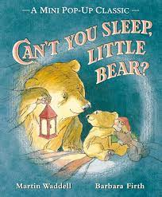
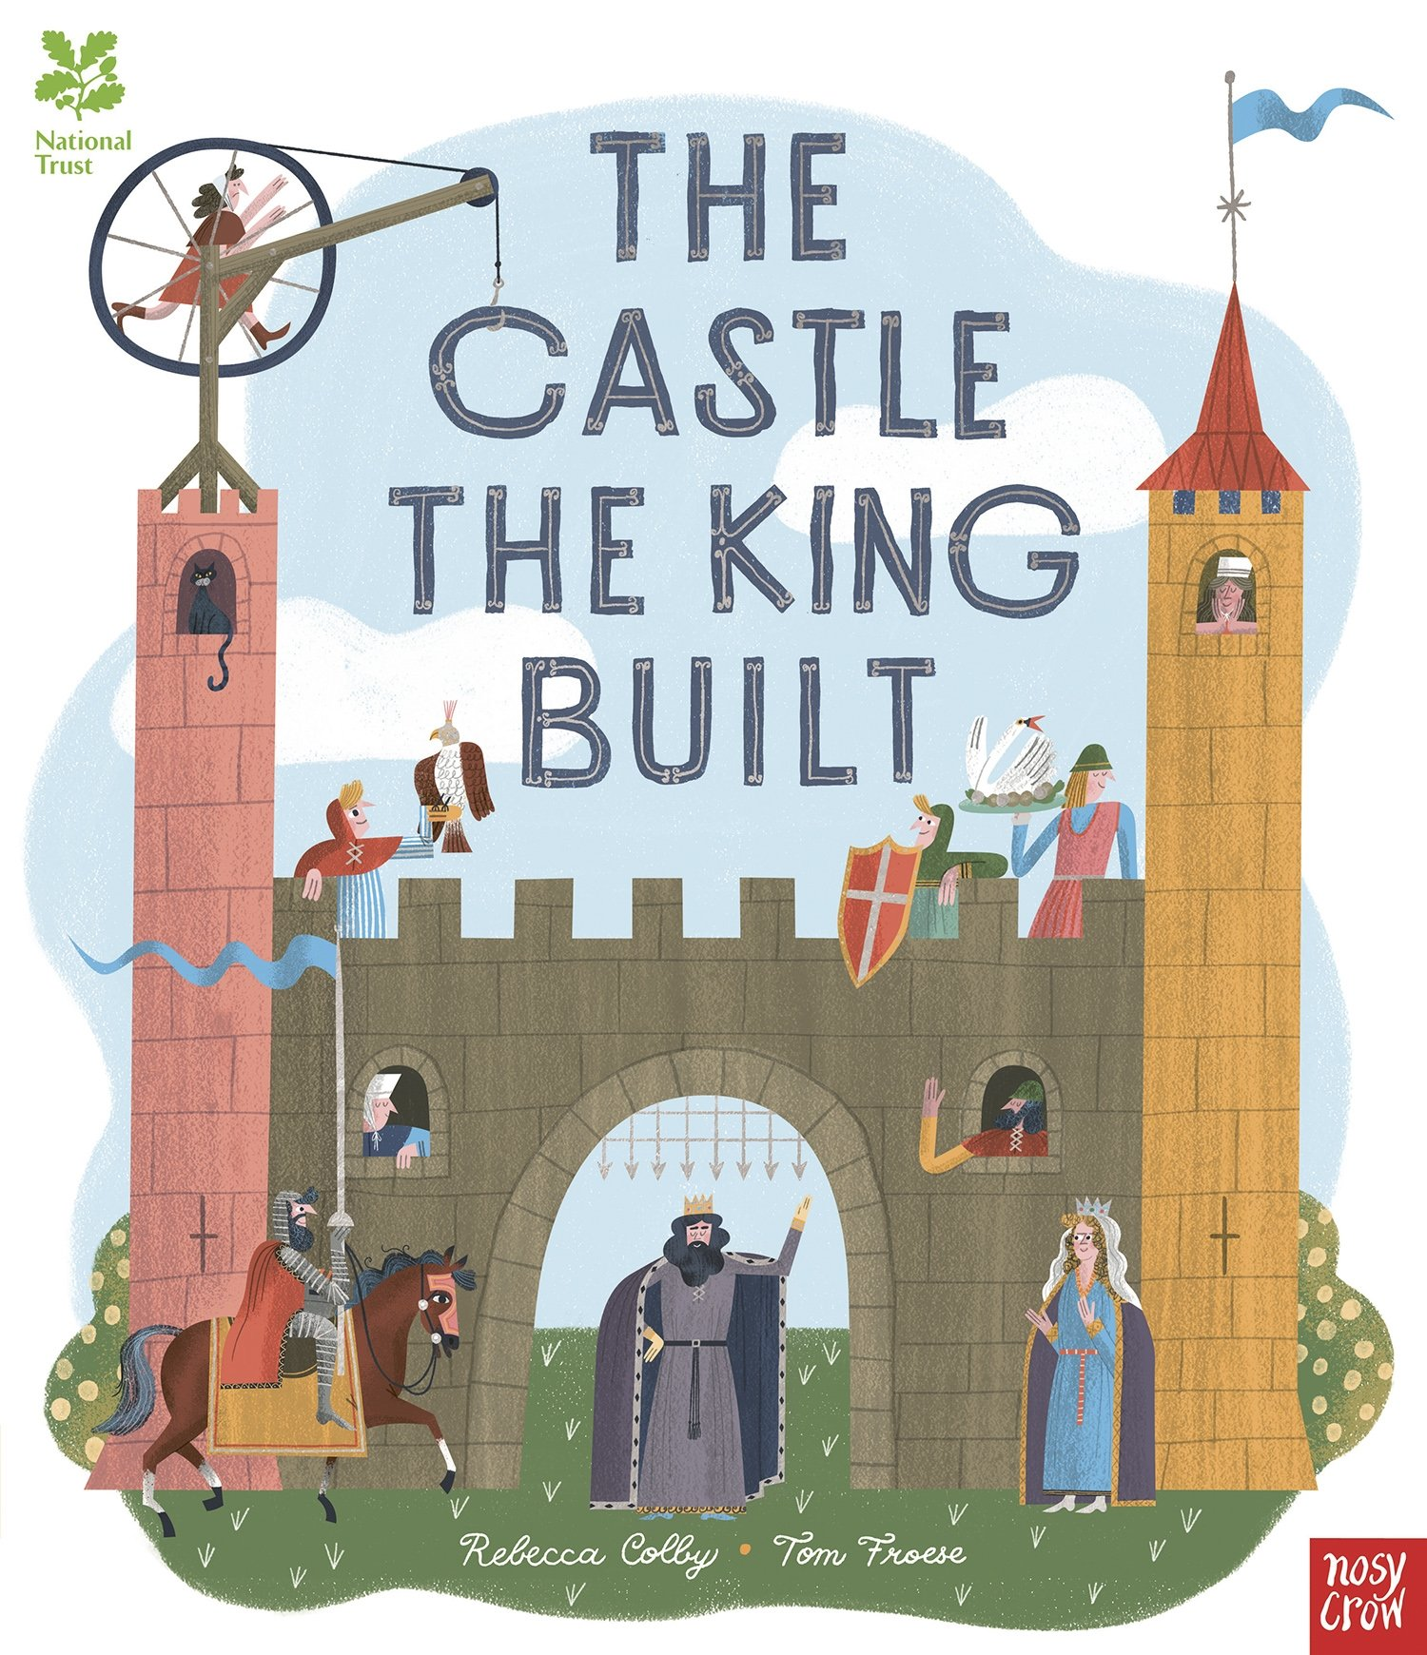
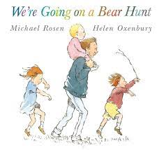
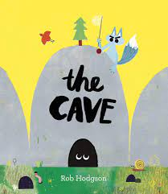
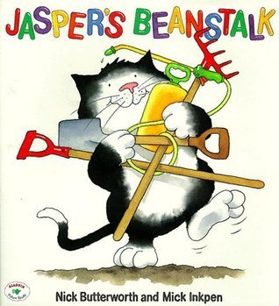
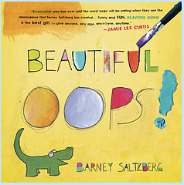





Ready Respectful Safe
Year R
I can keep coming back if I find something hard but a grown-up thinks I can do it.
I can cope with ‘no’.
I try new things within a structured routine.
I can be independent from familiar adults at teacher-selected times.
I can sometimes evaluate my choices.
I can focus on a set activity for an acceptable period of time.
I can socialise with others and accept their responses.
I can take turns.
I can develop new relationships with adults.
I know that the Muscliff Way means to try my best.
Progress check:
Who helps you when you find something hard?
Who helped in these stories?
Year 1
I can maintain my focus for longer periods as appropriate.
I am able to reflect and return to my work.
I can return to a task even if I find something hard and have another try.
I am independent from familiar adults for longer periods at teacher-selected times.
I am able to integrate into big school.
I can show empathy to others when they find something hard.
I am not afraid to have different answers/ideas to other children.
Progress check:
How did the teacher help Vashti in The Dot? How did Vashti help someone else?

Slide 3
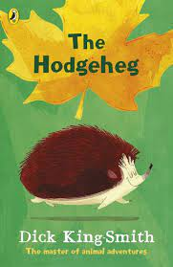
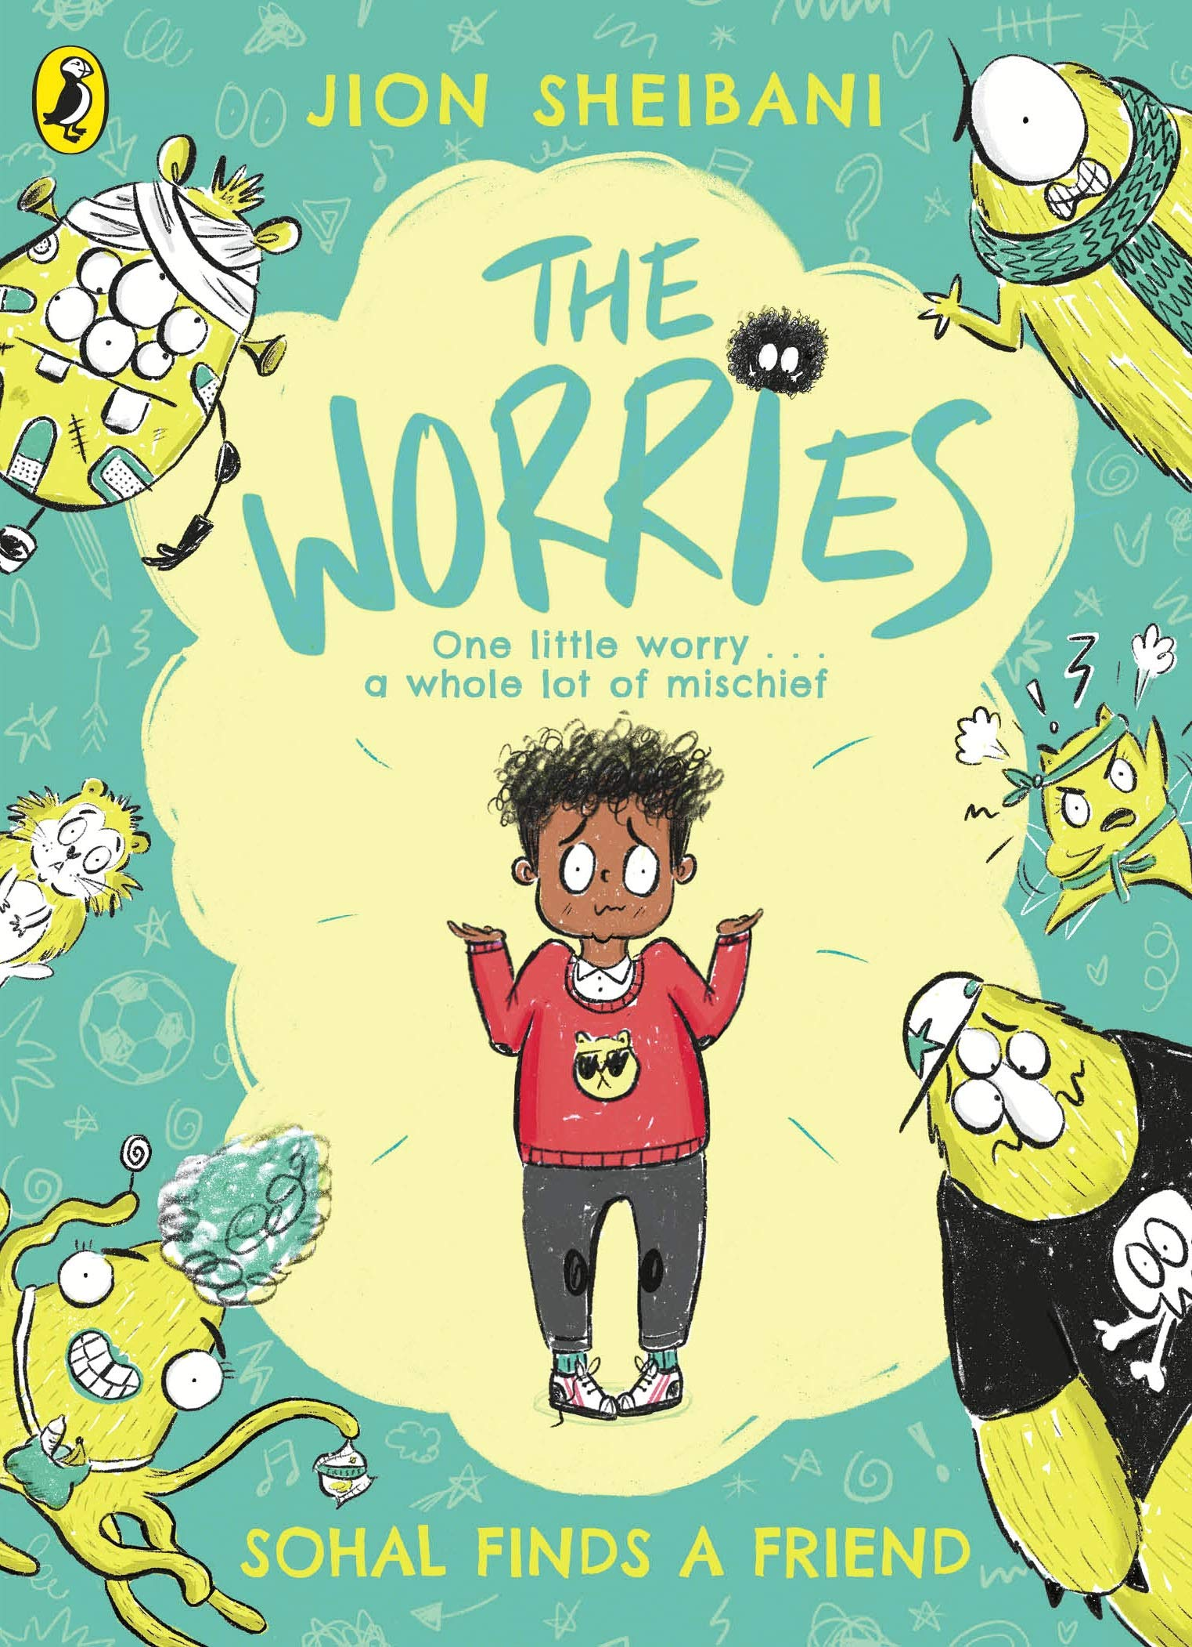
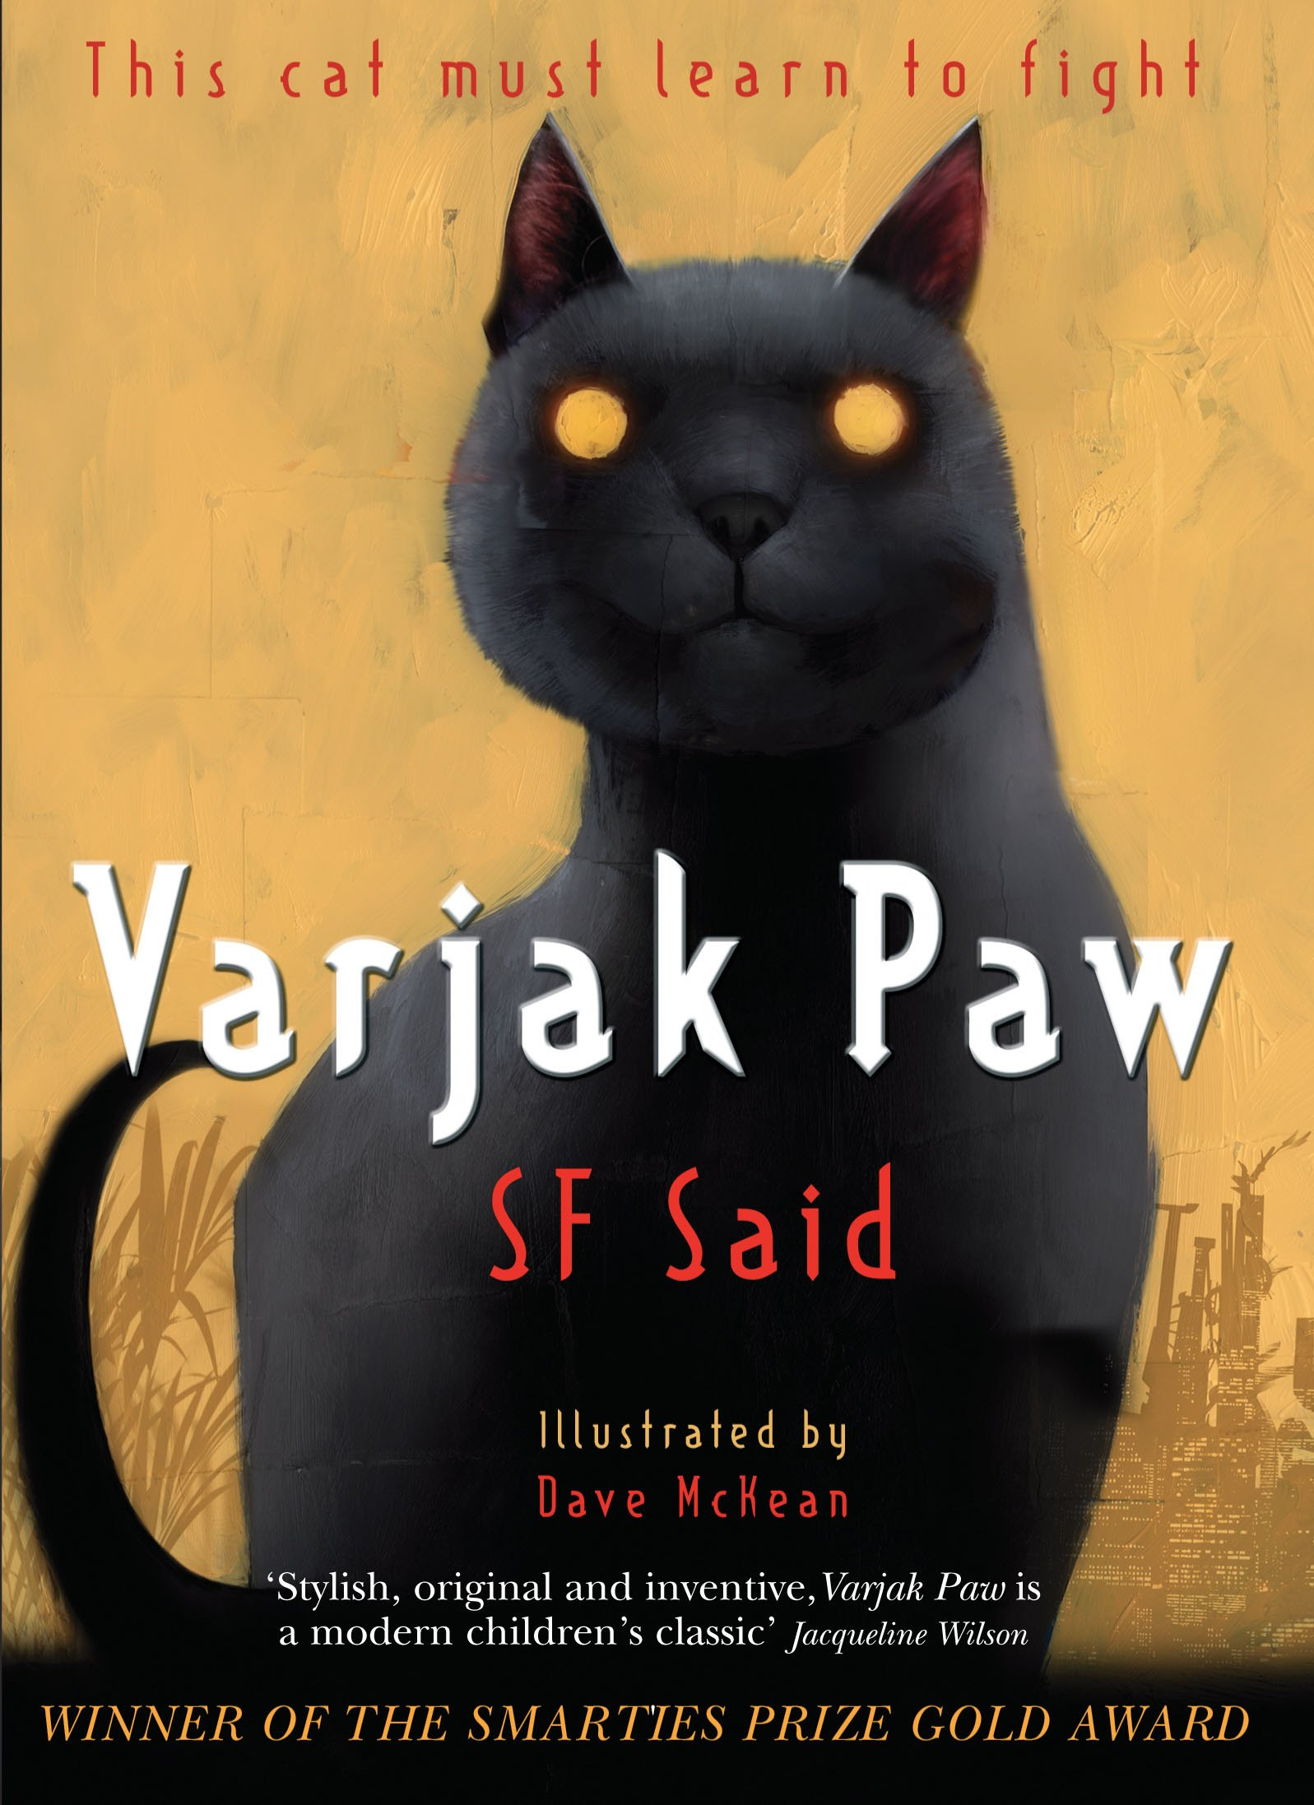
Ready Respectful Safe
Year 2
I try to use strategies before asking an adult for help.
I begin to prove knowledge and understanding with guidance and some adult support.
I am resilient in friendships when things don’t go how I wanted.
I am able to work with other children who I have not chosen to work with.
I show resilience towards ‘special jobs’.
I expect to get things wrong sometimes.
I can return to work that I found tricky after I’ve spoken to an adult.
Progress check:
When did Max show resilience in the Hodgeheg?
What things did Max get wrong?
Year 3
I efficiently use classroom strategies before asking an adult for help.
I am able to ask for help/ reassurance when needed.
I am increasingly independent during work time.
I can cope with longer mornings when we switch to KS2 timetable.
I both expect and welcome making mistakes.
I listen to verbal feedback.
I can move around the school on my own, coping with using the stairs.
I am able to share my mistakes with others.
Progress check:
How did Sohal cope with his worries? Can you identify how he shared his worries in the story?
Year 4
I use my mistakes as a springboard for further learning. I welcome growing green.
I cope with higher expectations (approach to work load).
I problem solve – socially and in my learning and can talk about the steps I need to make.
I recognise when I need to seek help and when I can keep going myself.
I begin to know when I’ve had enough and can cope with (and decide for myself) when it is time to stop.
Progress check:
The Seven Skills of Jalal that Varjak Paw learns are ALL rooted in resilience and metacognition. How would each of these seven skills be useful for a child at Muscliff Primary School? For example, how would ‘Trust Yourself’ support someone to be a successful learner in the classroom?

Slide 4
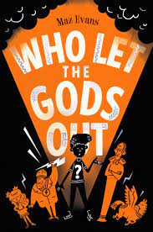
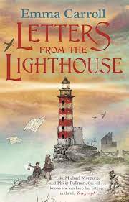
Ready Respectful Safe
Year 5
I exploit the mistakes of others as a springboard for further learning. I can assess when the mistake was made and relate this to my own learning.
I show social resilience in and outside of school, including using social media responsibly.
I am aware of individual identity and that different people have a different level of resilience to me.
I am developing confidence to be different.
I am aware of how much pressure, knowing when to stop and I can apply myself and independently challenge myself by taking myself out of my comfort zone.
Progress check:
Rank the characters in Who Let the Gods Out by their level of resilience. Is their level of resilience changed by the events in the book? In your own family, who is the most resilient and why? What characteristics does a resilient person have?
Year 6
I cope with ‘no’ from authority even when I don’t agree.
I show my best resilience in SATs and new and stressful situations.
I view change as inevitability and embrace it.
I show self reflection and can talk about how I might have done things differently, looking for multiple solutions to the same challenge.
I know my strengths and weaknesses and work on them. I ‘own my errors.’
I less frequently compare myself to others.
Progress check:
It is said that ‘The Great British Spirit’ helped Britons during WW2 to find the resilience to carry on. What was it specifically that inspired and supported the people of Britain during those challenging years? Consider how propaganda communicated resilience.

