Slide 1




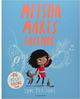
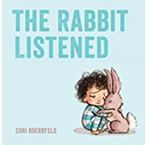
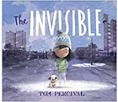

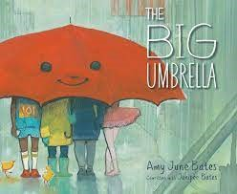

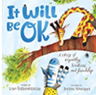
Ready Respectful Safe
Kindness Progression Map
At Muscliff, we teach our children to choose kindness because it is the right choice to make... Kindness is the ability to understand how someone else is feeling or to understand the situation they are in. Kindness is at the root of all healthy relationships. It helps us know how our actions affect others, what actions are needed to be taken to be a good friend or teammate, and it helps us to understand more about the people and the world around us.
Whole School Assembly Books
We use KS1 and KS2 assemblies to highlight the value of kindness. At the end of the assembly, children reflect on how the lesson in the story is relevant to them.
These are all of the books across the whole school that we use to teach the underpinning value of kindness. We have chosen these books specifically because they illustrate the value within a context that the children understand and can relate to. We also use these books as a vehicle to deliver the content of the National Curriculum.

Slide 2
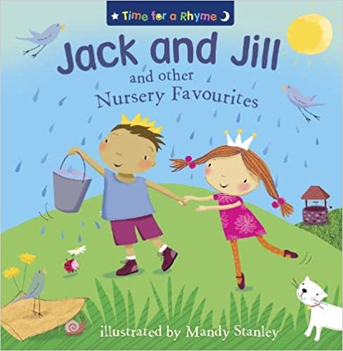
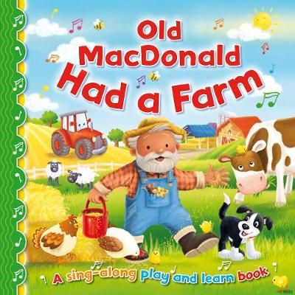
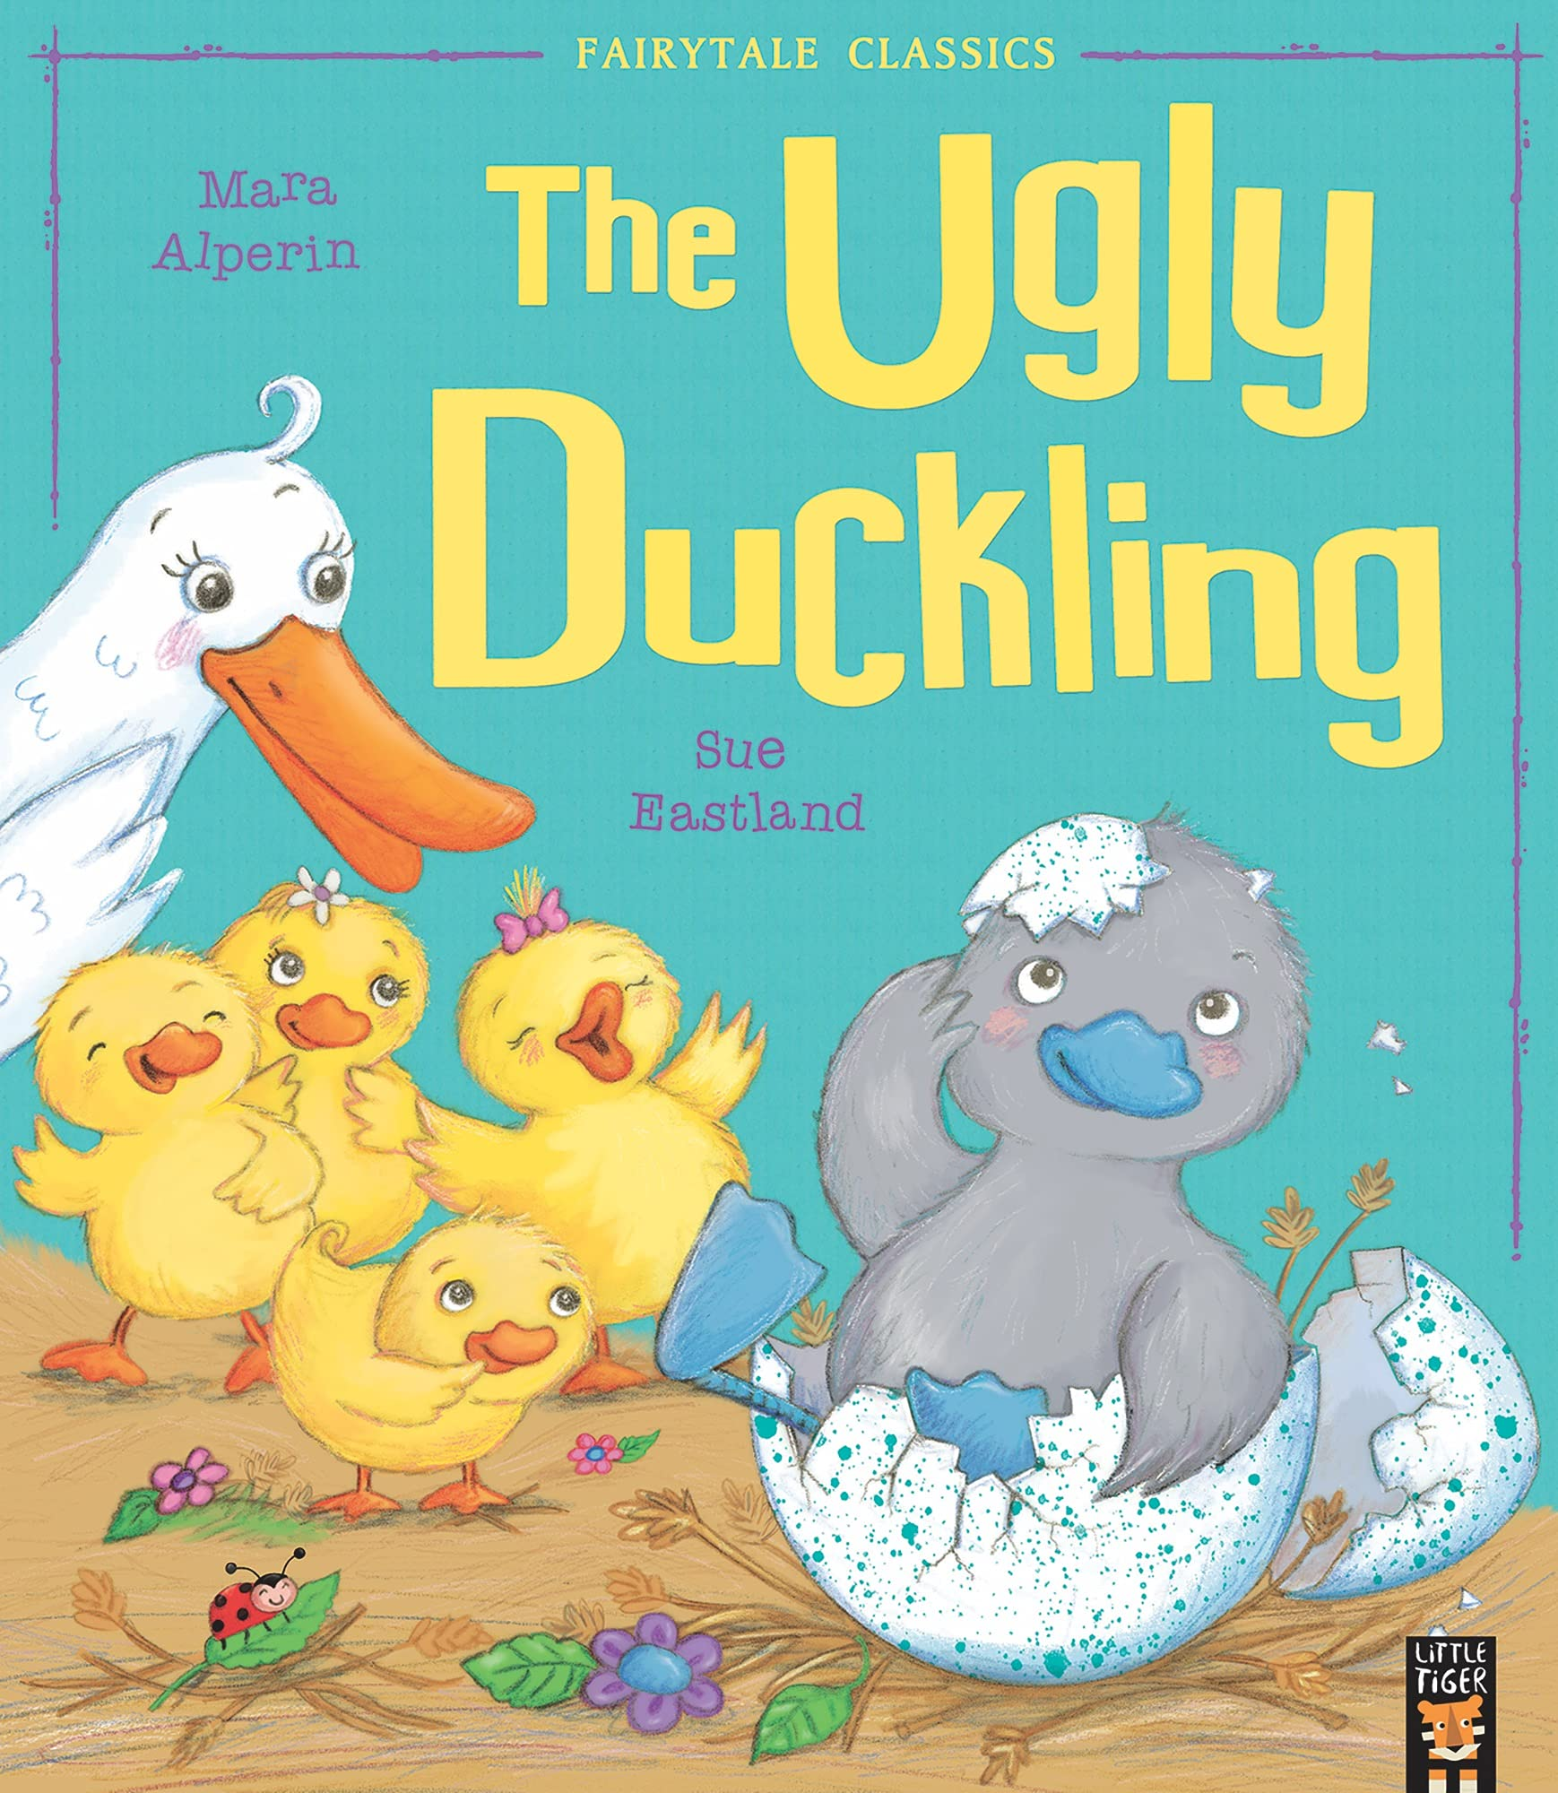
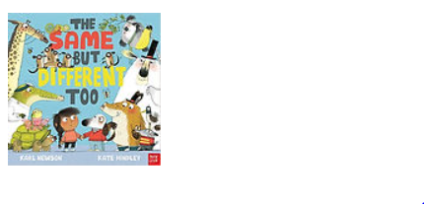




Ready Respectful Safe
Year R
When told to do so by an adult, I can apologise when I’ve done something wrong.
I say please and thank you although sometimes this will need reminding.
I realise that kind words/ actions have an effect on others.
I am able to share and take turns.
I tidy up taking collective responsibility.
Progress check:
How did Jack show kindness when Jill fell over?
What would you do if someone in Rainbows fell over in the playground?
Year 1
I apologise when prompted and sometimes without being told to.
I say please and thank you.
I listen to my learning partners.
I open doors for any adult (without expecting a VIP).
I walk on the left.
I have a growing empathy and awareness of others.
I am keen to volunteer for classroom roles.
I can share, recognising when someone needs something that I am using.
Progress check:
How do unkind words hurt?
What does it mean to feel different?
Should the other ducklings apologise to the cygnet?

Slide 3
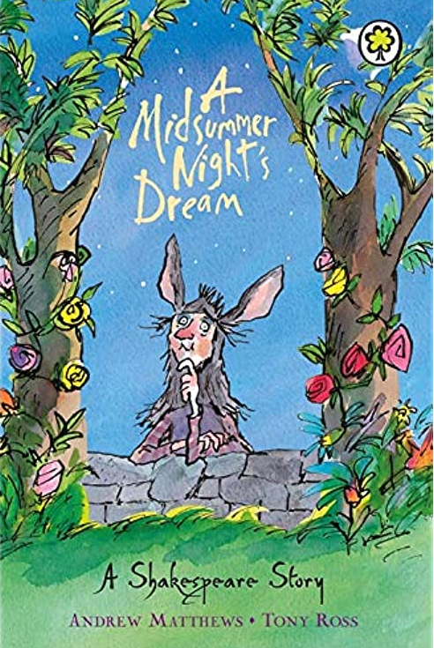

Ready Respectful Safe
Year 2
I apologise automatically when I know that I have made a mistake.
I show an intrinsic kindness at home re. property/ words
I model kindness to others and know why I should be kind.
I show kindness to younger children by playing considerately in the playground.
I am mindful of how I treat others.
I volunteer my help when I see that it is needed.
I can share, pre-empting when someone will be in need.
Progress check:
Friendships can often be tricky! There are often times in friendships when you disagree with a friend.
“The course of true love never did run smooth.”
How can you solve a situation so that both you and your friend are happy when there’s something you don’t agree about?
Year 3
I can consider kindness before I speak.
I don’t criticise the efforts of others.
I support and am tolerant of my classmates by recognising their visible/ invisible needs.
I have ownership of friendship issues and am starting to resolve friendship problems without an adult.
I am able to compliment someone else.
I am a good listener.
I convey my support to someone I believe in
I set an example to younger pupils.
I can share – even when I want it, recognising when someone else’s needs are greater than mine.
Year 4
Progress check:
What does it mean to be loyal?
Have you ever put someone else before yourself?
How did Bertie put the needs of the lion before his own?
How did Millie put Bertie’s needs before her own?

Slide 4

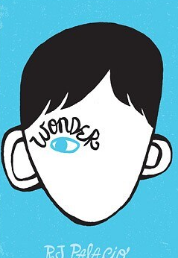

Ready Respectful Safe
Year 5
I understand that kindness includes ‘virtual’ situations using social media.
I am a responsible buddy and show kindness to younger children.
I reach out when it is less likely others will.
I am able to compliment someone else recognising it will make them feel good.
I am confident to initiate a conversation with grown-ups in school and ask how they are feeling when I greet them.
I can share by putting others before myself.
Progress check:
Imagine that the children in the story shared their exciting news of finding a ticket on social media. How would Charlie’s WhatsApp messages look different to those from the other children?
Progress check:
The important quote in Wonder is: “If you have a choice between being right and being kind, choose kind.“
Can you put Palacio’s words into your own words? What would this look like in your classroom?
I use social media responsibly and my activity online always reflects my kind character.
I always use non-derogatory language.
I have a good understanding of inclusion and my interaction with others reflects this.
I understand charitable acts and my role in the world/ in school.
I recognise that being kind to myself is important to my own mental health.
I can turn the other cheek and not retaliate.
I volunteer my time outside of school.
I choose not to be a bystander and will do the right thing when I need to.
I can make small sacrifices when someone else’s needs are greater than mine – even if this means I go without.
Year 6
Progress check:
Is someone born to be kind or unkind? What influences someone’s conscience?

