Slide 1



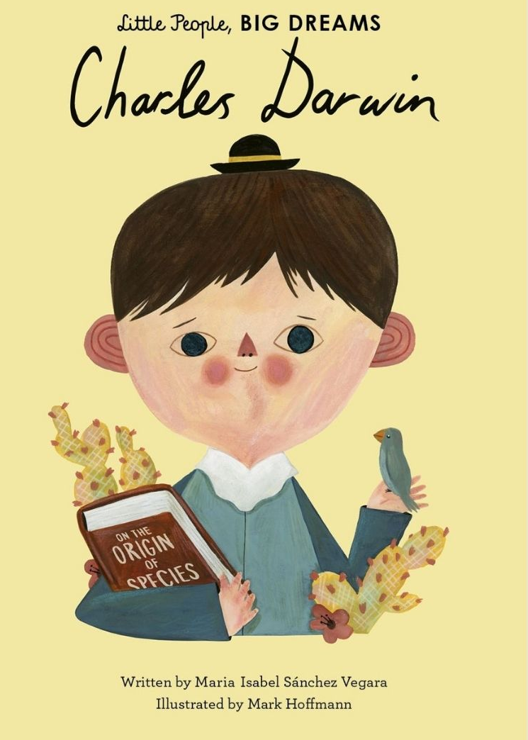
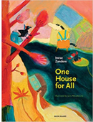
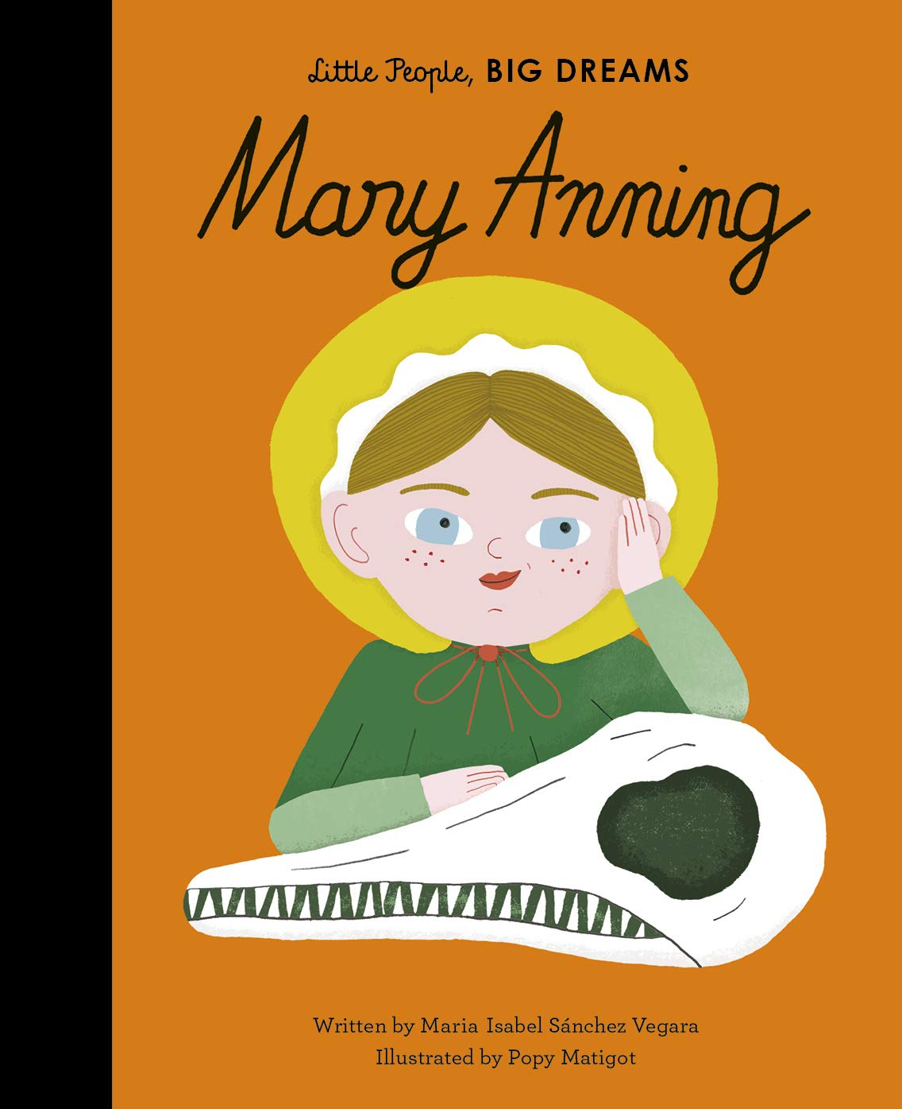

Ready Respectful Safe
Curiosity Progression Map
Curiosity is an inspiring journey to enrich imagination and find that there is no wrong way… just a different way.
What makes children want to learn? We believe it's the joy of exploration - a hidden force that drives learning, critical thinking, and reasoning. We call this ability curiosity, and we recognise it in children when we see them exploring their environment, devouring books and information, asking questions, investigating concepts, manipulating data, searching for meaning, connecting with people and nature, and seeking new learning experiences.
Whole School Assembly Books
We use KS1 and KS2 assemblies to highlight the value. At the end of the assembly, children reflect on how the lesson in the story is relevant to them.
These are all of the books across the whole school that we use to teach the underpinning value of curiosity. We have chosen these books specifically because they illustrate the value within a context that the children understand and can relate to. We also use these books as a vehicle to deliver the content of the National Curriculum.

Slide 2
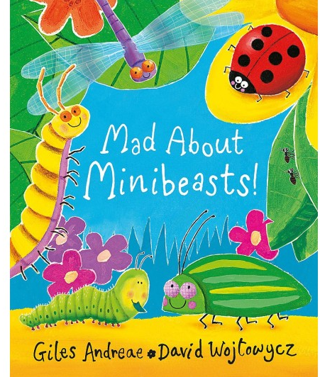
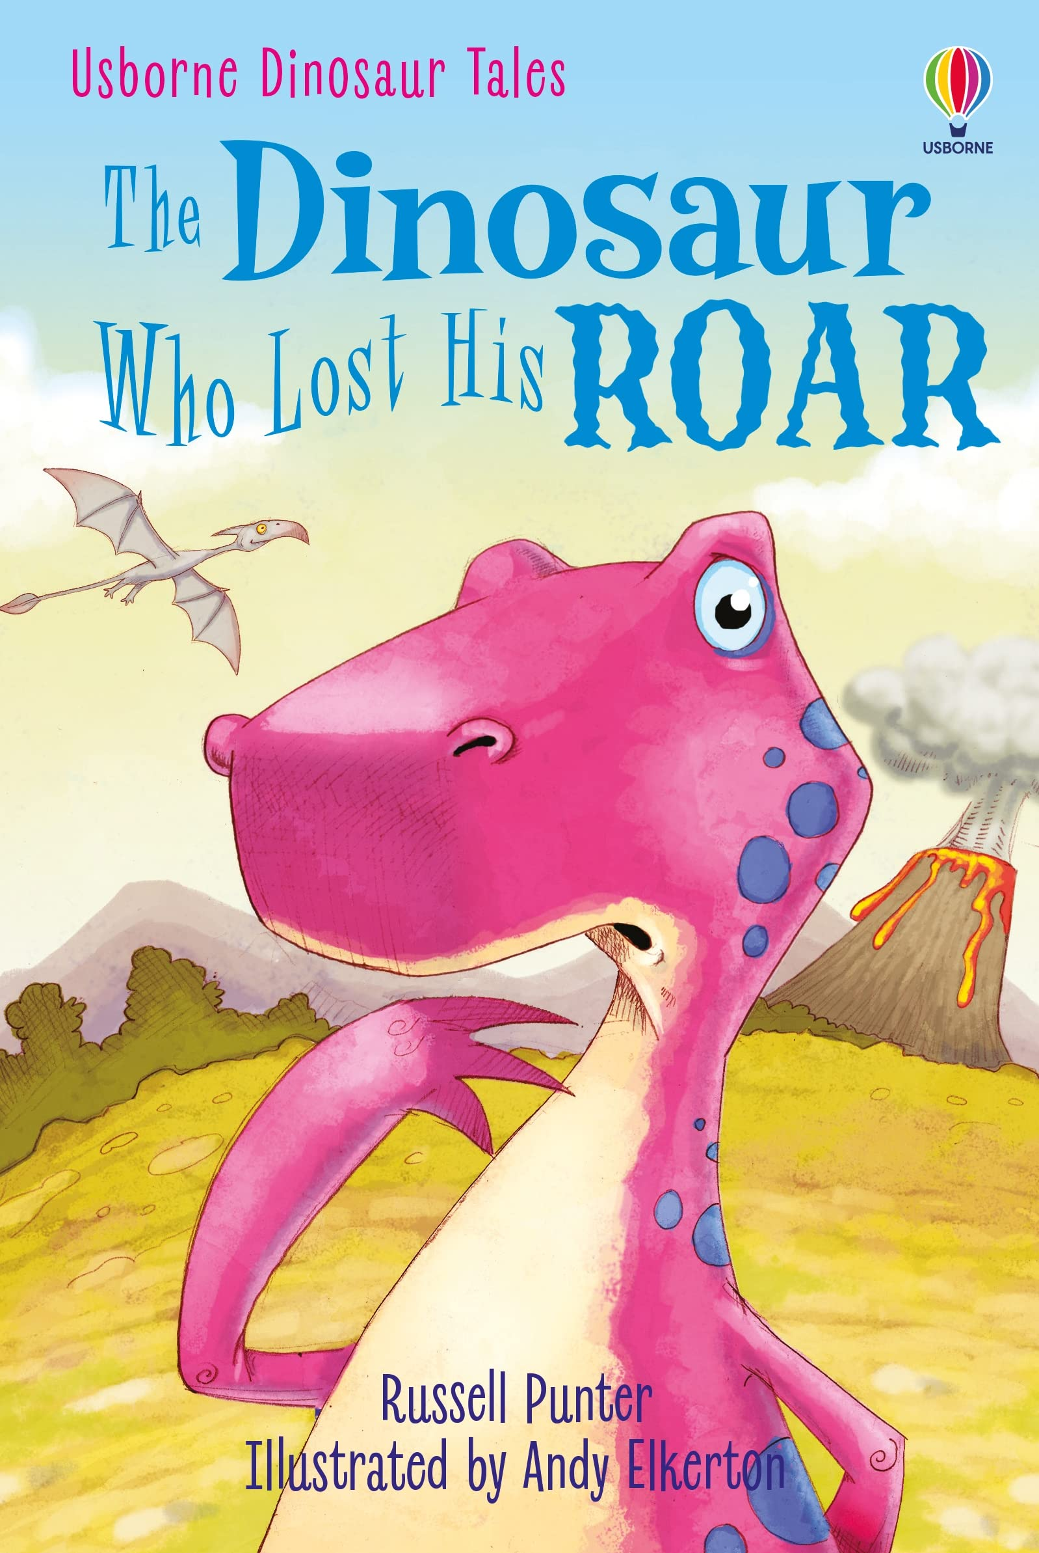
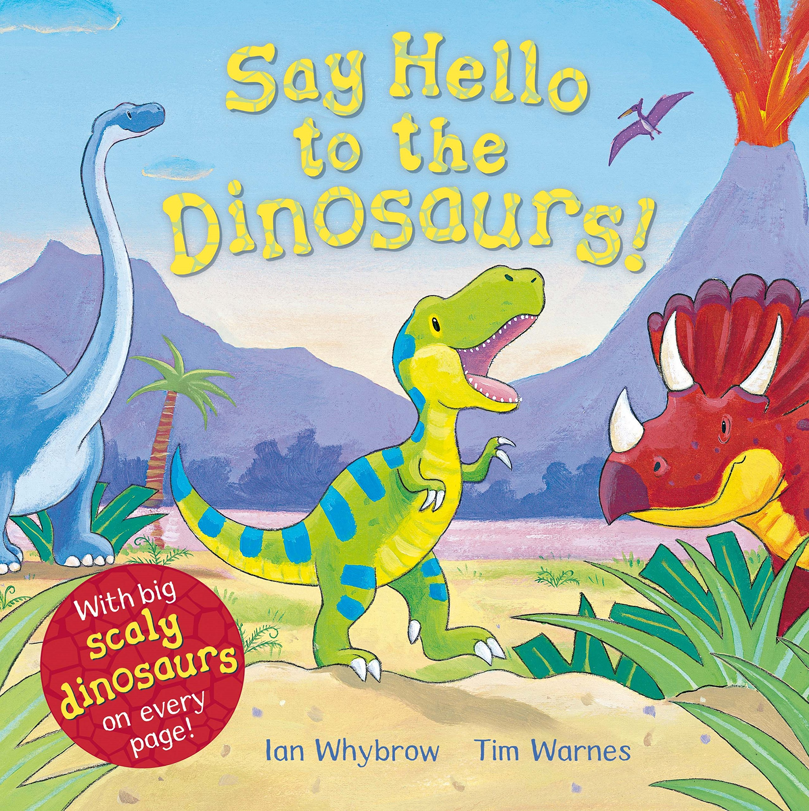
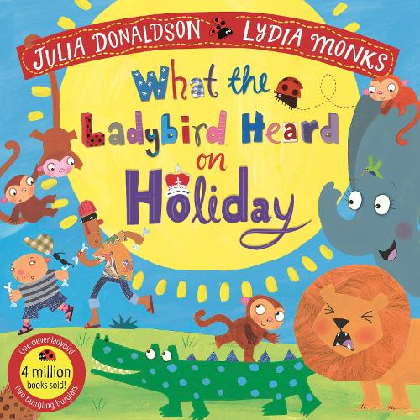
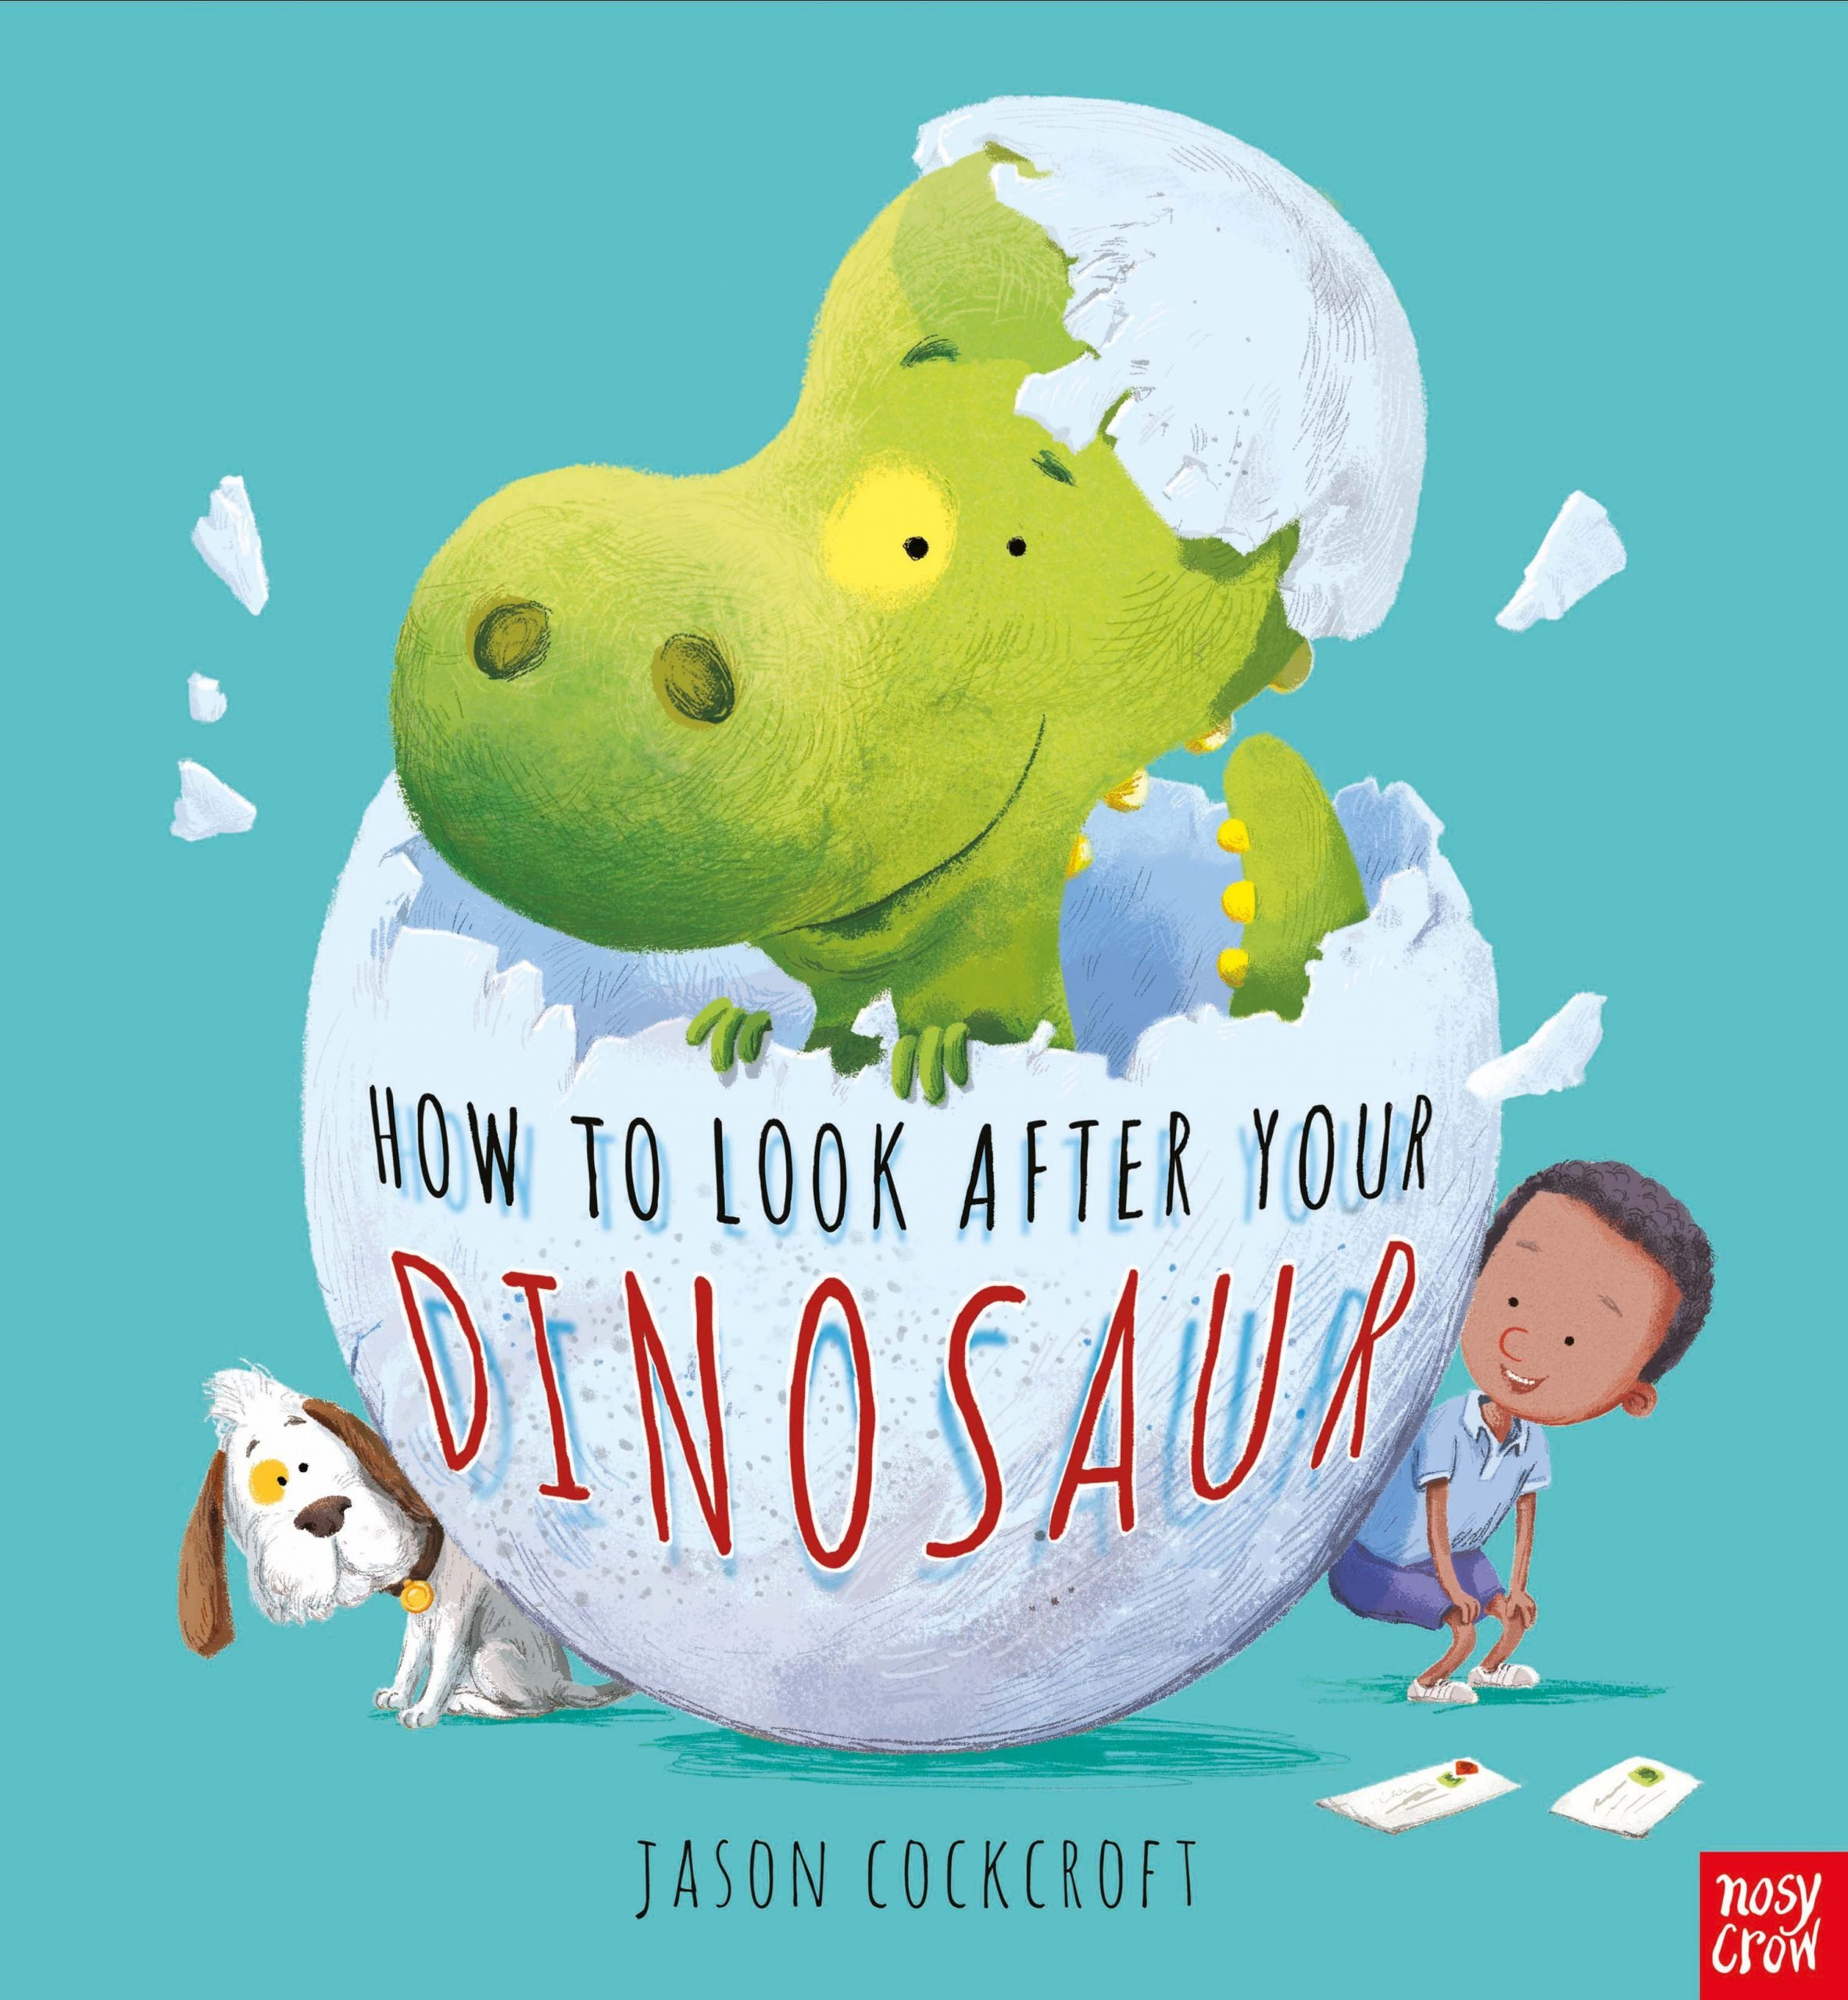
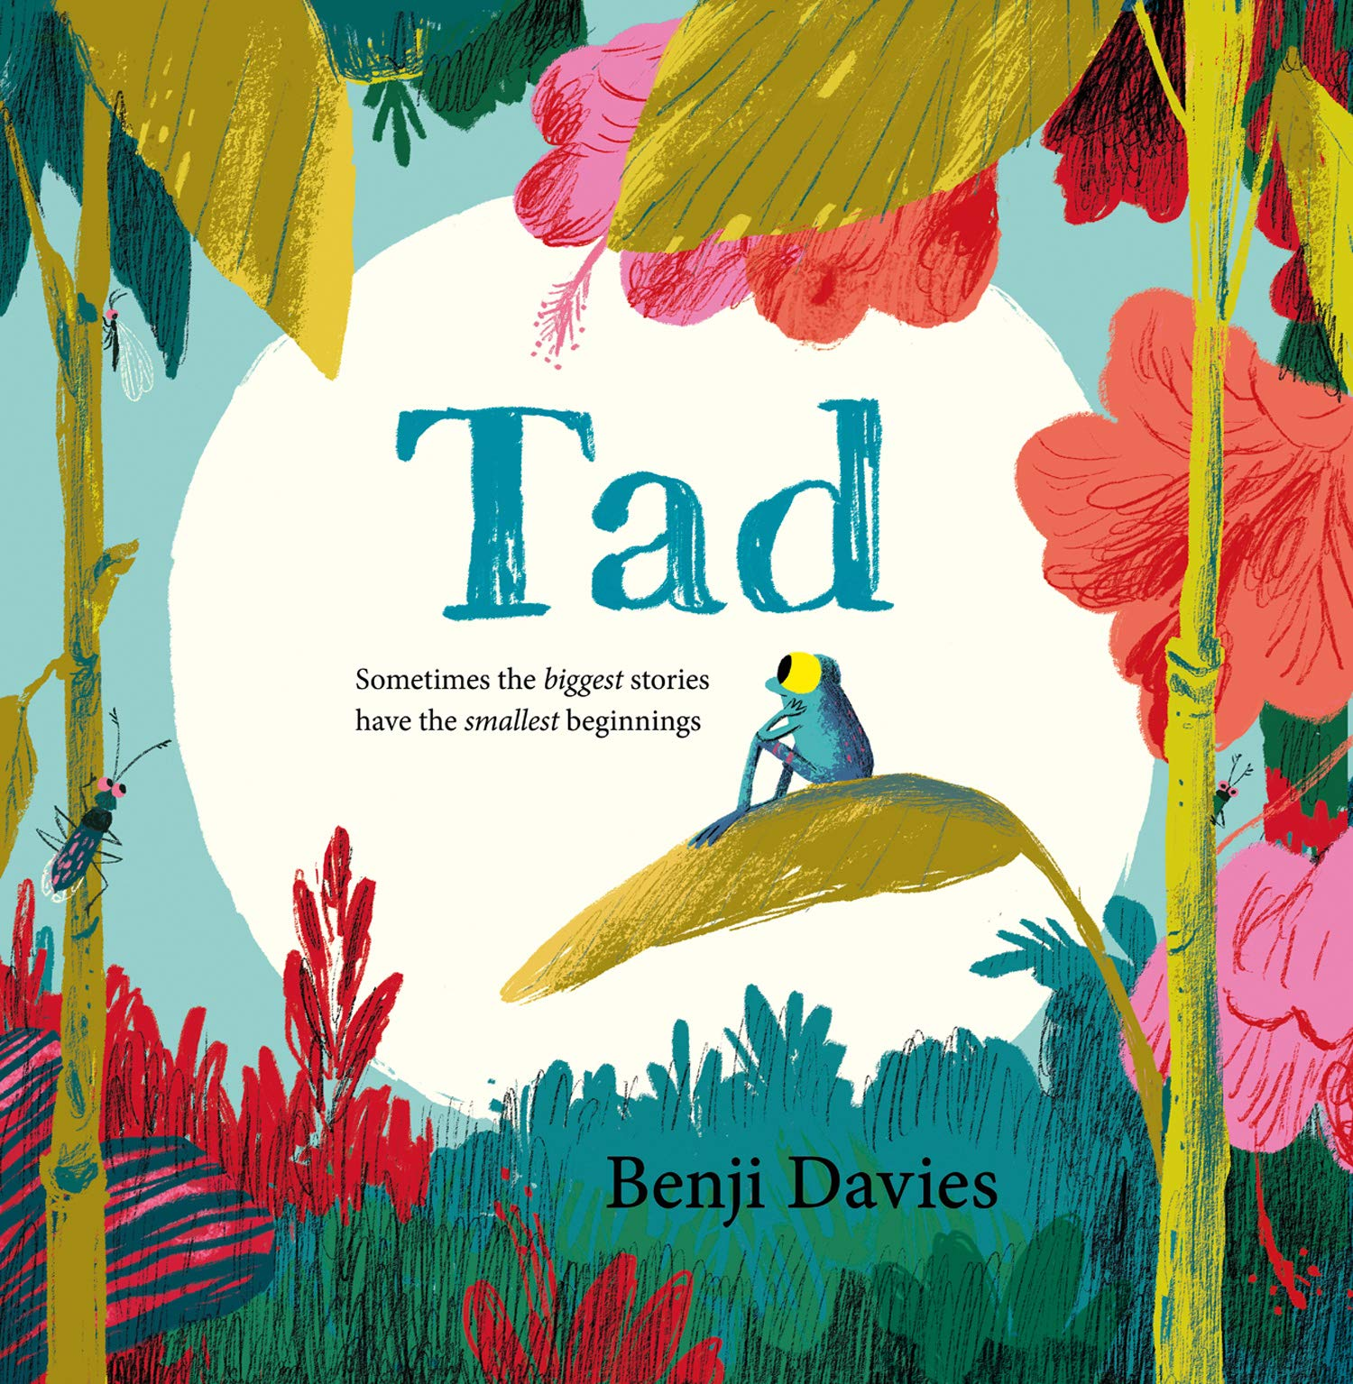
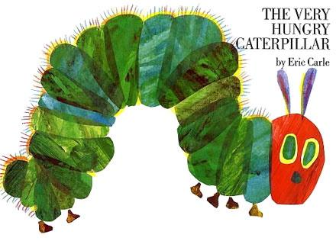
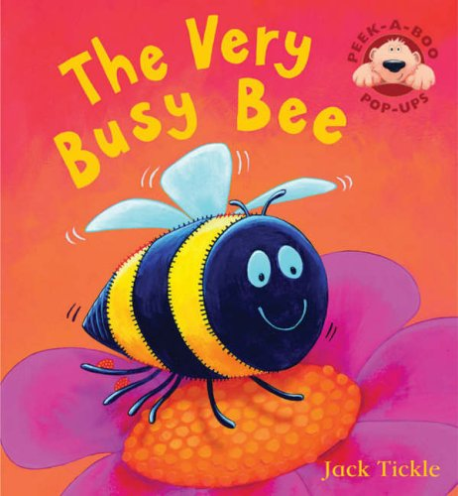
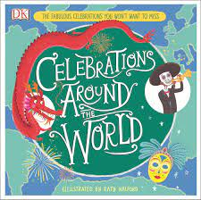
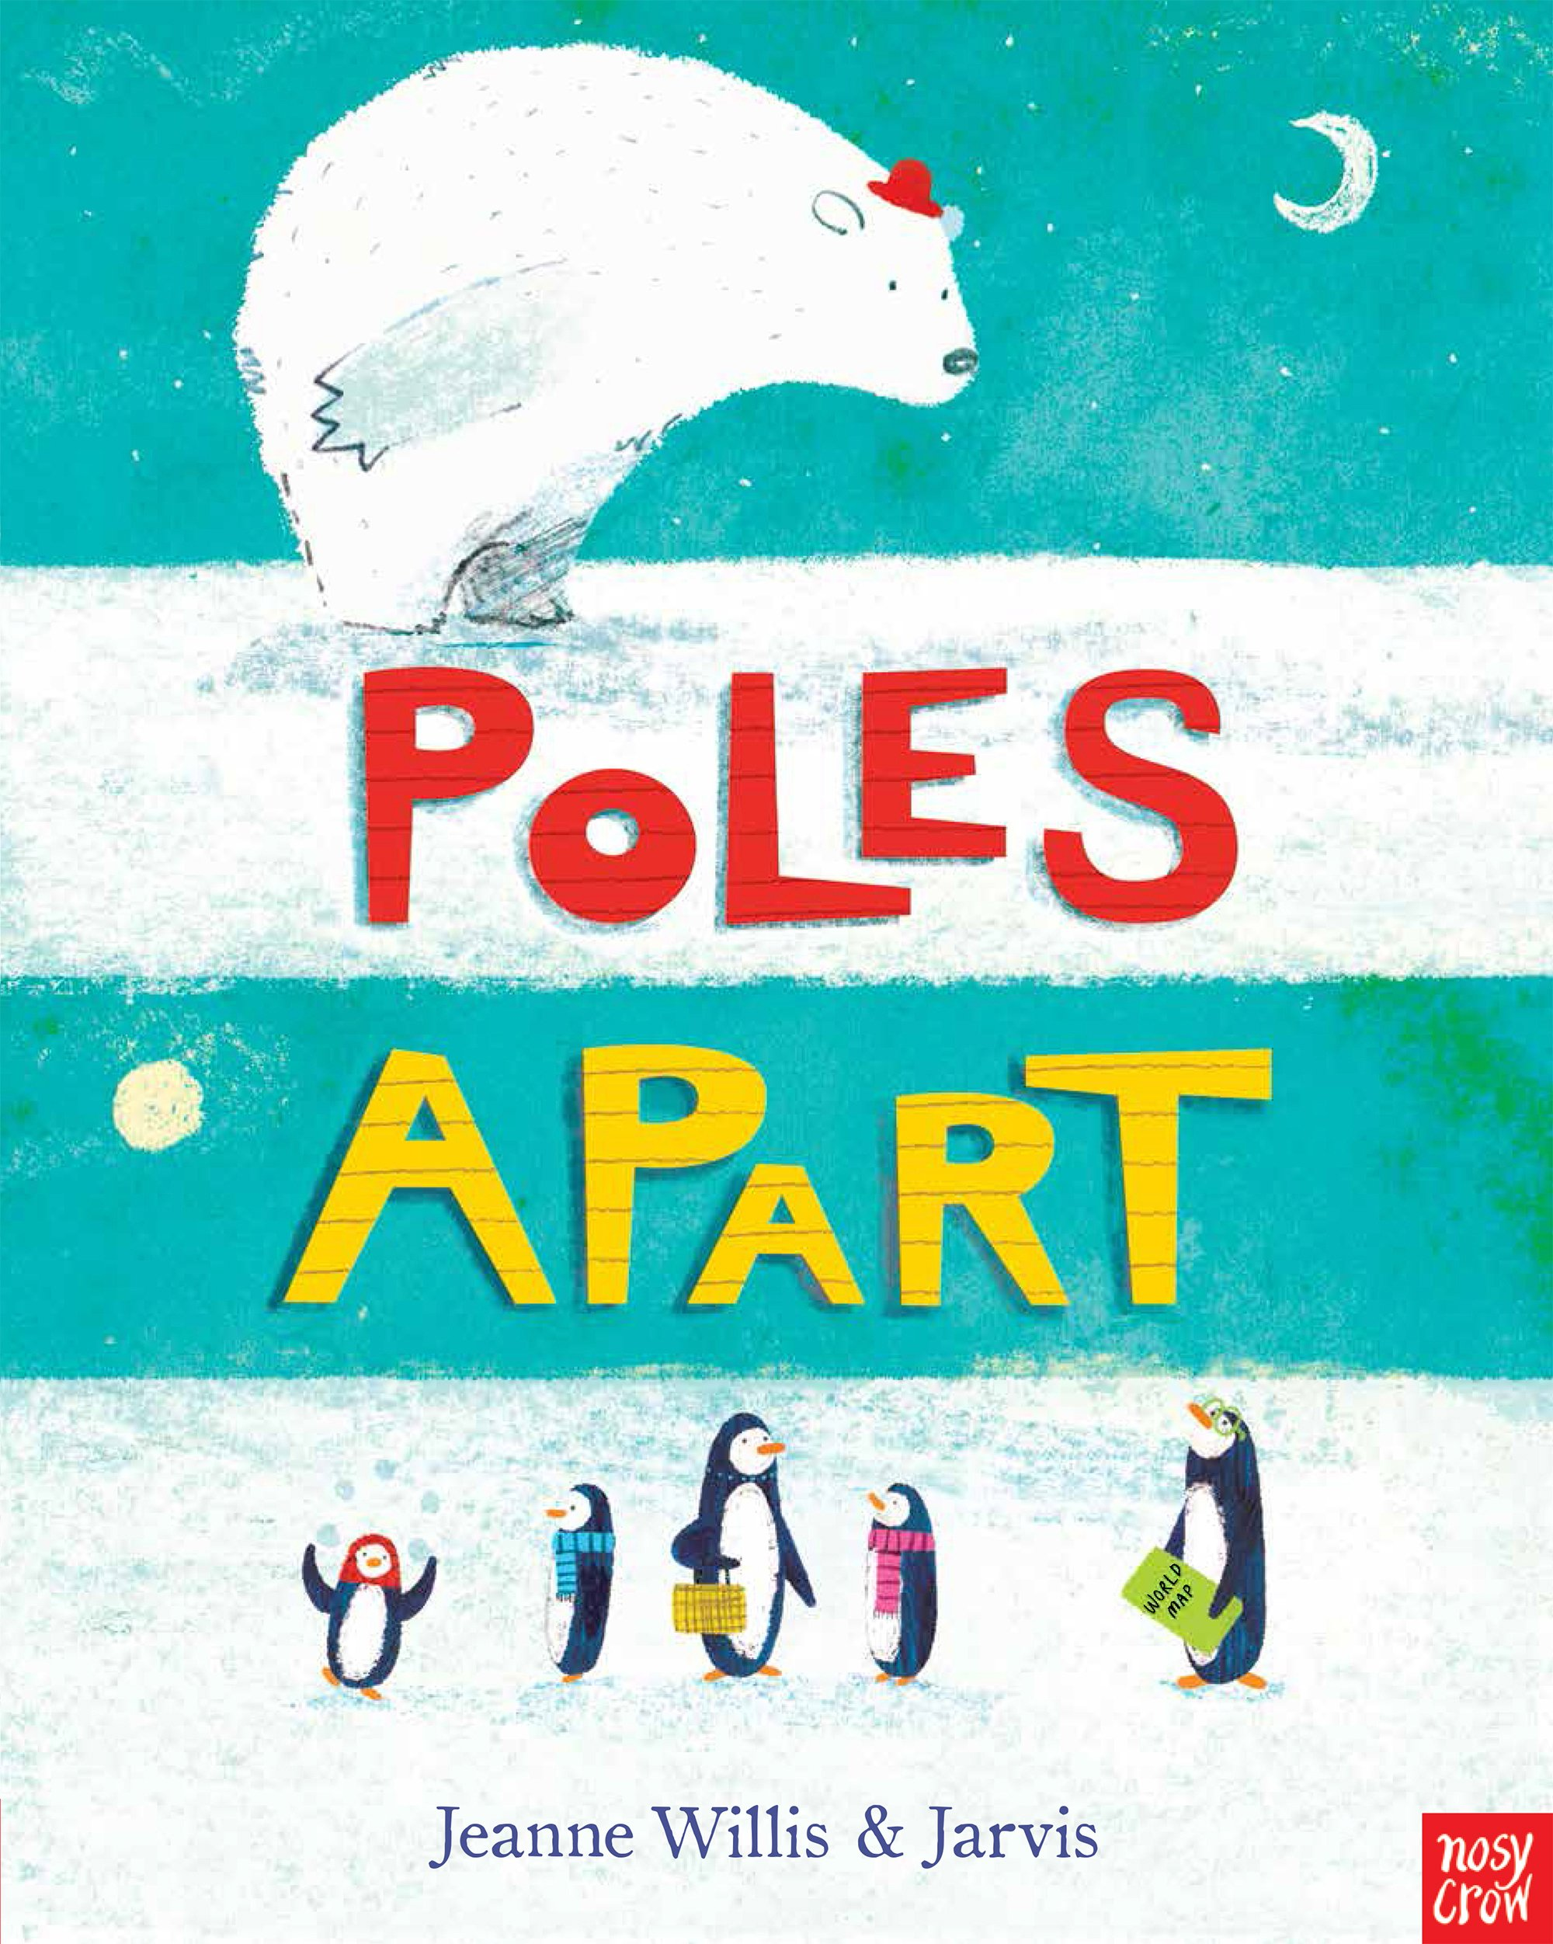
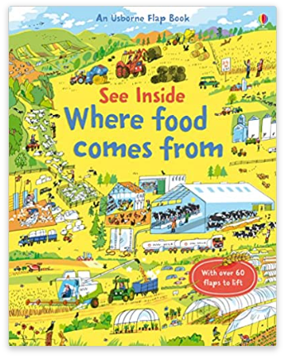
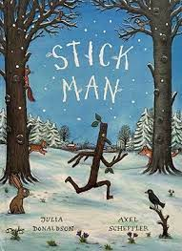
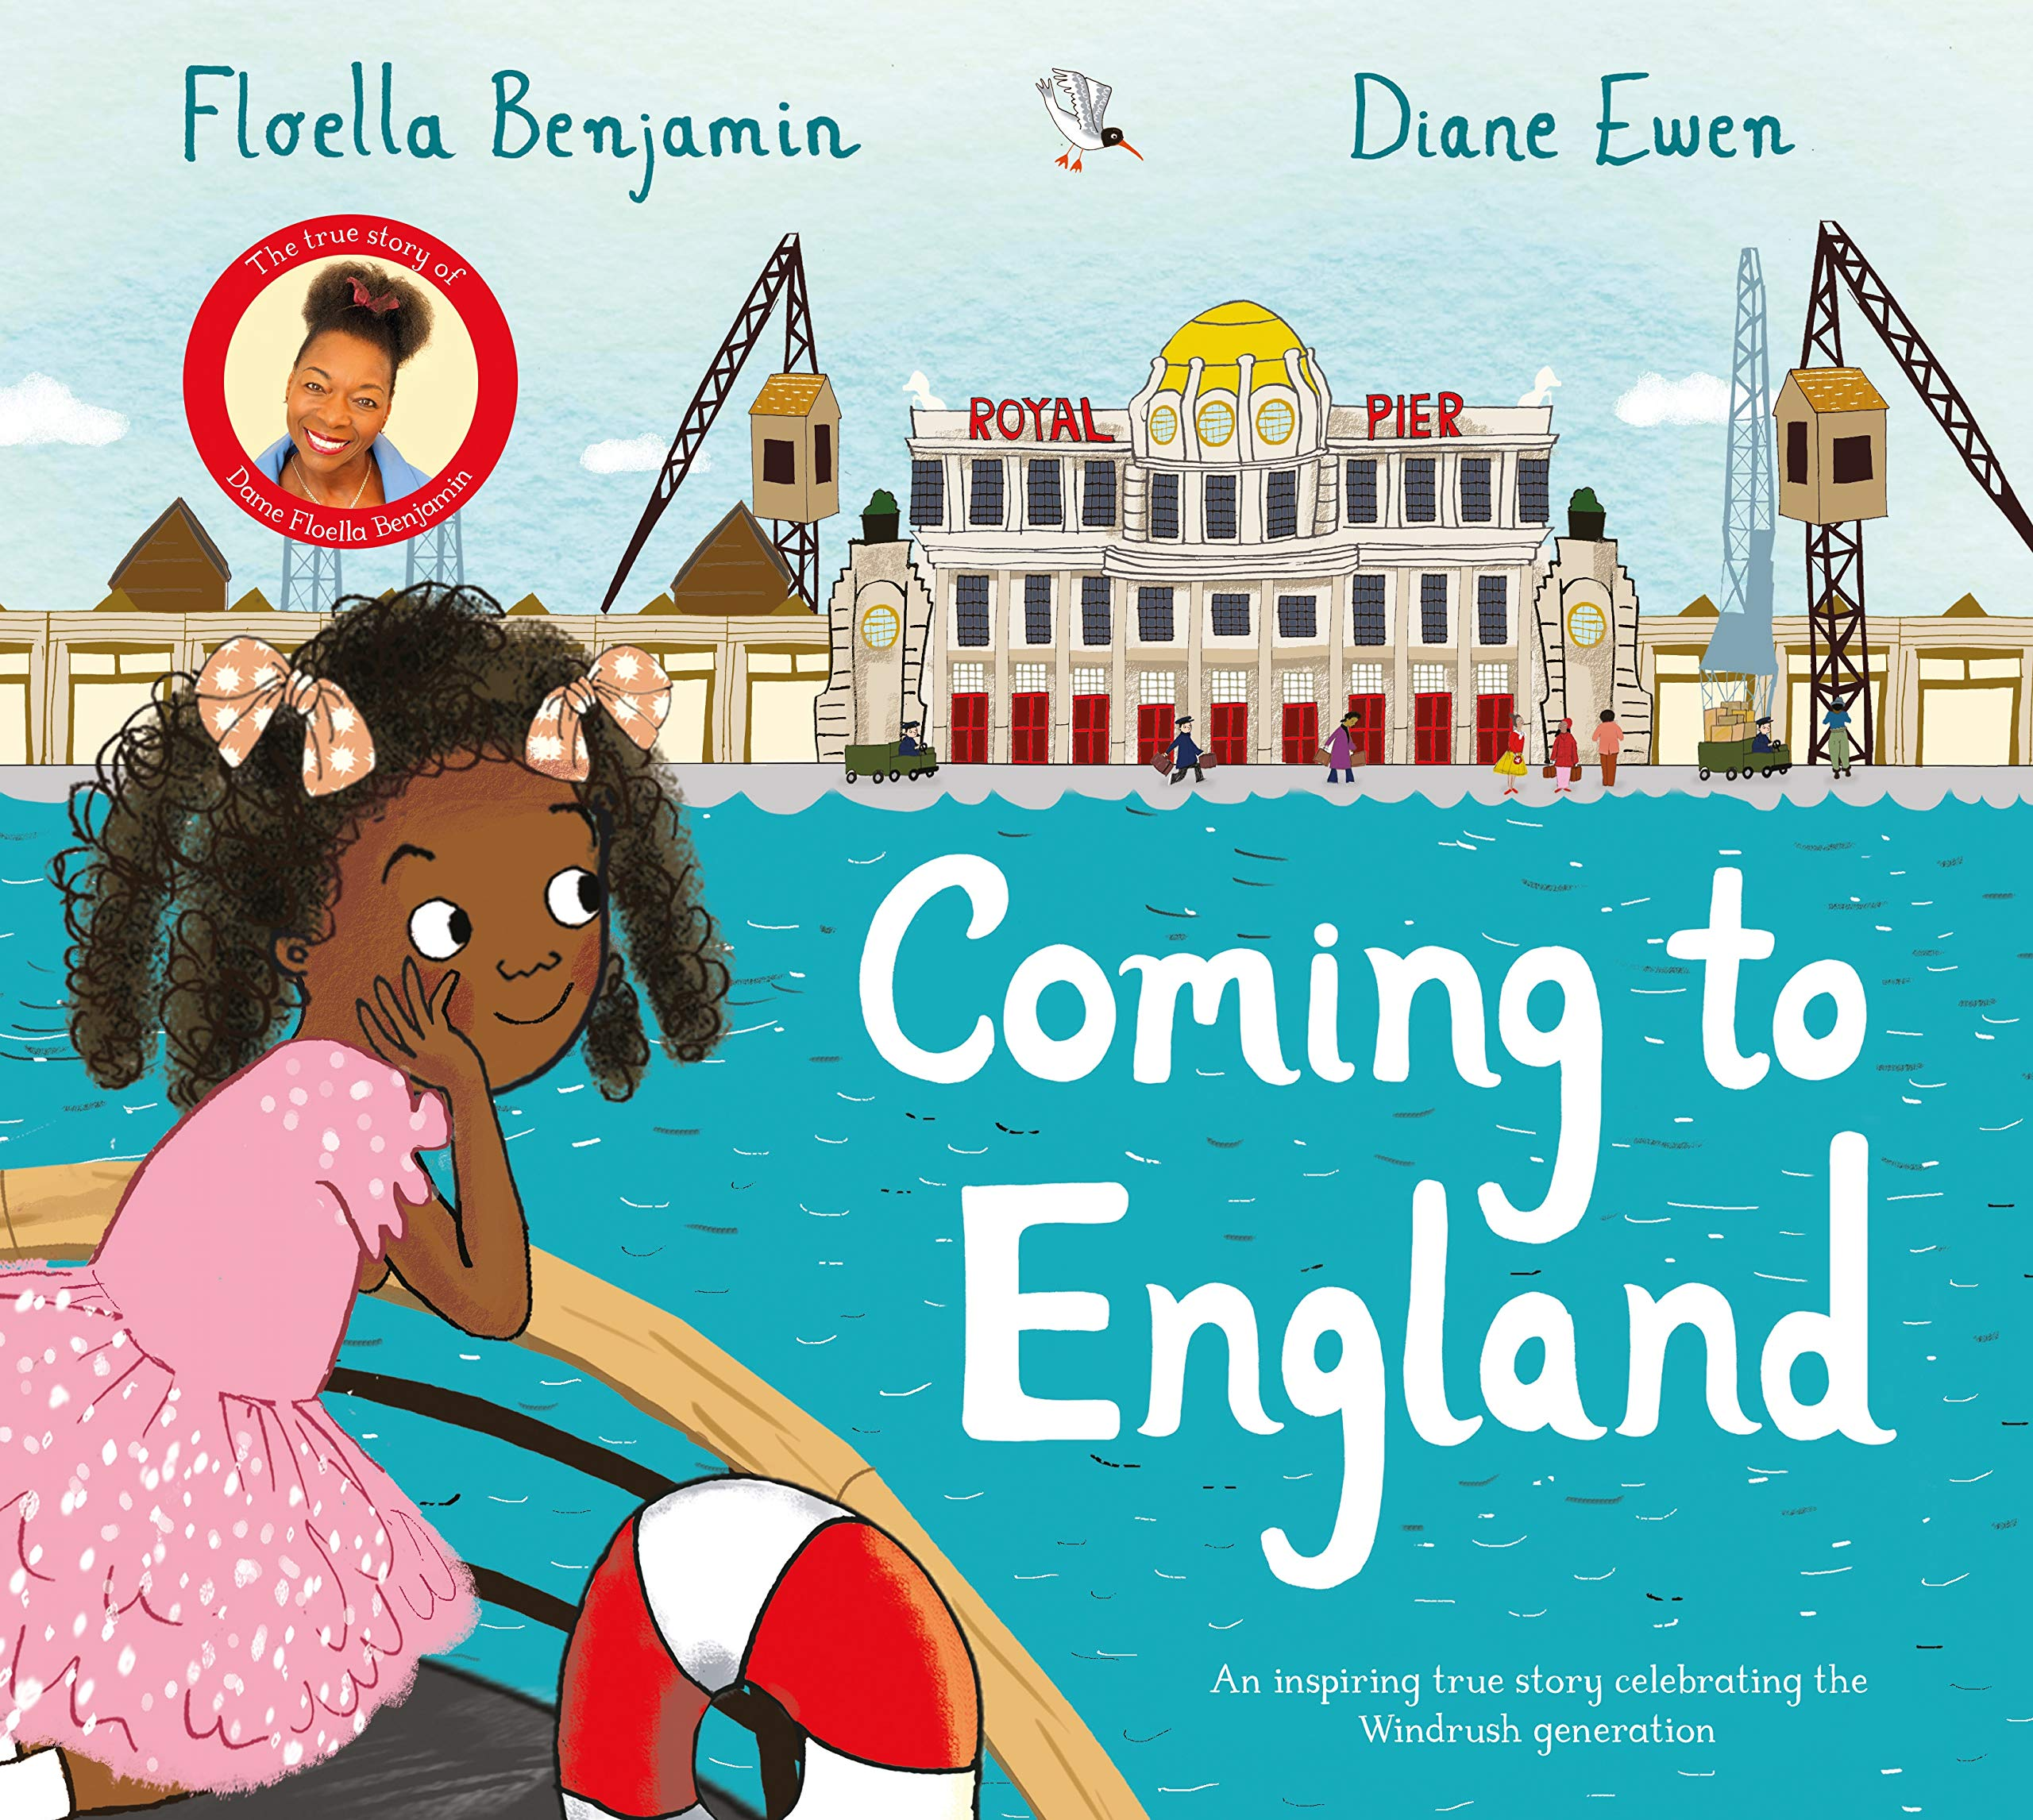
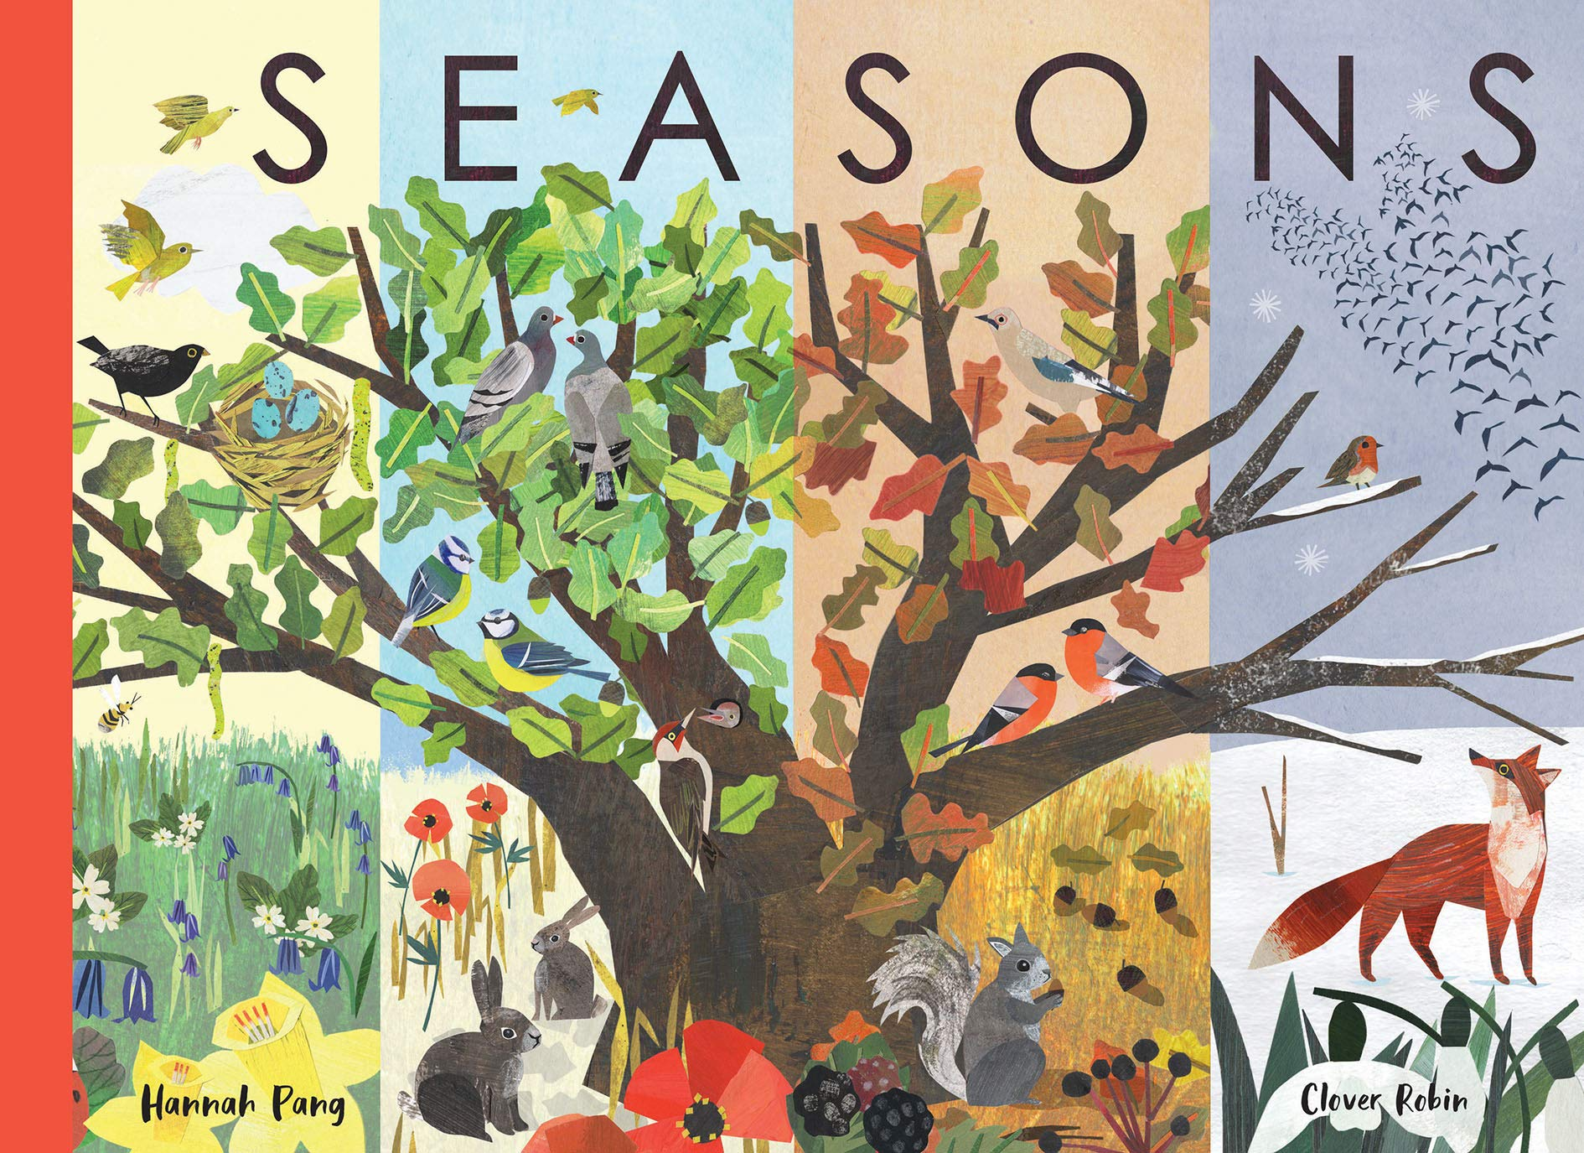
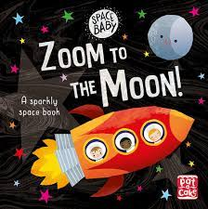
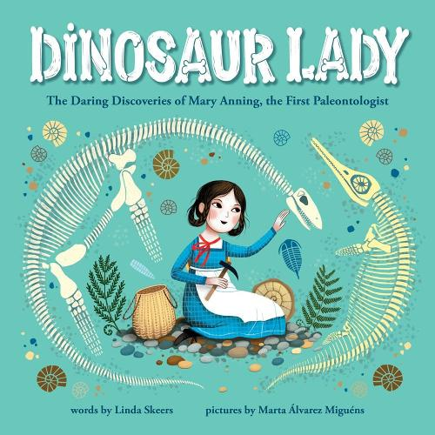
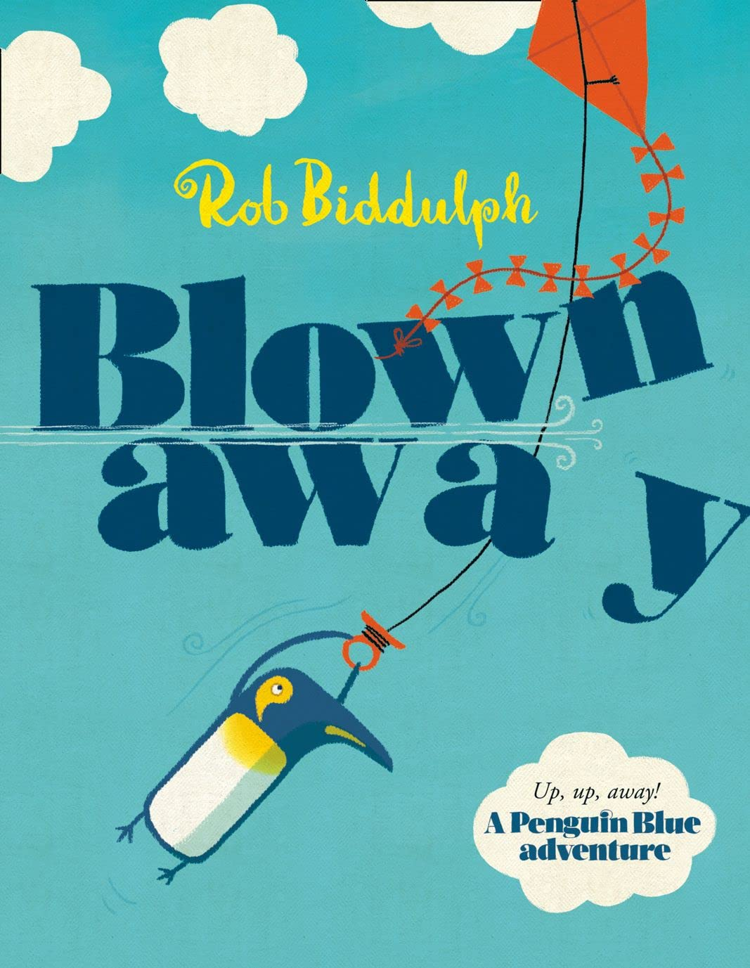




Ready Respectful Safe
Year R
I can ask a knowledge based question using:
What? When? Where? Why? Who? How? Do?
I ask questions about what I see in the environment around me.
I can begin to answer my own questions.
I can change my mind when new information is revealed.
I can use a variety of resources in an imaginative way.
My interest is often maintained for several days.
I interact with others in role play.
I am involved in group planning and organisation.
Progress check:
I wonder why the mini-beasts in these books seem so busy… What do you think they are doing?
Year 1
I accept that mistakes develop my curiosity.
I look for clues and answers in the books I read.
I pose questions about the world beyond my locality and about things that I can’t ‘see’.
I discuss my answers first; this enables me to contribute more. I am comfortable to say ‘we thought’ rather than ‘I think’.
I can use talk partners to deepen critical thinking and questioning.
Progress check:
I wonder in which seasons these books are set. What clues are there in the books?

Slide 3
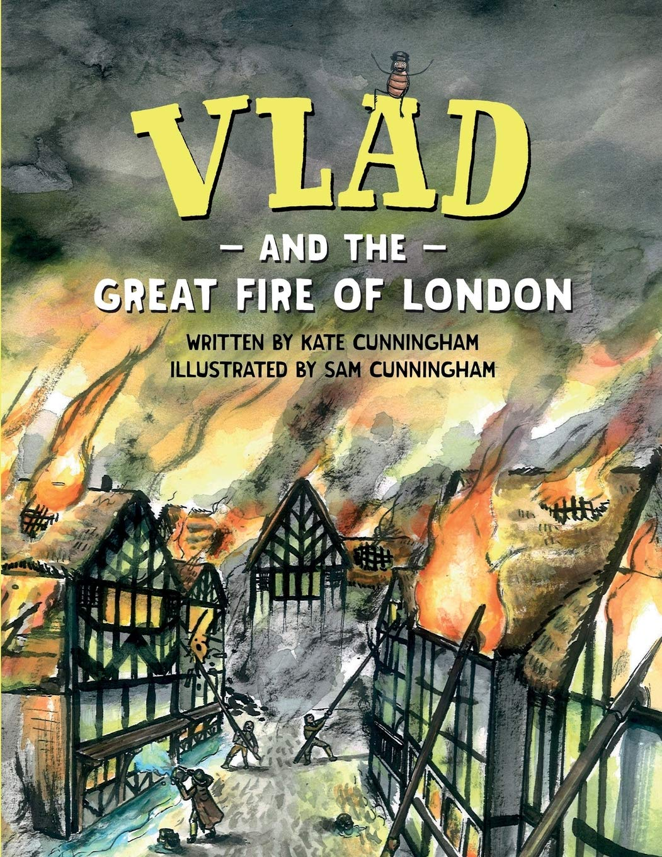
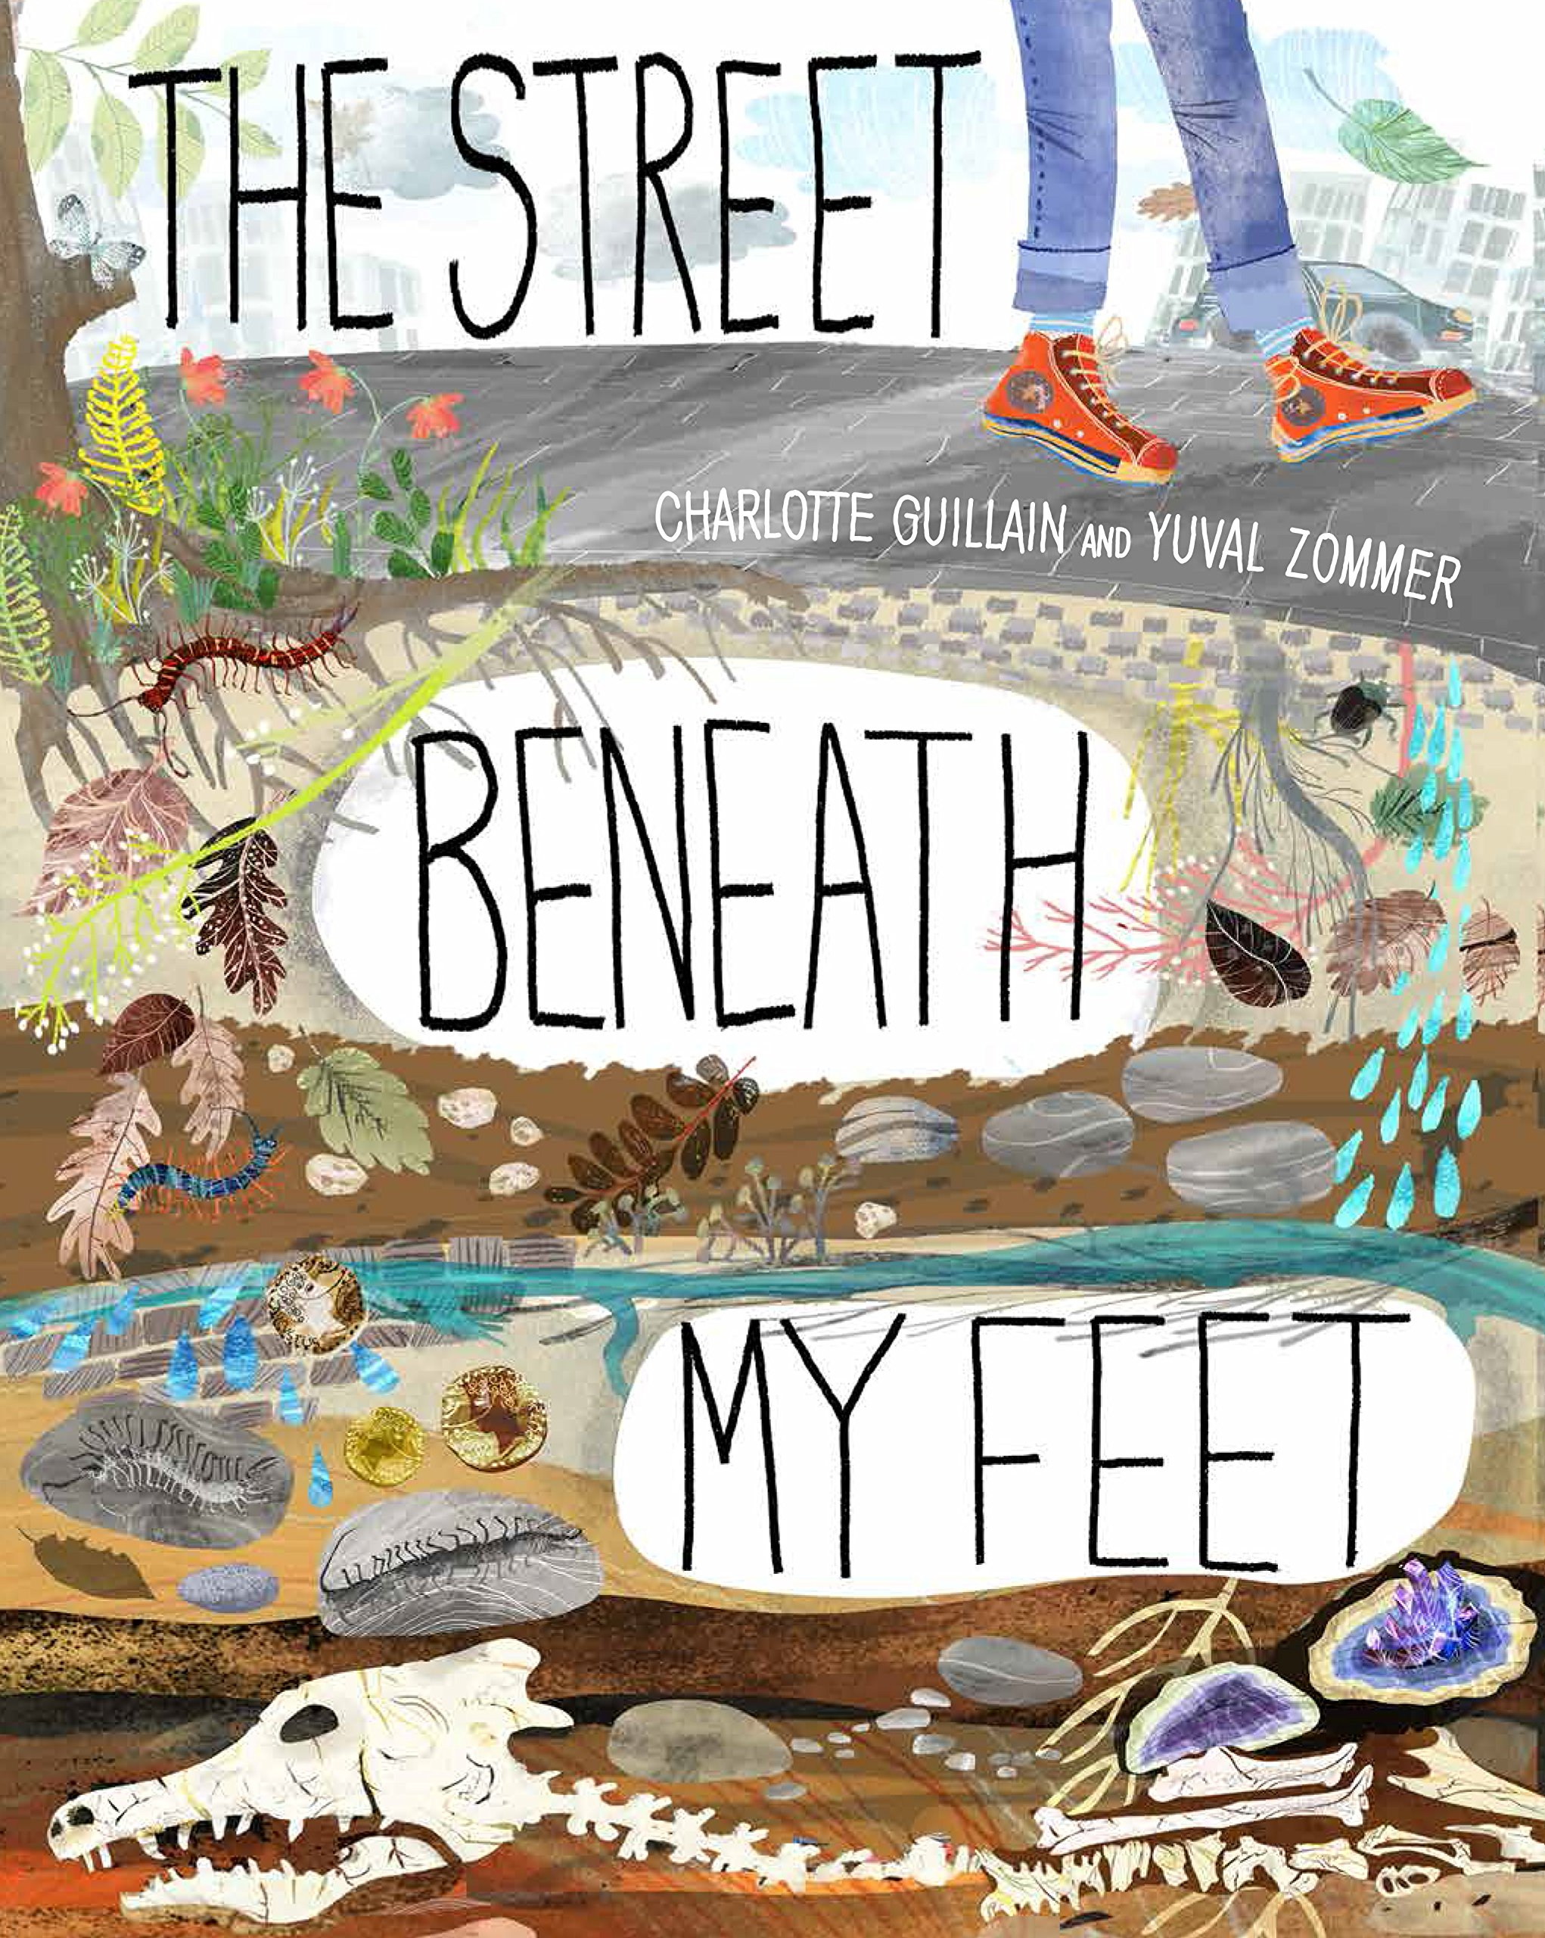
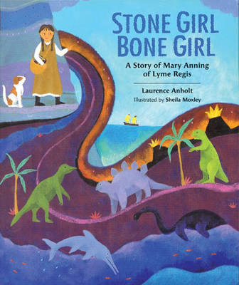

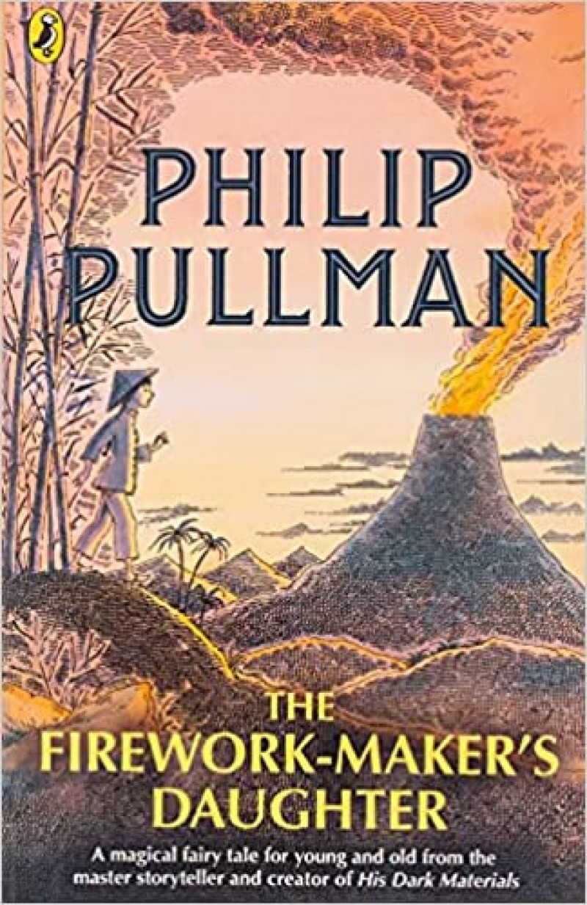
Ready Respectful Safe
Year 2
I can list what I would like to know about the topic or subject first to stimulate interest and assess how much I already know about it.
I can make links from previous understanding to the current situation.
I can ask both closed and open questions.
I show resilience – not stopping with first answer but acknowledging that sometimes a question has more than one answer.
Progress check:
What facts does Vlad discover about the Great Fire of London during his adventure?
Progress check:
How is The Street Beneath My Feet organised in a different way to most books? How does the author’s choice of this organisation help the reader to be curious?
Year 3
I can use provided sources of information to help me find out more.
I can recognise how useful/reliable or a source is.
I don’t always believe / accept first answers.
I am comfortable with silence while allowing a person to respond to a question.
I form my own questions based on my own interests.
I ask more open questions that begin with words like “What if...”
Year 4
Progress check:
Escape from Pompeii is a fiction text. How useful is this story in helping us to understand life in Ancient Rome?

Slide 4

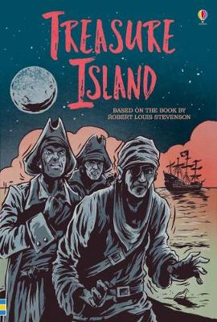
Ready Respectful Safe
Year 5
I can begin to use independent research to satisfy my own curiosity.
I can use the internet to create a key word search to find answers to my own questions.
I recognise when a source is unreliable, particularly when researching using the internet. I am curious but wary of internet sources.
I can begin to identify gaps and/or misconceptions in my own learning.
I am starting to critically support others by identifying misconceptions in other’s learning.
The more I know about something, the more I want to find out.
Progress check:
Which character in The Chronicles of Narnia shows the most curiosity?
When Lucy enters the wardrobe for the first time, she steps on snow. Prove that this is impossible.
Year 6
I use independent research to satisfy my own curiosity.
I can use a range of sources available to me and can independently decide which is most appropriate to support me.
I know when a source is unreliable. I recognise bias and prejudice based on different perspectives. I understanding the meaning of ‘fake news.’
I can use the internet to create a key word search to find answers to my own questions.
I can identify gaps and/or misconceptions in my own learning.
I question what I know – I prove with evidence
I orally work through my decision making process,
I can critically support others by identifying misconceptions in other’s learning.
My curiosity is sparked by appreciating that there’s always more to find out.
Progress check:
Jim Hawkins was driven by his curiosity. But if Treasure Island were written and set in modern times, how might Jim’s curiosity be different? Would his adventure have been the same? If he used the internet to search key words, would he have gone on this adventure?
Was Jim’s relationship with Long John Silver healthy or unhealthy?

