Slide 1





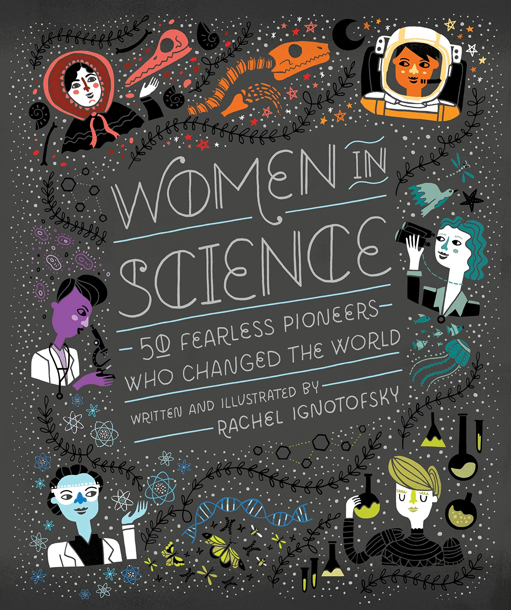
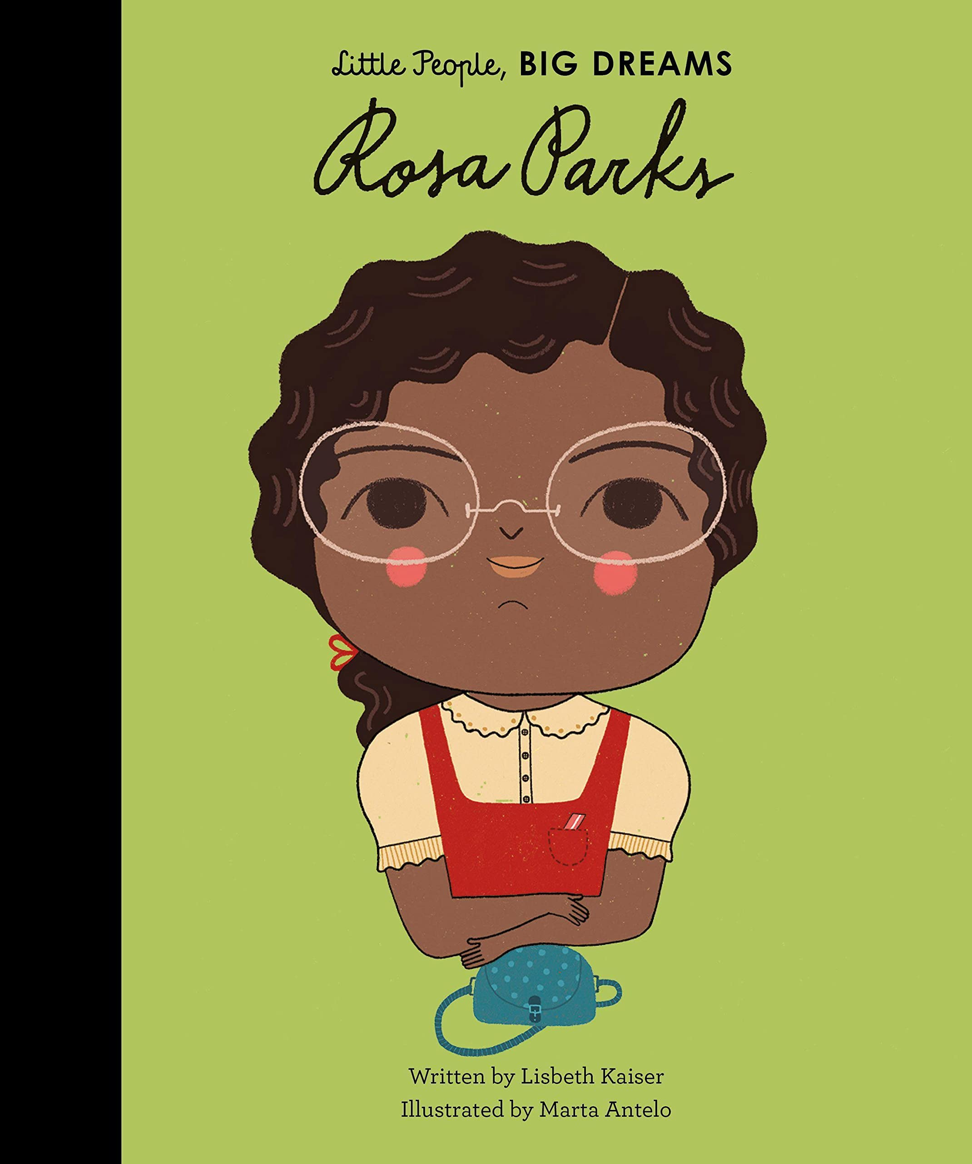
Ready Respectful Safe
Aspiration
The idea of aspiration has a positive, upward connotation. Our aspirations create powerful emotions and are deeply embedded within us; they are aligned with our values, and the very core of who we are. It is important that we all aspire to be or to become something that is seen as better than what or where we currently are (the best version of ourself). We can have social aspirations, career aspirations, and personal aspirations.
These days, children spend more time online and it’s easy for children to confuse short-lived celebrity status with achievement; sometimes children can be influenced by social media trends, confusing the number of ‘likes’ someone gains with success. At Muscliff, we want children to have a thorough understanding of aspirations and goals so that they can aspire to be the best version of themselves rather than a pale imitation of someone else.
Whole School Assembly Books
We use KS1 and KS2 assemblies to highlight the value. At the end of the assembly, children reflect on how the lesson in the story is relevant to them.
These are all of the books across the whole school that we use to teach the underpinning value of aspiration. We have chosen these books specifically because they illustrate the value within a context that the children understand and can relate to. We also use these books as a vehicle to deliver the content of the National Curriculum.

Slide 2

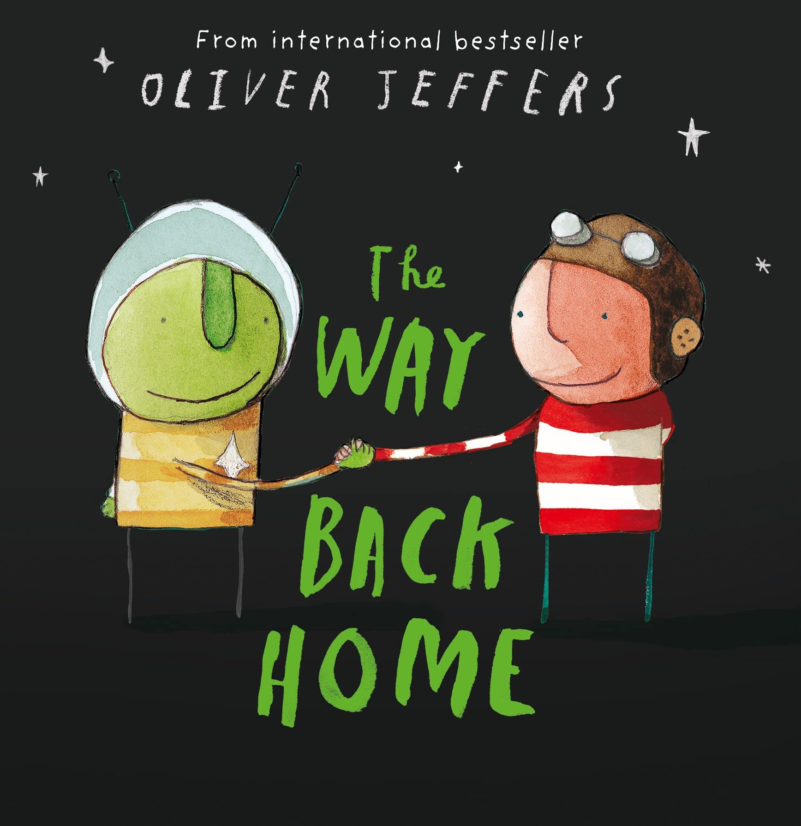


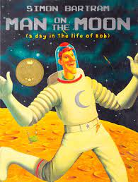
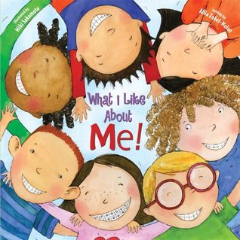

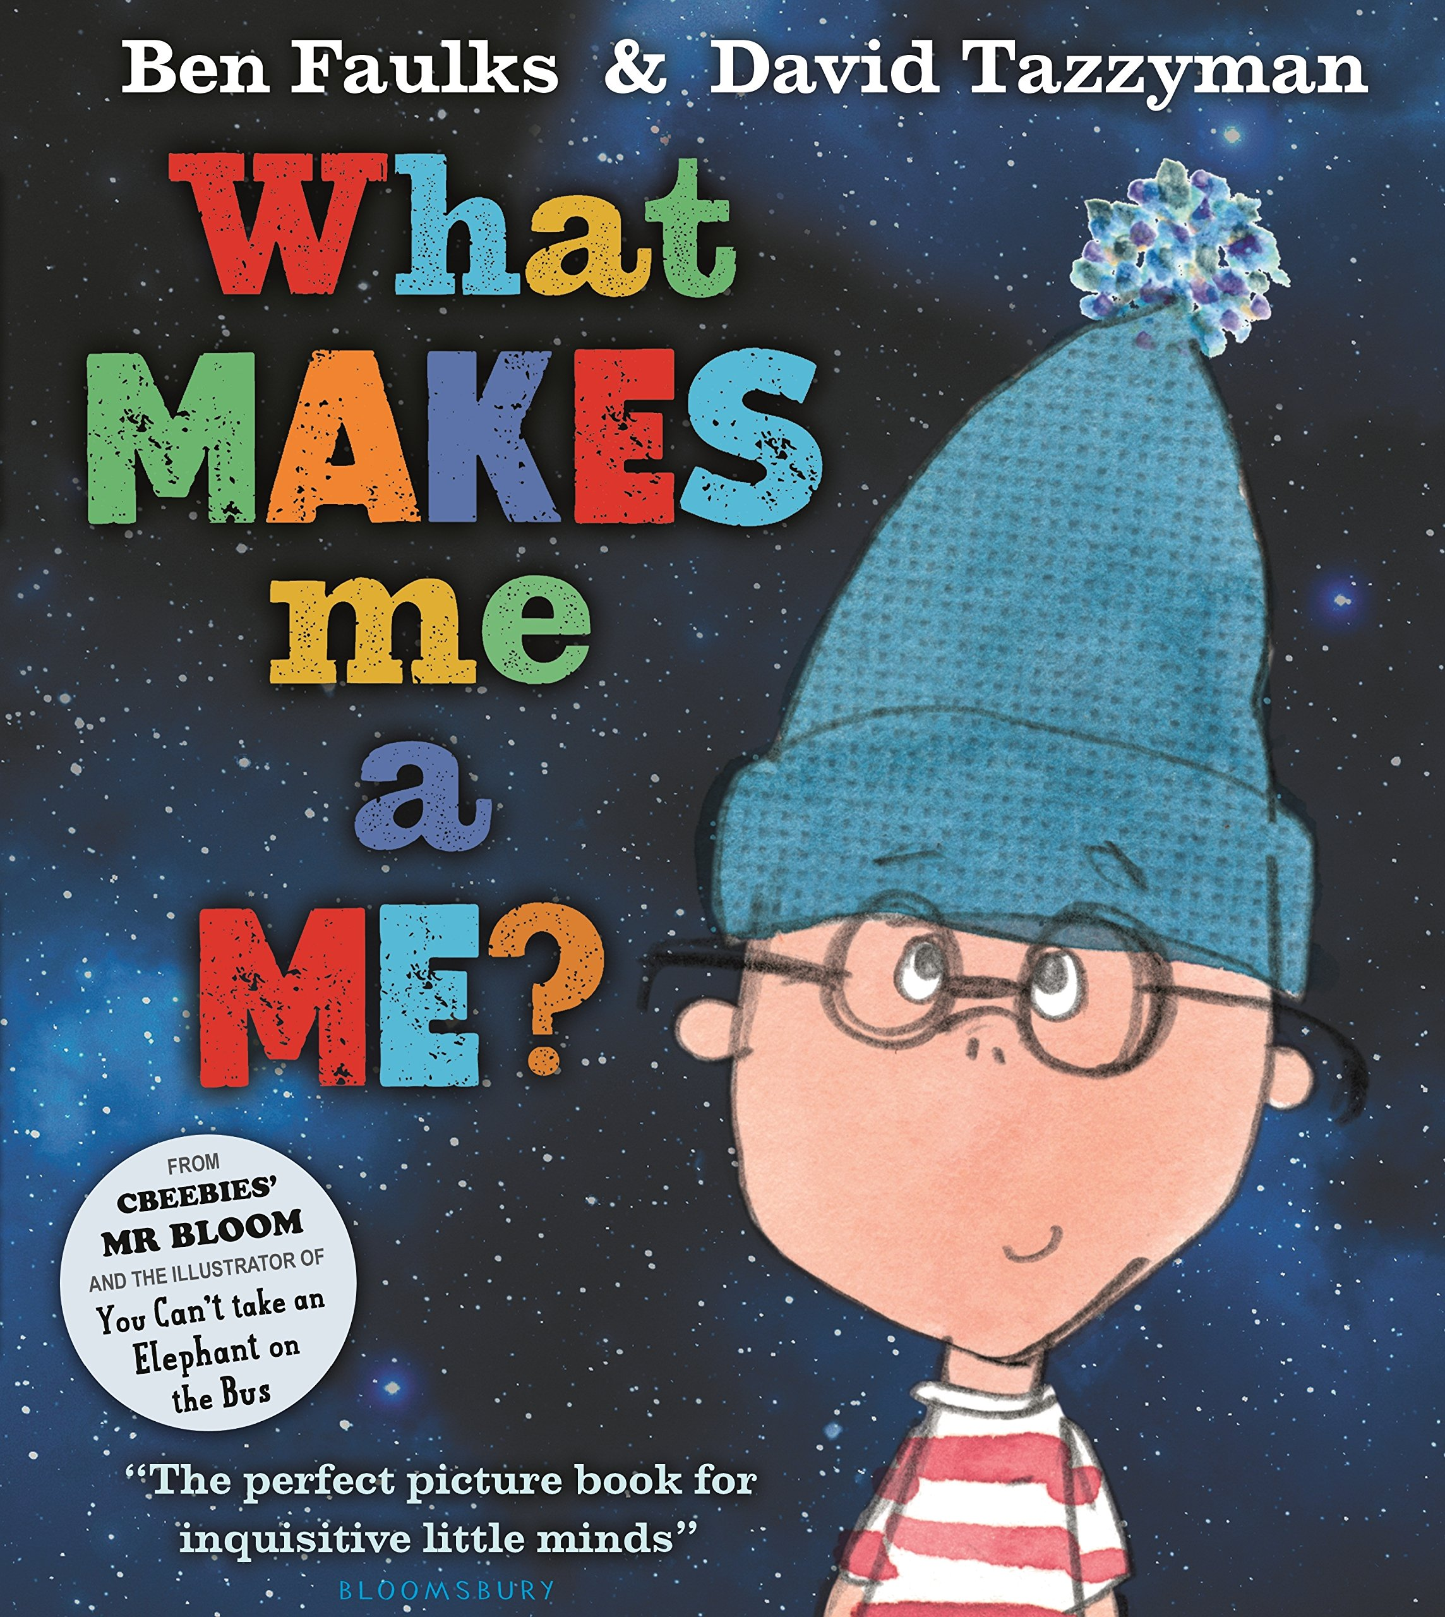




Ready Respectful Safe
Year R
I discuss my own star qualities;
I identify what a positive learning attitude is;
I can identify people who are special to me and who I would like to be like when I am older.
I talk about jobs I might do when I grow up;
I discuss what skills and interests are needed for different jobs;
Progress check:
How many different jobs can you talk about? What does it mean to have a job? What different jobs can you find in the books we read?
Year 1
I can identify star qualities in others;
I talk about hopes I have for the future;
I discuss what I am looking forward to about next year.
I give examples of positive learning attitude statements;
I can identify attributes I have that would suit me to a desired job;
I challenge stereotypes;
I can discuss my ambitions;
I can identify ways next year will be different and explain why I think this.
I can name role models.
I can identify people in our community who provide a solid role model.
Progress check:
What would be your perfect job? Who do you know that has a job that they enjoy doing?

Slide 3
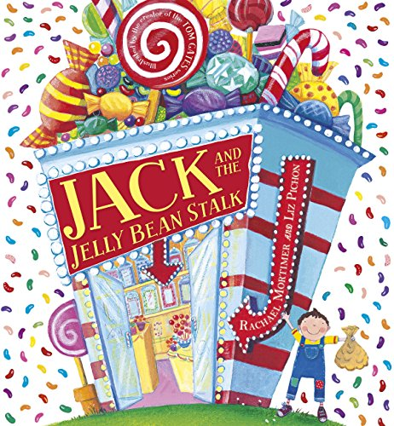
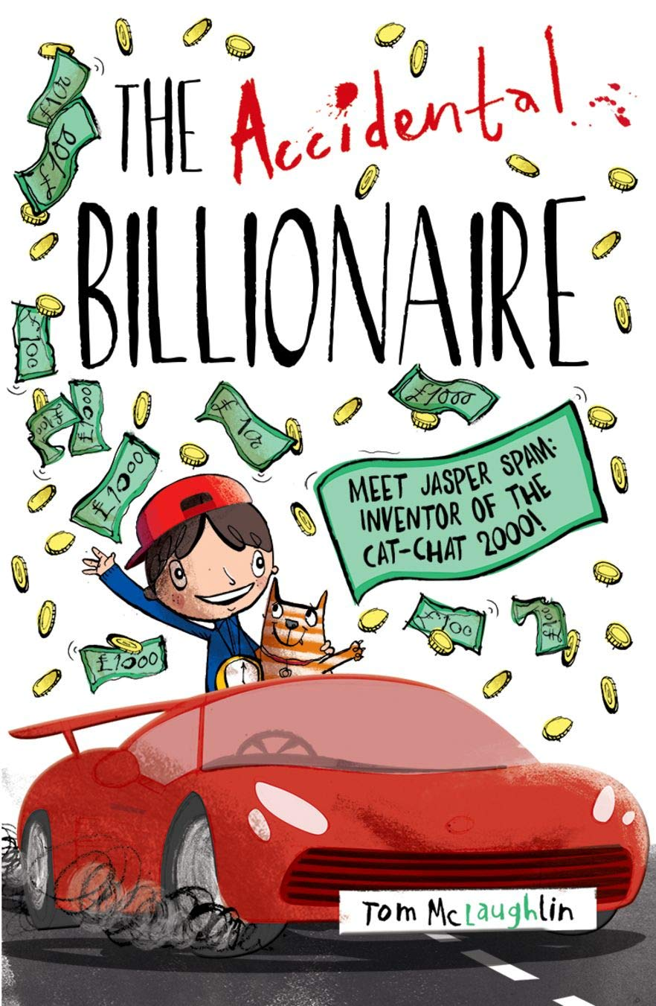

Ready Respectful Safe
Year 2
I explain why a positive learning attitude is helpful;
I explain what steps I can take to achieve future ambitions;
I explain why stereotypes need to be challenged;
I identify why routines and responsibilities might change as I go through school.
I can talk about a studied inspirational person from history (for example, William Shakespeare).
I can set a realistic goal
I can say what I want to happen and when there is a problem (set a goal).
I can predict and understand the consequences of reaching my goal.
I can choose a realistic goal.
I can sometimes plan to reach a goal
I can break a goal down into small steps.
I show persistence I can resist distractions.
I can work towards a reward or for the satisfaction of finishing a task.
I can recognise when I am becoming bored or frustrated.
Year 3
Progress check:
Pick a fairy tale. How was the main character rewarded for their goodness?
I explain why a positive learning attitude is helpful;
I explain what steps I can take to achieve future ambitions;
I explain why stereotypes need to be challenged;
I identify why routines and responsibilities might change as I go through school.
Progress check:
Is being rich, like Jasper, a sign of success?
Is aspiring to have lots of money the best goal?
Year 4
I talk about role models and define them by what they have achieved rather than their celebrity status.
I can discuss different learning styles;
I can identify what a positive learning attitude is;
I talk about the range of jobs that people do;
I understand what a gender stereotype is;
I talk about skills employers look for in employees;
I work with others in a team;
I discuss the skills everyone needs to succeed.
I discuss my personal achievements and skills;
Progress check:
If we were looking for a new teacher at our school and William Shakespeare applied for this job, should we give him the job?

Slide 4


Ready Respectful Safe
Year 5
I can identify skills and attributes that are useful in many roles;
I can identify how I learn best;
I identify potential barriers to success;
I identify opportunities that might be available to me in the future;
I identify and challenge stereotypes;
I discuss goals they could set to work towards their ambitions;
I understand the different roles within a team;
I discuss challenges many people face and how some people overcome these.
Progress check:
“You can’t blend in when you’re born to stand out.”
Looking beyond Auggie’s facial deformity, how does he stand out? Where does he succeed? What are his strengths?
Why do you think the author Palacio chose Auggie’s mask to be an astronaut helmet?
(Other perspectives)
Year 6
I can talk about how inspirational people from history have shaped our future (entrepreneurs).
I explain what is meant by innovation and enterprise;
I consider ways to develop their innovation and enterprise skills;
I understand how to use the knowledge of my learning style to further my learning;
I discuss the impact a growth mindset can have on achieving my goals;
I understand that our goals can change and explain why this might happen;
I appreciate the importance of seizing opportunities;
I explain the impact of stereotypes and why they need to be challenged;
I apply core skills when working within a team;
I identify limitations to achieving goals and discuss how challenges can be overcome.
Progress check:
In this biography, J.K Rowling is called a phenomenal, “Rowling is a writer whose work has impacted the world far beyond the content of her books”. What does this quote mean to you? What does it take to be a role model?

