Slide 1



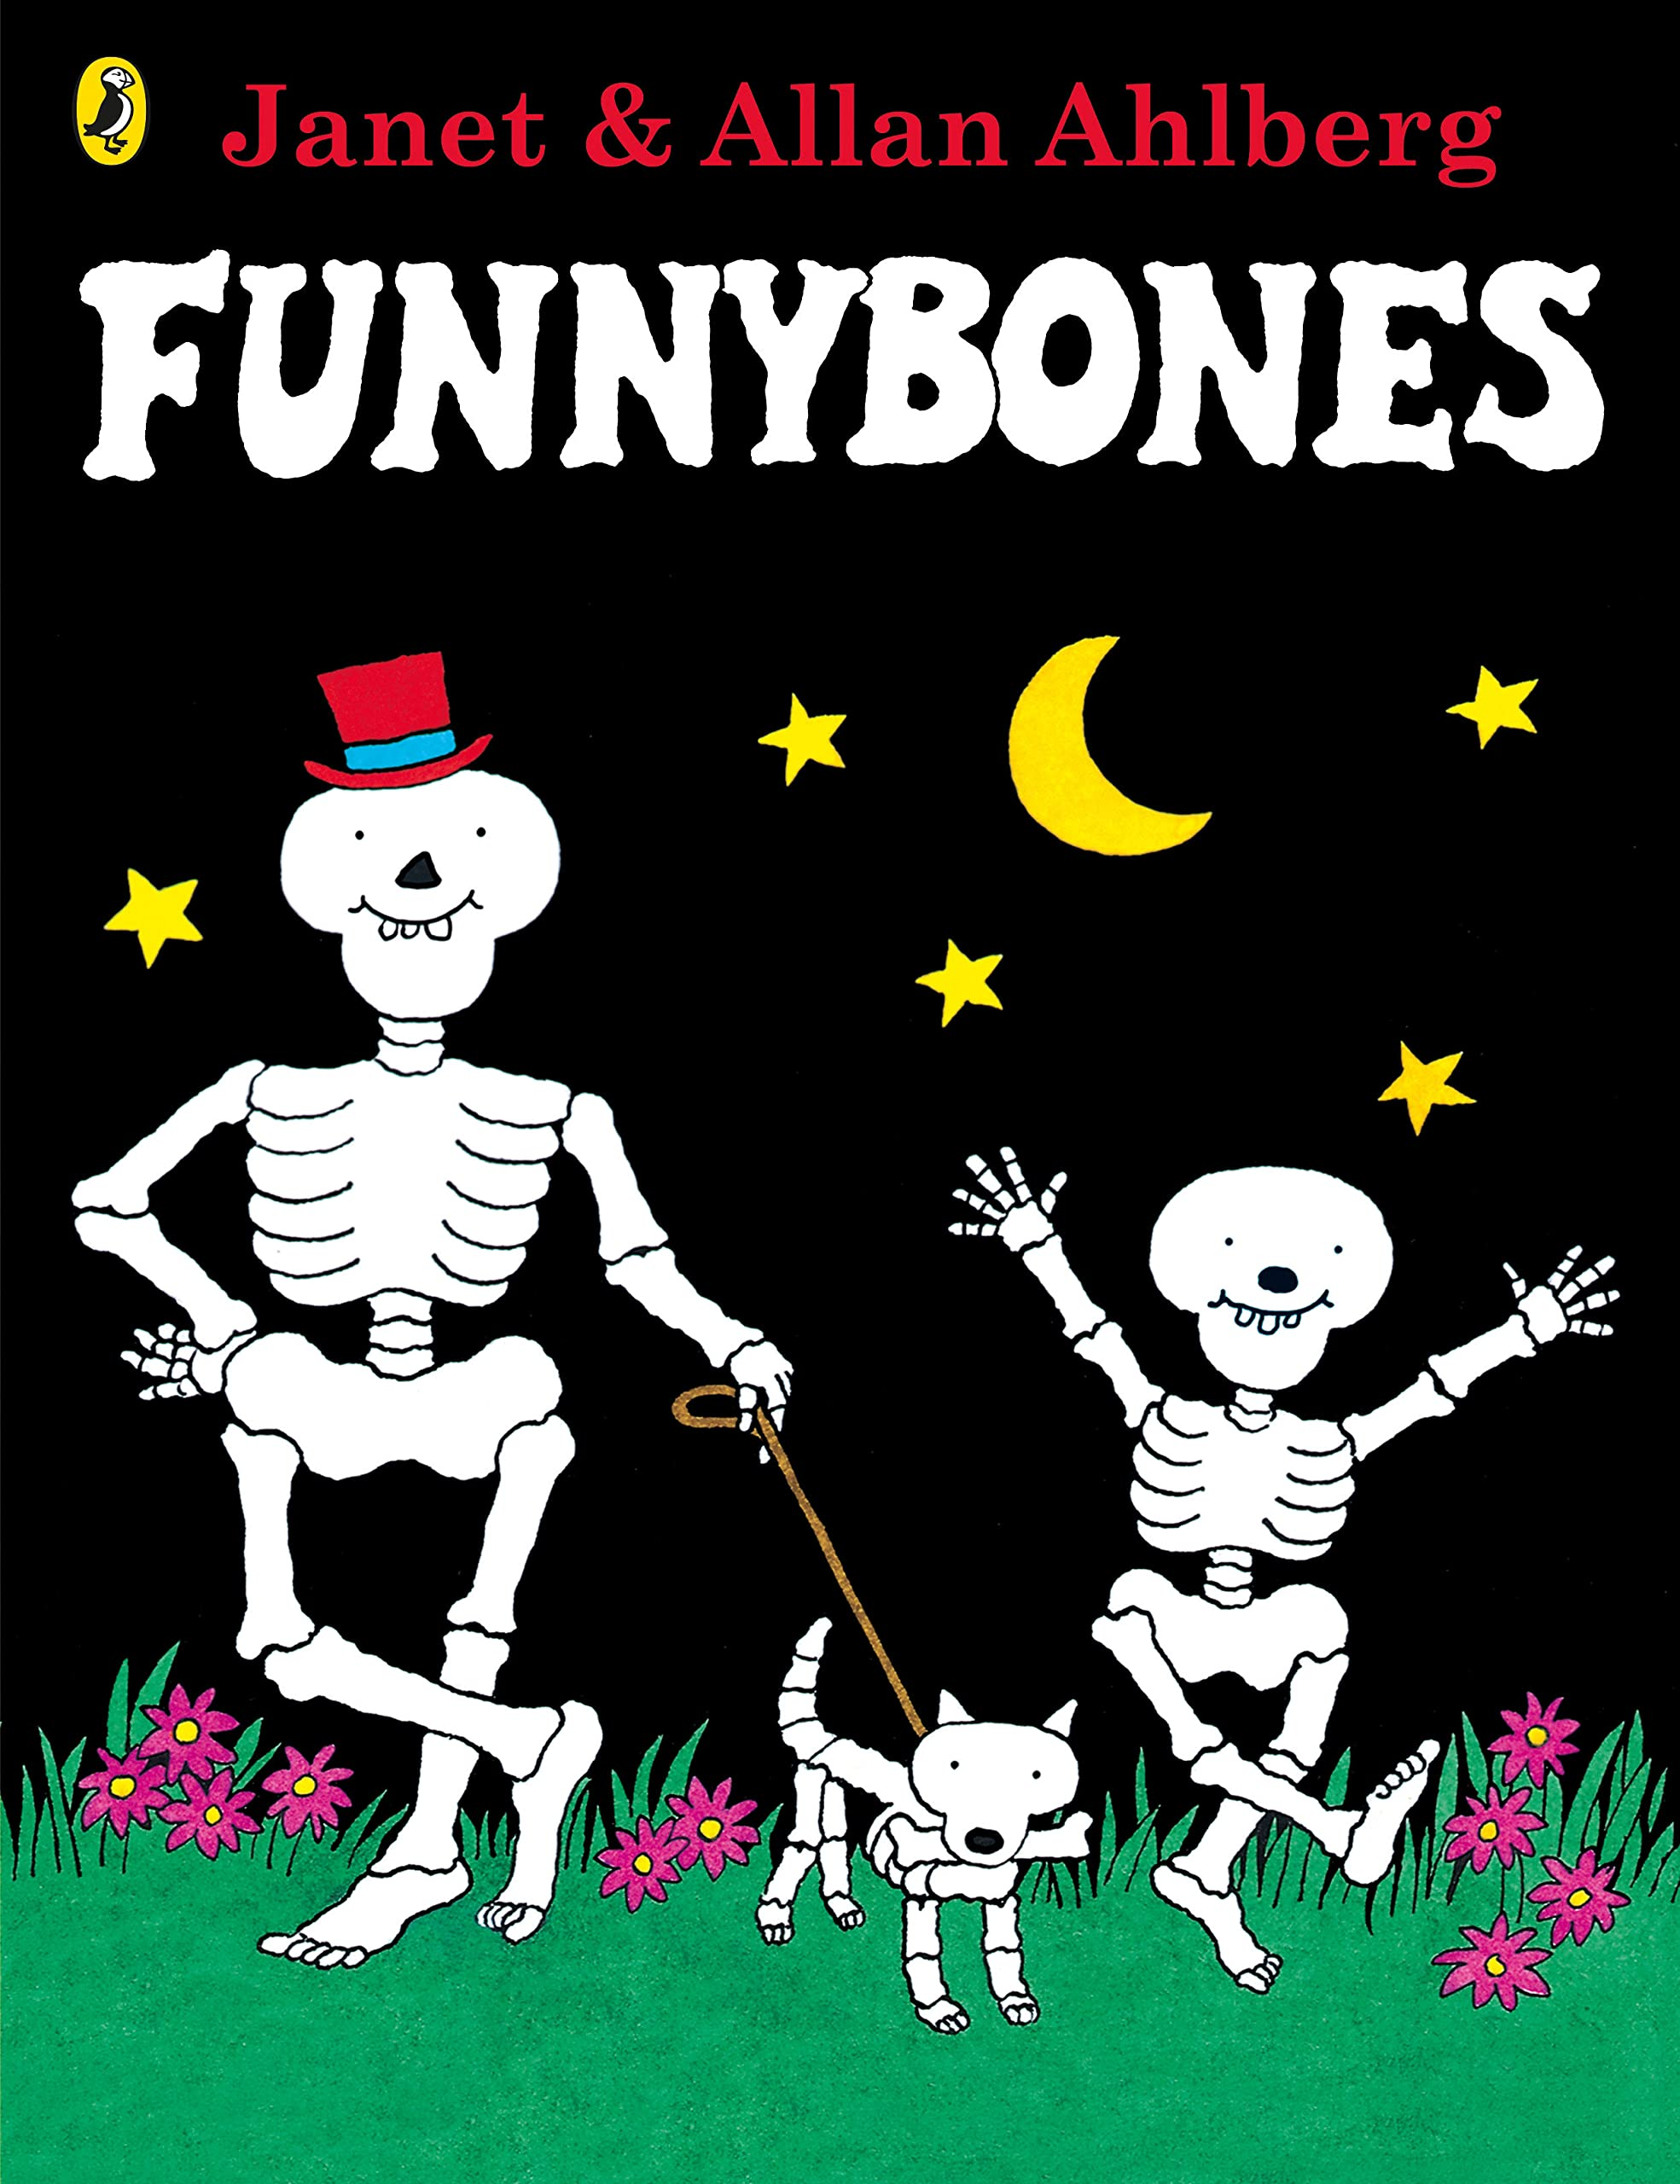

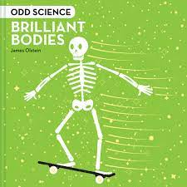





Year 1
Autumn term
1
Ready Respectful Safe
Science: The human body
History: Timelines and family trees
RE: Christianity Creation Story
PSHE: Similarities and differences
PE: Running and jumping
English
Constructing simple sentences and identifying subject and verbs. Understanding sentences need a capital letter, full stop and finger spaces.
How you can help at home:
Children can practice their handwriting and spellings regularly at home. You could practice sounding out words and using their phonics knowledge to support with their spelling.
Maths
Counting to 10, recognising numerals and words for numbers, ordering numbers, addition and subtraction and counting in 2s and 5s.
How you can help at home:
When talking about numbers use the language of greater/more and less than/fewer.
Practice finding different ways to make 10 (number bonds).
Which would I choose?
Ask me an interesting fact about my body.
What makes me special?
Other information:
.
Homework:
Regular reading each week using you Little Wandle book.
Weekly handwriting and spelling practice.
Use of Numbots regularly to develop maths fluency.

