Slide 1

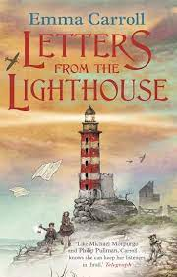





Year 6
Autumn term
2
Ready Respectful Safe
Letters from the Lighthouse
Why this particular book and not something else?
This narrative, which follows the life of 10 year old Olive, is our chosen text because it is crafted in such a way that is shows our learners what life was like for children in the war. Subtle details are dropped in to the narrative which adds much context to our history learning. From the descriptions of rationing, the movies at the ‘flicks’ to Olive’s experiences of evacuation, the author does such a good job of elaborating on the facts Y6 learn in history. To add to this, Emma Carroll’s characterisation is so strong that our Y6 children can really relate to her characters – this enhances their understanding of the life of evacuees and we build a strong link to our main character. This book has everything we need to support our own amazing writing.
School values this book reinforces:
Curiosity is a key theme within this beautiful text that explores a mysterious coded letter. However, our over-arching value this term is resilience. With a particular focus on ‘the Great British Spirit,’ we explore how during the war the British families found the strength to ‘carry on’ during such a troubling time.
Extended Writing in school:
By the end of the unit, children will have developed the skills to be able to describe an air-raid in realistic detail. The children’s character might be sat in the red velour seats of their local cinema. Perhaps they are watching Judy Garland in The Wizard of Oz. Suddenly, the lights come on and the familiar sound of the air-raid siren begins…
Skills that will be developed through this unit:
The language in the book is just wonderful for enriching vocabulary of our Y6 writers. It really is ‘the bee’s knees!’ Above all, we hope that our children absorb the figurative language in this text and apply it in their own writing.
Children learn about language techniques in poetry (which can then be transferred to their narrative writing too). This includes, metaphors, alliteration, repetition, personification and onomatopoeia.
Possessive apostrophes are tackled again but in Year 6 we consider irregular plurals alongside possessive apostrophe. For example, the difference in meaning between ‘the babies’ toys’ and ‘the baby’s toys’ (both are correct but have different meanings in this example).
Speech punctuation is explored alongside characterisation.

Slide 2
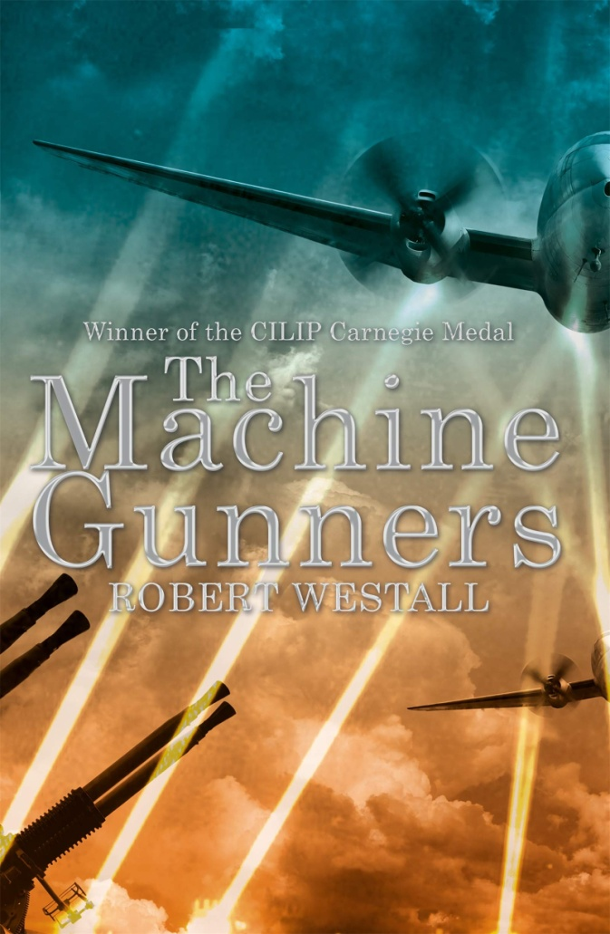
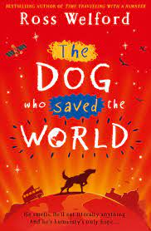
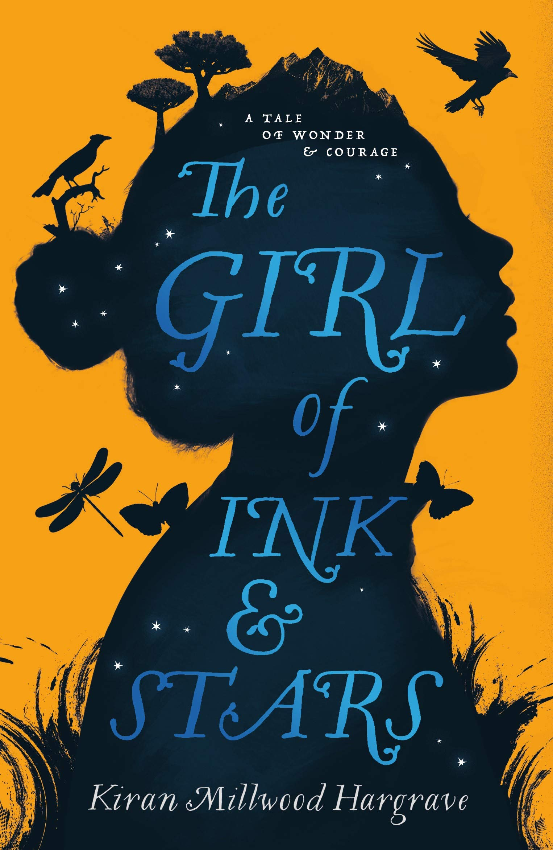
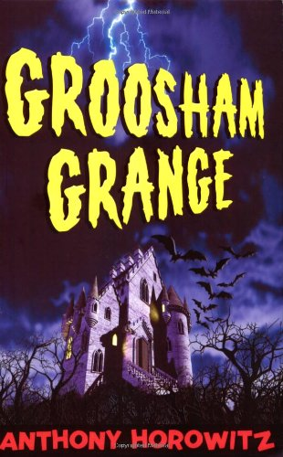
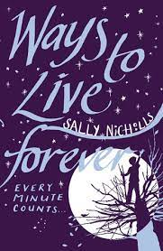
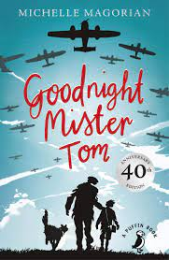
Year 6
Autumn term
2
Ready Respectful Safe
Writing Homework
1) During this unit, the focus will be on creating vivid descriptions. The Year 6 Team would like to see what skills you’ve already got! Now, the season of autumn presents a fantastic opportunity to build the most amazing descriptions. There’s so much to describe; from the crimson autumnal leaves that seem to chase each other playfully around the playground, to the grey sky, which is like a blanket wrapping around the world, you have got the chance to really show off your skills.
2) Last week we looked at poetry and considered these techniques: simile, metaphor, alliteration and repetition (as well as other techniques too). This techniques don’t only appear in poems – you’ll also find them in narratives. As you read this week, search for these techniques in your books. The Project X books are often packed with these language skills so these would be a good place to start.
3) Having now been to Bovington Tank Museum, your task this week is to either write a letter of thanks to their team or to write a short recount of what we did.
4) The possessive apostrophe must be the hardest punctuation to fully understand. Both of these are correct but have different meanings: the girls’ toys, the girl’s toys. And both of these are correct too: the babies’ room, the baby’s room. No wonder so many children find apostrophes a challenge! At home this week, make a poster that aims to support with this very tricky punctuation mark. Try to give some examples too.
5) During this unit, you have learned plenty of 1940s vocabulary. Do you know what ‘the bee’s knees’ means? If I said I was off to the greengrocer, would you know where I was going? What about if someone asked you how you were getting on with your rations? Would you understand? This week, either create a word search, or for a challenge, a crossword that is packed with words from WW2.
6) You have been learning about direct speech punctuation and a character’s body language. For this homework, you’ll need to be able to rewind a film or a television programme. Hunt for any programme that interests you but you’ll need to find a part where two characters are talking to each other, even better if they are arguing with each other. Watch the scene once to understand. Rewind! Watch it again and write down what the first character says. Watch again but listen to their voices – how did they speak? Watch it again but look at how they act when the speak – what do their bodies do? Repeat for the other character. Write the conversation remembering to add a new line for each speaker. To expand this, pack it with your recently taught Y6 skills, including amazing vocabulary.
7) Personification is one of our favourite techniques. “The snowflakes danced.” Find just one example of personification that you find appealing. Build it into a full Christmas description. What else can you use to make your paragraph really sparkle?
Our Extended Book Spine
To complement Letters from the Lighthouse, our school can thoroughly recommend these texts for this half term:

Slide 3
Year 6
Autumn term
2
Ready Respectful Safe
Our Extended Book Spine
To complement Treasure Island, our school can thoroughly recommend these texts for this half term:
Book Title | What is it about? | What the teachers think…
Ways to live forever (Sally Nicholls) | Sam loves facts. He wants to know about UFOs and horror movies and airships and ghosts and scientists, and how it feels to kiss a girl. And because he has leukaemia he wants to know the facts about dying. Sam needs answers to the questions nobody will answer. "Ways To Live Forever" is the first novel from an extraordinarily talented young writer. | This was popular with Y6 last year and could be one of the most powerful and uplifting books you will ever read.
The Girl of Ink and Stars (Kiran Millwood Hargrave) | When her friend disappears, she volunteers to guide the search. The world beyond the walls is a monster-filled wasteland – and beneath the dry rivers and smoking mountains, a fire demon is stirring from its sleep. Soon, following her map, her heart and an ancient myth, Isabella discovers the true end of her journey: to save the island itself. | Magic, myths and legend – there’s plenty for the reader here. This contains rich language and description and is a high quality text that would support your child’s writing.
Groosham Grange (Anthony Horowitz) | Sent to Groosham Grange as a last resort by his parents, David quickly discovers that his new school is a very weird place. New pupils are made to sign their names in blood; the French teacher disappears every full moon; the assistant headmaster keeps something very chilling in his room... What's the meaning of the black rings everyone wears? Where do the other pupils vanish to at night? Most important of all, how on earth can David get away – alive? | This is dark, humorous with clever plot twists by a well known author. We think your child might enjoy this book.
The dog who saved the world (Ross Wellford) | When eleven-year-old Georgie befriends an eccentric retired scientist, she becomes the test subject for a thrilling new experiment: a virtual-reality 3D version of the future. But then a deadly disease threatens the life of every dog in the country and Georgie’s beloved dog, Mr Mash, gets sick. And that’s only the start of her troubles. Soon, Georgie and Mr Mash must embark on a desperate quest: to save every dog on earth, and maybe even all of humanity …. without actually leaving the room. | I wonder who will be the first to borrow this from our shelf to read in school?

