Slide 1

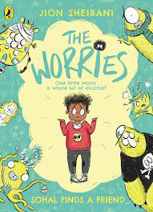





Year 3
Autumn term
2
Ready Respectful Safe
The Worries
Why this particular book and not something else?
This is a brand new book which affords us the opportunity to present a brand new unit of work to Year 3. We can’t wait to introduce our children to the main character, Sohal as we believe that our children will immediately identify with his character and the various situations that he faces throughout this book. As a school, discussing and exploring children’s mental health and emotions is an aspect that we feel is vital to healthy development and we are committed to weaving this throughout our whole curriculum. This book is beautiful because it shows how Sohal reflects on his worries and how he overcomes each of them. And if that wasn’t enough, it’s well-written and is just packed with the writing skills that children in Year 3 need to develop this term. In short, this book truly is a Beautiful Text and is certainly a book that we believe will have significant impact on our children’s progress, both in their English literacy and their emotional literacy.
School values this book reinforces:
This book teaches resilience. It is an ideal story to demonstrate to the children strategies for overcoming problems and who can help us when things get too much. We believe that this text will be a very useful prompt in supporting children to develop their own resilience.
Writing Composition in school:
Children will create a non-fiction explanation text that details emotions, possible triggers that cause this emotion and then advice on how to manage these feelings.
Our end piece of work will be a characterisation of a worry. How will the worry act, speak and interact with Sohal?
Skills that will be developed through this unit:
With a focus this half term on characterisation, children will be exploring skills that the author uses to bring her characters (quite literally) to life. Each worry in the book is presented as an actual character. For example, the character called Hurt is quiet speaking and wears a bandage. We look at how speech is used to show how a character behaves and how a character’s behaviour tells us lots about how the character feels.
Similes are used effectively within this book and we want our children to think about the power of a well-chosen simile. Similes use ‘as’ and ‘like’ and we will explore these with feelings. “When I am nervous it feels like a swirling washing machine in my stomach and I can’t think of anything else.”
We will also write non-fiction advice booklets that support children to manage emotions. Subordination will be a helpful skill here for adding information and offering this advice, “When you feel like this, you could….” “If you begin to feel…., you might try….”

Slide 2
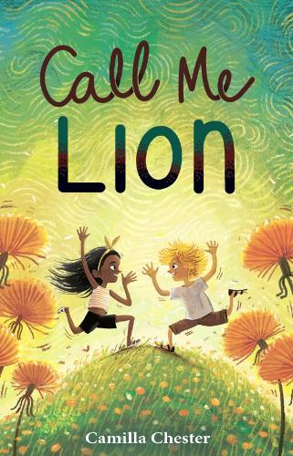
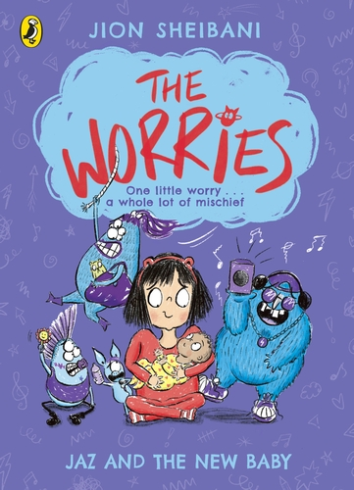
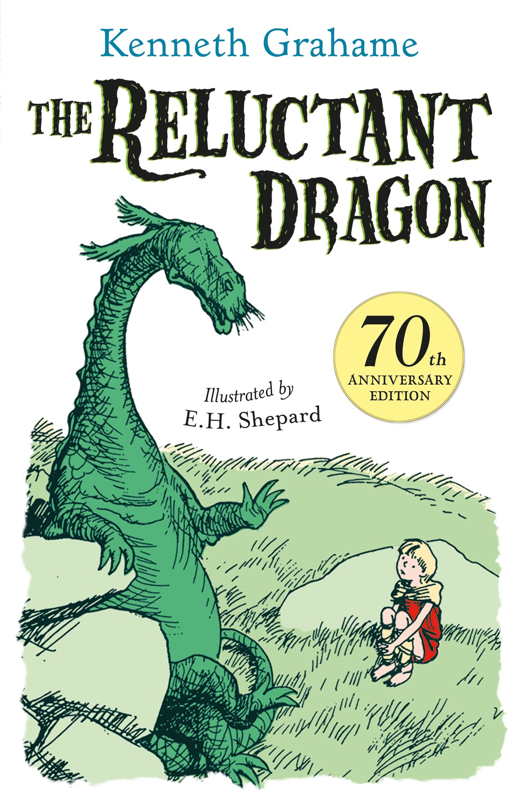
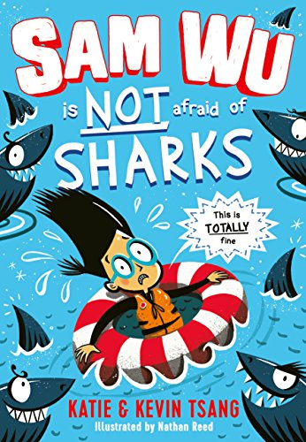
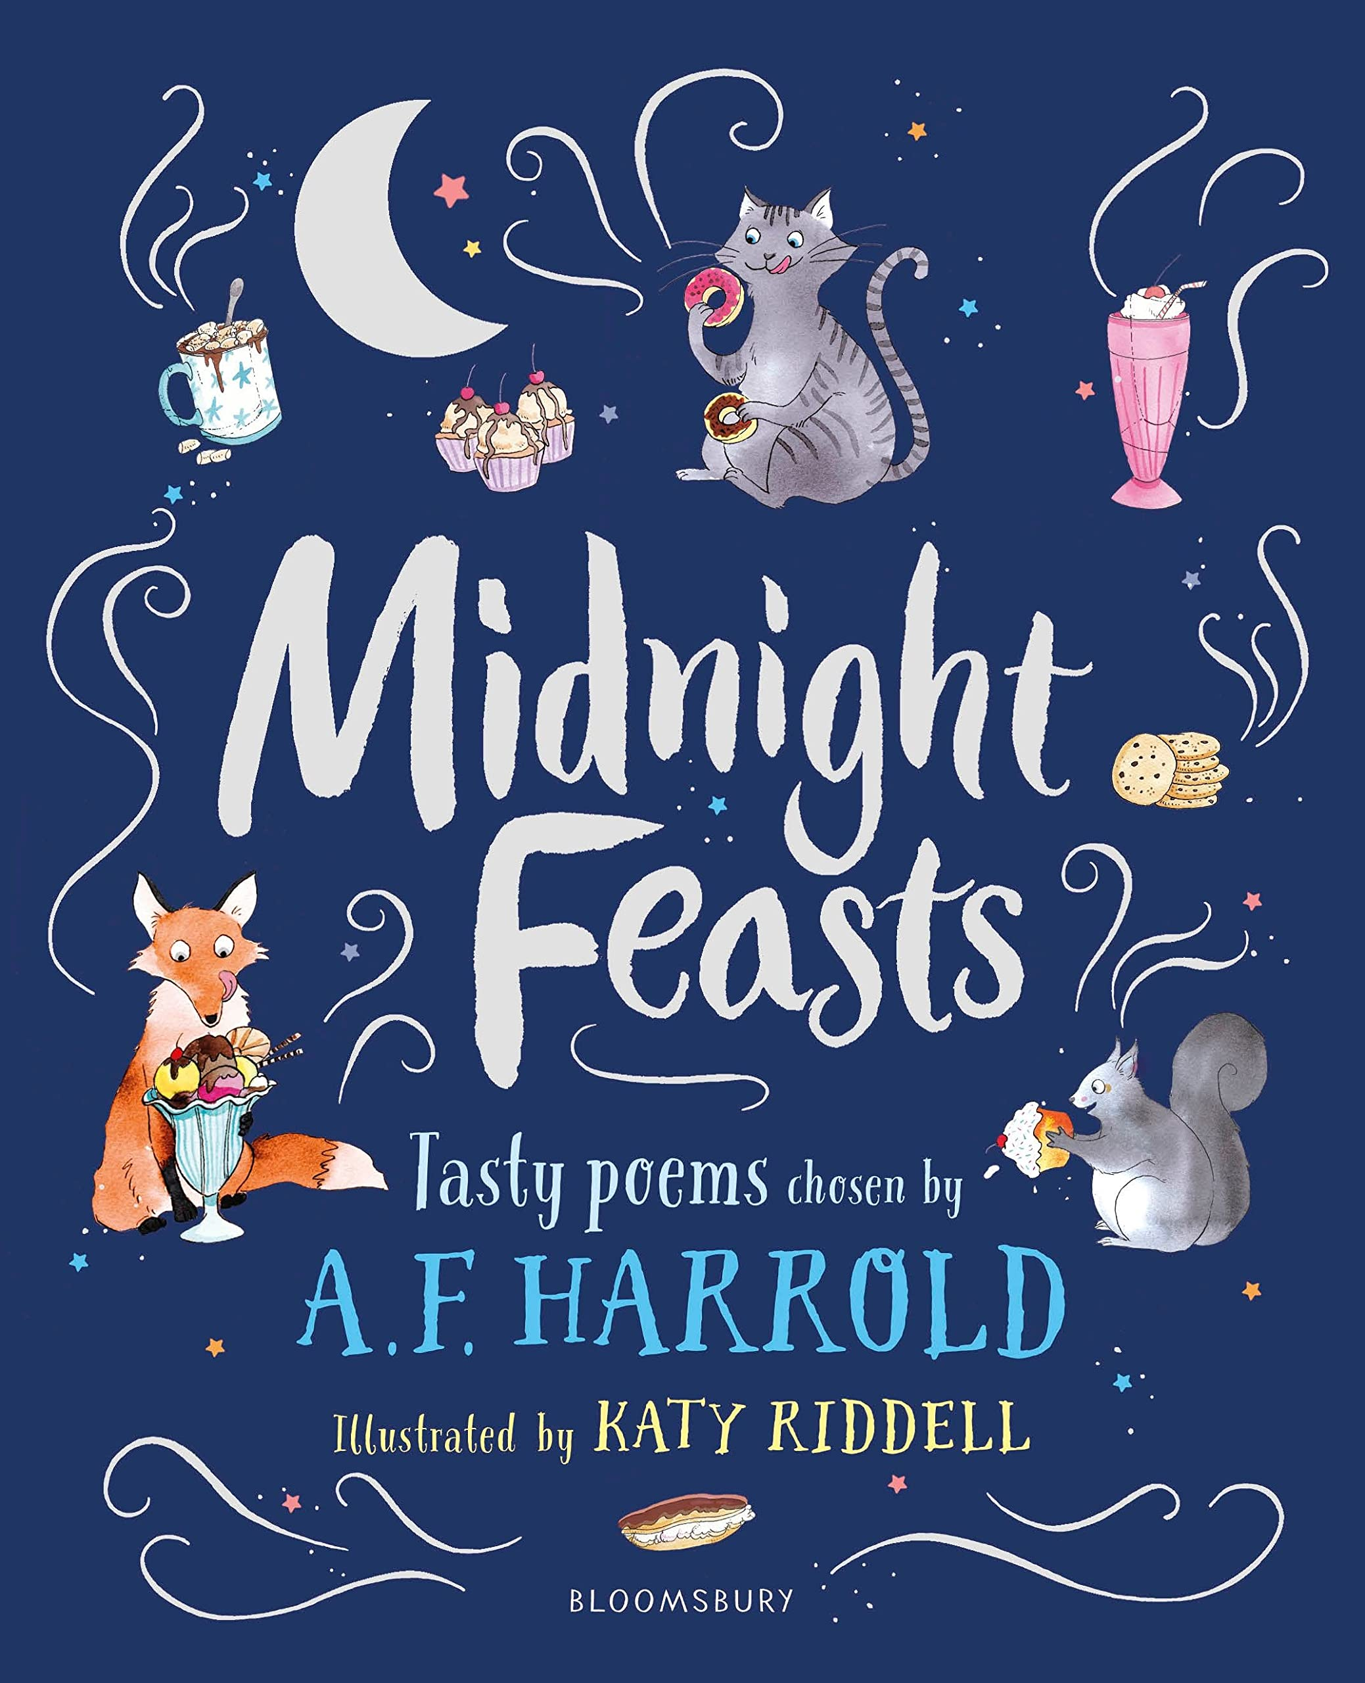
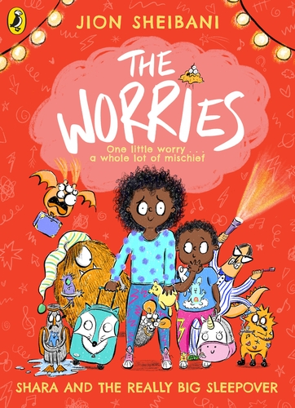
Year 3
Autumn term
2
Ready Respectful Safe
Homework
1) How many feelings and emotions can you think of? Sometimes we can think of many words for the same feeling, for example we could say nervous or anxious. Create a list of different feelings. As you write them, can you think of how you could write the word in a different colour or style. Often, anger might be presented in red or in block letters, like this ANGER. Can you add colour and style to different feelings?
2) Prepositional phrases give the reader extra information about a noun; very often it is about where the noun is. “Th pen on the table,” “The pen under the table,” “The pen by the table,” “The pen through the table.” We would like to see a preposition poster with plenty of drawing! In my example here, I picked ‘pen’ as my noun. How boring! Choose your own theme and have fun drawing prepositional phrases. I wonder where a unicorn might go or even the Muscliff Mouse…
3) Similes are used frequently in everyday life. I’ll start a simile here and I bet you can finish it… as cheeky as a____. How many similes do you already know? If you get stuck, colours are an easy way to get the flow going. “As red as a ______”
4) What makes you happy? An important skill recently has been using subordination to grow our sentences. Words like, because, if, when and as would be useful for this homework. Write in full sentences and think about a specific time when you were happiest or write several sentences giving examples of when you were happy.
5) Have you seen the film Inside Out? If you have, great! Draw your own character that could be called Anger. Write a speech bubble next to the character – what would they say? To make this even better, add some sentences that describe Anger’s personality and what makes the character cross.
6) Direct speech is an important skill that continually needs practising. Grab a couple of toys and get your toys to have a conversation! Do this with you voice first – get the toys to start chatting. Think about what the toys might say to each other and you might even put on a voice. After you’ve played, have a go at writing the conversation in full speech.
“Let’s save the city,” growled Batman.
“But we need to save the unicorns first,” replied Princess Belle.
7) Offer Father Christmas advice so he doesn’t get stressed over his busy schedule! Father Christmas spends the whole of Christmas worrying that everyone else gets the correct presents. What might you tell him to reassure him that he is doing a fantastic job?
Our Extended Book Spine
Let us know if you come across any other books that are about worries or emotional well-being. At Muscliff Primary School, we are keen to create a culture of recommending books and this would be an excellent way to share our book knowledge.
To complement The Worries, our school can thoroughly recommend these texts for this half term:

