Slide 1

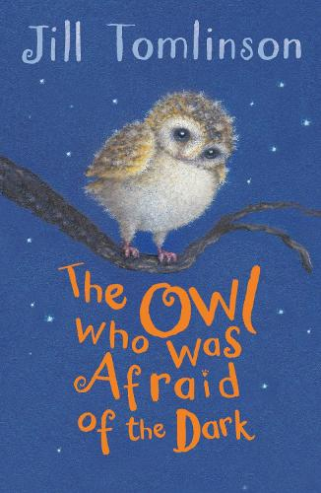


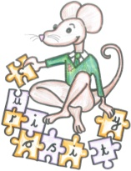


Autumn term
2
Ready Respectful Safe
Art:
Weaving
I wonder how Plop’s mum weaved their nest…
Music: Using instruments to create sounds from the forest.
ICT: Logging on, opening Word and typing sentences.
DT:
Joining Materials
I wonder how we can join fabric to make a soft toy of Plop…
Science: Animals and humans
I wonder if all animals grow in the same way we do…
English
Please take a moment to read the Y2 Reading Spine for this half term. It will provide more detail on what the children will be learning in this unit.
How you can help at home:
Oxford Reading Buddy – please ask if you have forgotten your child’s individual password.
Optional English assignments
Maths
Multiplication and Division
Length
How you can help at home:
https://whiterosemaths.com/resources/
https://www.topmarks.co.uk/maths-games/5-7-years/counting
https://numbots.com/
How does each chapter title help us to understand how Plop will become more confident?
How could this book be helpful for dealing with problems other than fear of the dark?
How does the author make dark NOT seem scary?
How does the author show Plop’s thoughts and feelings?
Other information: PE -Wednesday and Friday for this half term. Wednesday is Dance and Friday is Football with AFCB! Magical Starter: Monday 30th October 2023 Come back to school after dark! Please return to school at 4.30 to take part in wonderful 'Dark is...' Activities. Please look out for the letter. Please look out for the 'sock' letter for Design Technology!

