Slide 1

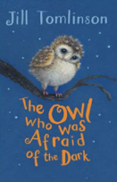
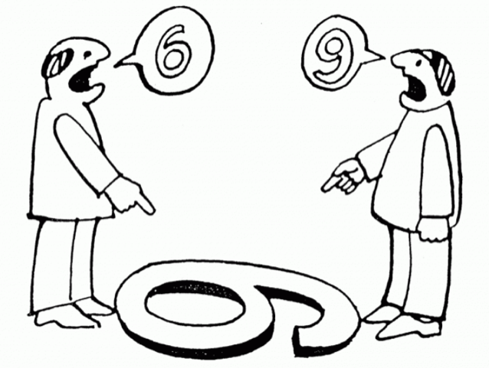





Year 2
Autumn term
2
Ready Respectful Safe
The Owl who was Afraid of the Dark
Why this particular book and not something else?
Although this text is very old (1968), it is a new one to Year 2 this year. From our Year 2 team meetings, it was clear that we all wanted a book that showed the children how important it is to look at problems from a range of perspectives. Plop is an expert at reflecting on a situation to support himself to move forward. At Muscliff, teachers learn about something called metacognition; this means thinking about thinking! And we really want our Year 2 children to become better at talking through their thought processes and make the best decisions possible based on prior knowledge and reflection.
In this book, Plop is scared of the dark. But in each chapter, he meets someone that prompts him to think a little bit differently. Luckily, Plop is very reflective and is willing to try to see things in a different way and he is open to trying something new.
In the end, Plop is a ‘self-regulated learner’ as he is motivated to make decisions for himself. And that is exactly what we want Year 2 children to do too.
School values this book reinforces:
Both curiosity and resilience are clearly signposted in this book. We show the children how Plop had an open mindset and used his curiosity to find our more even though he was scared.
This diagram represents Plop’s meta-thinking!
How do Y2 children explore different views?

Slide 2
Year 2
Autumn term
2
Ready Respectful Safe
English Skills that will be developed through this unit:
In Year 2, the main end of year outcome is that children are able to write accurately and are writing for someone else to read – children need to show an awareness of what the reader needs. One focus this term is ‘cohesion.’ This means the ability to develop writing so that it flows for the reader.
We will look at how our author creates sentences that start with an adverb of time. Adverbials such as ‘To begin’ and ‘at that point’ really help the reader understand how the sentence fits into the bigger piece.
Children will be encouraged to stay on one idea and develop 3 independent sentences based on one idea before moving on to a different idea.
We will consider composition as a process. We will learn how to plan, draft and then edit a piece of writing making sure that we keep the needs of our reader as the main influence in any decisions that we make.
Vocabulary choices will play another key role in writing composition so that we can sound like an expert.
Of course, we continue to reinforce basic accuracy in our sentences. Those full stops, capital letters and questions mark/exclamation marks will be polished until they shine this half term!
Writing Composition in school:
There are three main writing genres that we tackle this half term.
1) Recounts: children will need to write in first person (I) and retell a real life event. They will write in the past tense and be encouraged to use adverbs of time to sequence the events.
2) Contrasting description: we aim to not only use exciting vocabulary but also use our suffixes _er and _est.
3) Instructions: how to make a toy owl OR an information page about weaving.
Help at Home:
Any language enrichment about night time and darkness would be the best support. Talk about how night is different to day – use specific vocabulary, such as dusk. What animals are nocturnal? How does your road look different at night time.
Contrasting sentences would also be helpful: In the winter it gets dark earlier than in the spring.
Writing Tasks:
Go on a night walk along your road. How are things different at night? Focus on the lights in the homes, the road being less busy, the quietness of the birds. What can we hear? What can’t we hear?
Create a word bank of ‘Time Words and Time Phrases’ that would help us to put ideas in order. For example, ‘First,’ ‘Next,’ ‘Later in the day,’ ‘Before lunch time,’ ‘In between playtime and lunchtime.’
Ask your adults to recount something that is special to them but was before your time. For example, their wedding day or their first day at school. Can you remember and retell their account in the right order?

Slide 3
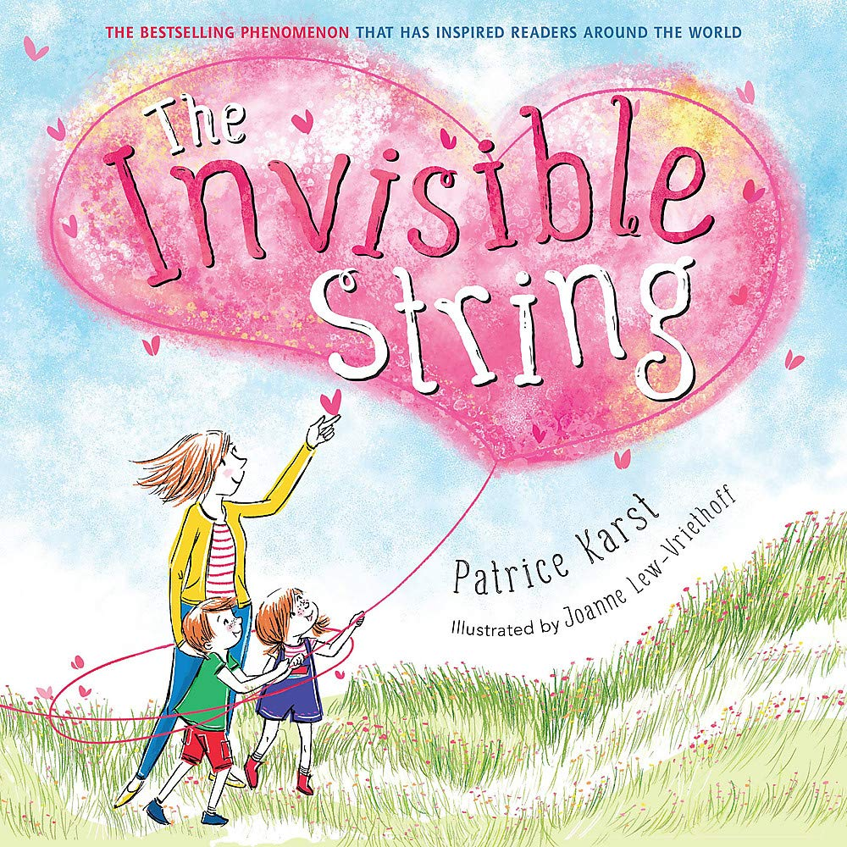
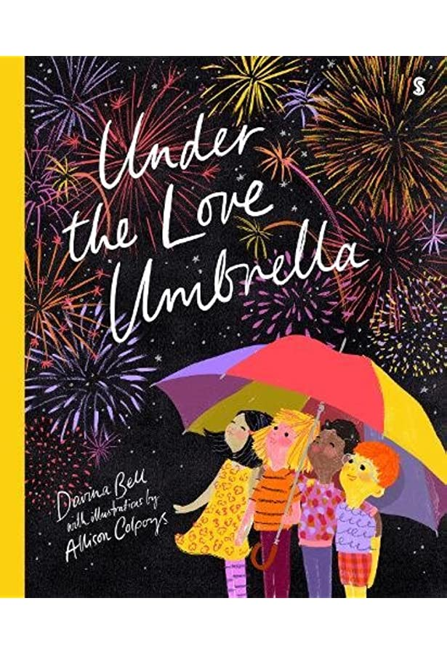
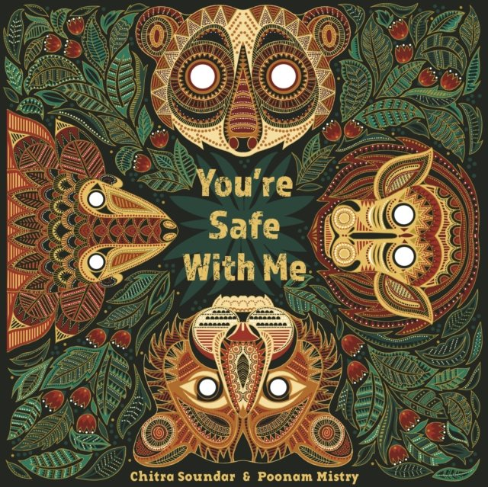
Year 2
Autumn term
2
Ready Respectful Safe
Our Extended Book Spine
In our lead text, The Owl who was Afraid of the Dark, Plop uses his curiosity to find out more about his fear. Being curious is a wonderful characteristic but it is important that curiosity is explored in a safe and supportive environment. Plop is supported by people around him who he can trust. To complement The Owl who was Afraid of the Dark, our school can thoroughly recommend these texts for this half term. These books are wonderful to help children understand who keeps them safe and how they are kept safe.
The Invisible String the perfect tool for coping with all kinds of separation anxiety, loss, and grief. In this relatable and reassuring contemporary classic, a mother tells her two children that they're all connected by an invisible string. "That's impossible!" the children insist, but still they want to know more: "What kind of string?" The answer is the simple truth that binds us all: An Invisible String made of love. Even though you can't see it with your eyes, you can feel it deep in your heart, and know that you are always connected to the ones you love. Does everybody have an Invisible String? How far does it reach? Does it ever go away? This heartwarming picture book for all ages explores questions about the intangible yet unbreakable connections between us, and opens up deeper conversations about love.
Up in the sky, amongst the stars, there’s something you might not see–the love umbrella, protecting all children, whether they’re feeling lost, left out, sad, or scared. When things aren’t fair, when big dogs bark; a bad dream, a lost tooth, moving house – when any of these things occur, a diverse variety of parents and carers are there to make it all better.
When the moon rises high and the stars twinkle, it is bedtime for the baby animals of the Indian forest. But tonight, when the skies turn dark and the night grows stormy, the little ones can't sleep. SWISH-SWISH! CRACK-TRACK! FLASH-SNAP! goes the storm. Only Mama Elephant with her words of wisdom can reassure them, "You're safe with me."

