Slide 1
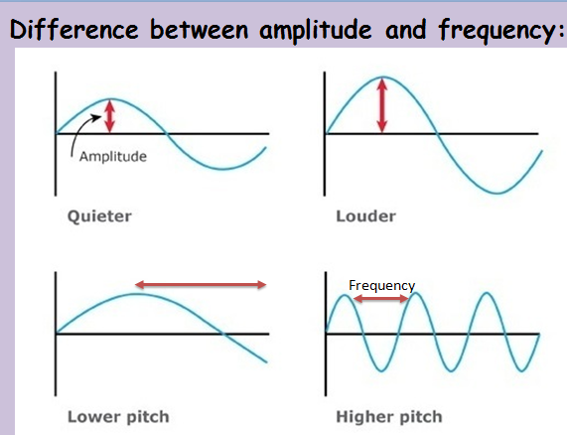
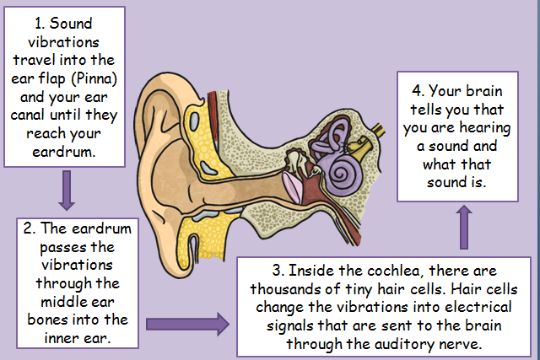
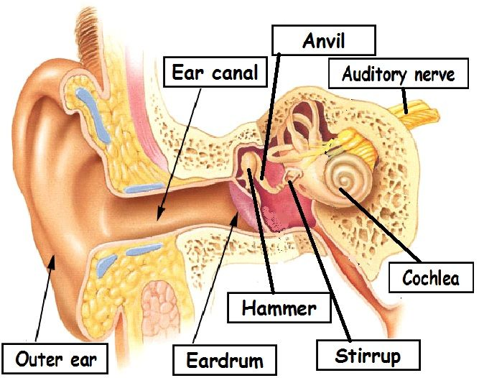
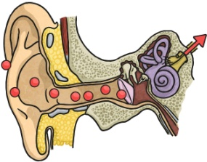
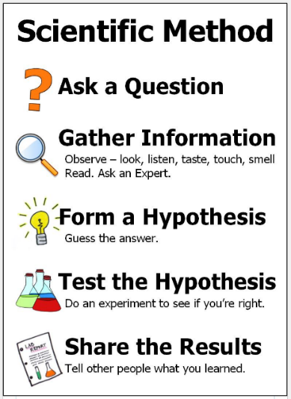
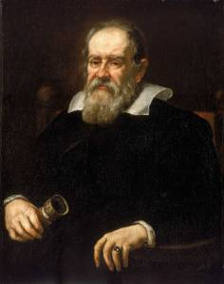
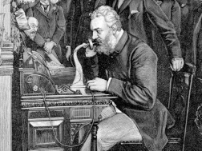
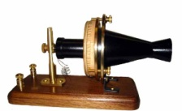
Science: Sound
What is sound? Sound is simply vibrations that spread through the air. Our ears sense these vibrations and tell our brain what sound we are hearing. | Sound Frequency How high or low pitched a sound is, is known as frequency. To make a high-pitched sound you have to create a very fast vibration. Frequency is measured in Hertz after a German scientist. | Sound Volume Sound is a form of energy and if we put more energy into making the noise then the noise will be louder (e.g. hitting it harder, shaking it harder – using more force). The MORE ENERGY the vibration has, the LOUDER the sound.
Key Vocabulary
Term | Definition
sound (noun) | Vibrations that travel through the air and can be heard when they reach the ear.
vibration (noun) | A rapid motion back and forth.
pitch (noun) | How high or low a note is.
high pitch (noun) | A high, squeaky sound, like a mouse.
low pitch (noun) | A low, deep sound, like a cow’s moo.
particles (noun) | A minute portion of matter.
frequency (noun) | How high or low pitched a sound is.
Hertz (noun) | The unit for frequency.
volume | A measure of how loud of soft a sound is.
amplitude (noun) | How loud or quiet a sound is.
cochlea (noun) | The spiral, snail-shaped part of the inner ear that converts sound vibrations into nerve impulses.
The ear
How do we hear things?
Key Figures
Galileo |  | Alexander Graham Bell
. Italian physicist, Galileo, was the first scientist to record the relationship between the frequency of the wave to the pitch it produces.
 |  | Alexander Graham Bell was a Scottish-born inventor, scientist, and engineer who is credited with patenting the first practical telephone.
“Science is simply the word we use to describe the method of organising our curiosity.” – Tim Minchin
1609: The moon is observed for the first time by Galileo using a telescope
1687: Newton discovers the law of gravity and motion
1751: Benjamin Franklin establishes that lightening is electrical (kite).
1859: Charlies Darwin publishes Theory of Evolution
1905: Albert Einstein’s theory of relativity E=MC2
1927: Lemaître produces the Big Bang theory
1969: The moon is walked on for the first time by Neil Armstrong
1997: Dolly the sheep is cloned by the Roslin Institute

