Slide 1
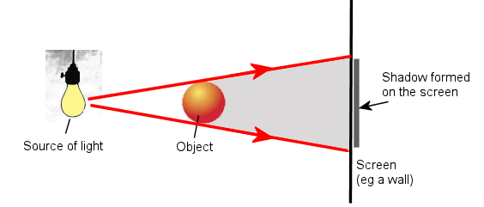
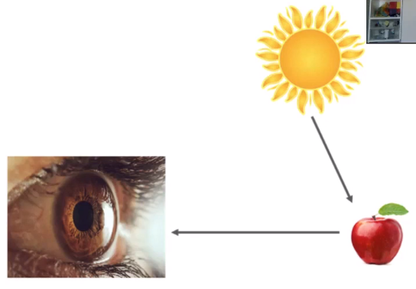
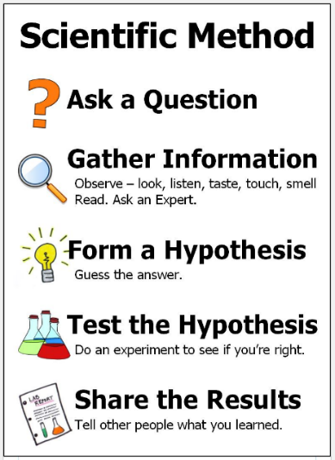
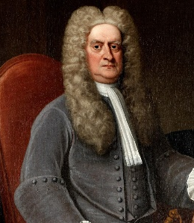
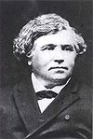
Science: Light
Light Darkness is the absence of light. You need light to see. Light travels in straight lines. | How do we see things? A light source emits light. Light travels in a straight line to an object. The light reflects off the object. The light reflects into our pupil in our eyes so we can see the object. | Light safety Light can be dangerous. It is very important that you never look directly at the sun or another bright light, as it can damage the retina in your eyes. | Shadows Shadows are made when an opaque object block the light rays travelling from a light source. This results in an area of darkness.
Key Vocabulary
Term | Definition
light (noun) | A form of energy that travels in a wave from a source.
light source (noun) | An object that emits light
emit (verb) | To give off
darkness (noun) | The absence of light
reflection (noun) | When light bounces off an object
reflective material (noun phrase) | a material that reflects light well. The light bounces off the material
non-reflective material (noun phrase) | A material that doesn’t reflect light well. Some light bounces off but most is absorbed
opaque (adjective) | You can’t see through it
transparent (adjective) | You can see through it
shadow (noun) | An area of darkness formed by an opaque object blocking the light
How do we see things?
How are shadows formed?
Key Figures
Sir Isaac Newton |  | Hippolyte Marié-Davy
Discovered that light travels in straight lines. |  | A French chemist who invented the first Naval periscope in 1854.
“Science is simply the word we use to describe the method of organising our curiosity.” – Tim Minchin
1609: The moon is observed for the first time by Galileo using a telescope
1687: Newton discovers the law of gravity and motion
1751: Benjamin Franklin establishes that lightening is electrical (kite).
1859: Charlies Darwin publishes Theory of Evolution
1905: Albert Einstein’s theory of relativity E=MC2
1927: Lemaître produces the Big Bang theory
1969: The moon is walked on for the first time by Neil Armstrong
1997: Dolly the sheep is cloned by the Roslin Institute

