Slide 1
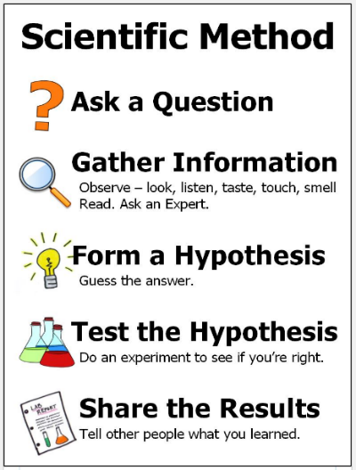
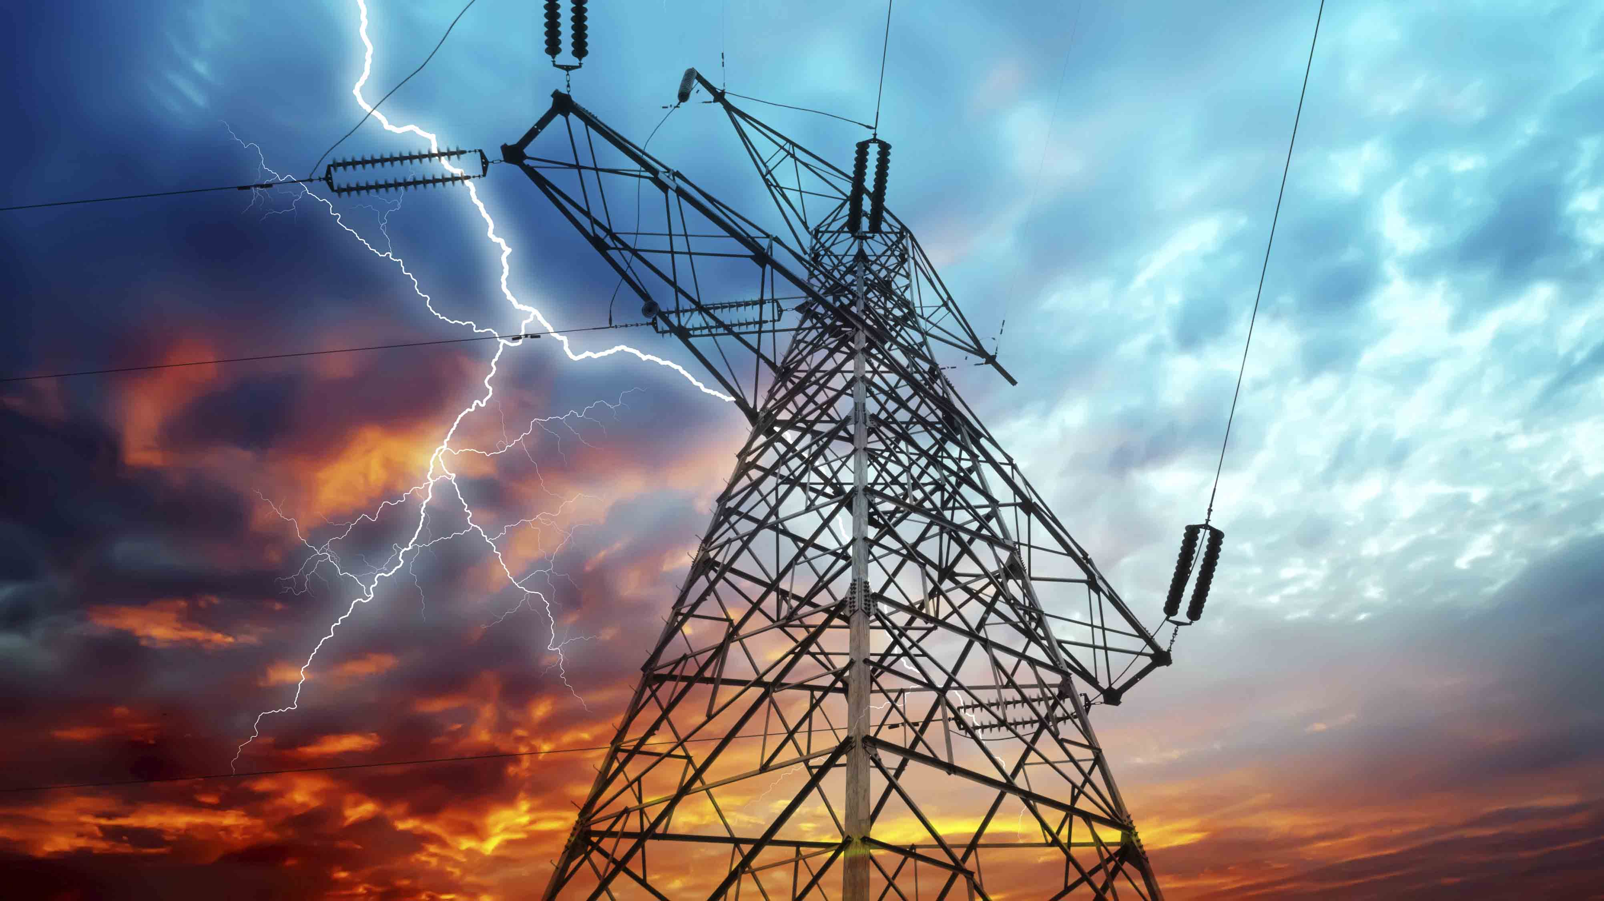


Science: Electricity
What is electricity? When we refer to electricity, what we mean is electric current, which is the flow of electrical charge. There are two types of electrical current that we use to power our appliances: Mains electricity which is an alternating current (AC) and batteries which generate a direct current (DC). | Where does electricity come from? An energy source is a way of powering something. Electricity is a secondary resource. This means it is made from primary sources of energy. Some primary sources of energy include: coal, oil, natural gas, wind & solar power. | Types of electricity and staying safe Mains electricity: to use this type of electricity you need to plug the appliance into a socket. Battery electricity: you need to insert a battery into an appliance. Mains electricity can be dangerous, causing anything from a minor electric shock, to serious burns and even death. | Electrical circuits Current electricity is the flow of electrical charge through materials. Every complete circuit must have a power supply. The power supply could be the mains or a battery. For a circuit to be complete, there must be wires connected to both the positive and the negative ends of the power supply. | Electrical conductors and insulators In some materials, some of the electrons are free electrons and can move. If you create a circuit with these materials, the free electrons can be made to move in one direction, creating an electric current. These materials are called electrical conductors. For example metal. A material which acts as an insulator will not let the elctrical current pass through it. For example; wood & plastic.
Key Vocabulary
Term | Definition
Electricity (noun) | The flow of an electric current or charge through a material, e.g. from a power source through wires to an appliance.
Generate (verb) | To make or produce.
Renewable (noun) | A source of electricity that won't run out. These include solar, hydro, nuclear, wind and geothermal.
non-renewable (noun) | This source of energy will eventually run out. These include fossil fuels- coal, oil and natural gas.
Appliances (noun) | a piece of equipment or device designed to perform a particular job.
Battery (noun) | a device that stores electrical energy as a chemical.
Circuit (noun) | a pathway that electricity can flow around.
Electrons (noun) | Small particles with an electric charge.
Electricity can be generated by nature, and also by man
Key Figures
Benjamin Franklin 1706-1790- In 1752, Franklin conducted his famous kite experiment. | Alessandro Volta 1745-1827- Italian physicist best known for the development of the voltaic pile (battery).
“Science is simply the word we use to describe the method of organising our curiosity.” –
Tim Minchin
1609: The moon is observed for the first time by Galileo using a telescope
1687: Newton discovers the law of gravity and motion
1751: Benjamin Franklin establishes that lightening is electrical (kite).
1859: Charlies Darwin publishes Theory of Evolution
1905: Albert Einstein’s theory of relativity E=MC2
1927: Lemaître produces the Big Bang theory
1969: The moon is walked on for the first time by Neil Armstrong
1997: Dolly the sheep is cloned by the Roslin Institute

