Slide 1

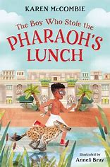
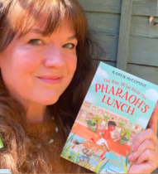
Year 3
Autumn term
1
Ready Respectful Safe
The boy who stole the Pharoah's Lunch
Why this particular book and not something else?
Understanding events that happened thousands of years ago can be very hard when you are only 7 years old yourself and trying to understand an Egyptian sarcophagus or a canopic jar is very challenging indeed. Luckily, in 'The boy who stole the Pharoah's lunch' all of this vocabulary is encountered.
When we first got hold of this brand-new book, what stood out most was the story’s structure. As an introduction to chapter books, we felt the structure of this book very much supports the children’s understanding of how a story develops. The structure is very clear – in fact, the story structure is very similar to the good old-fashioned Magic Key books. But in being a chapter book, rather than a picture book, each step in the story sequence is expanded with detail and is packed with key vocabulary. We start off Year 3 by being transported off to Ancient Egypt where Seth learns some important life lessons in this absorbing time-slip adventure. This fun and exciting text provides the children with many opportunities to learn about different tenses, sentence types, contractions and st. The children are exposed to rich vocabulary and interesting adjectives which they then use in their own story writing.
School values this book reinforces:
Being curious is a key value that we believe all children should develop and we encourage them to be critical thinkers, just like Seth. At the start of the story, Seth isn’t at all curious and he is not very keen on learning either. Through Seth’s character development, this book shows our children that by being a critical thinker, we can begin to better understand the world around us.
Writing Composition in school:
In school, our main focus is story structure. Children will plan a story that follows the same structure as our lead text. They will write a story start that will give them the opportunity to demonstrate their descriptive writing skills.
Children will also write a recount of their school trip to Dorchester.

Slide 2
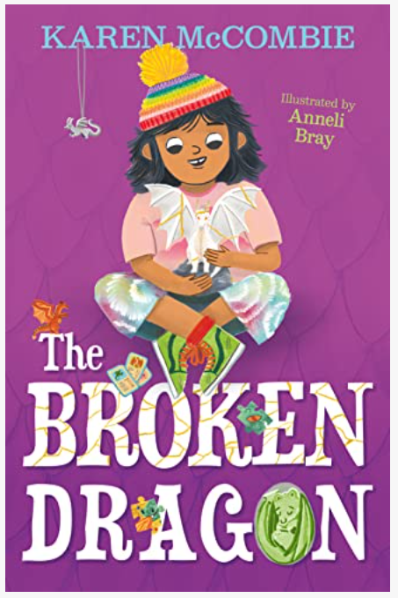
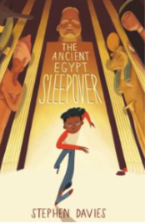
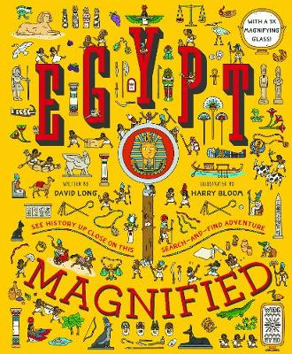
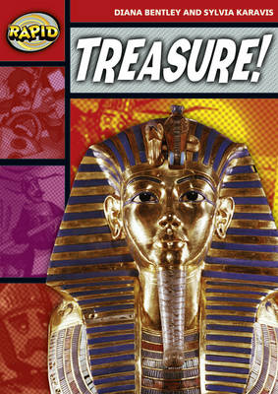
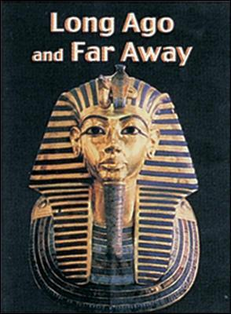
Year 3
Autumn term
1
Ready Respectful Safe
The boy who stole the Pharoah's Lunch
Skills that will be developed through this unit:
This unit supports children to understand how stories are structured. We consider what common features must be established at the start, middle and end of any story.
We learn how to plan a chronological sequence using a Story Mountain.
Use of a dictionary and thesaurus will be another skill that is rehearsed in class and parents might want to consider supporting their child by looking at alphabetical order and using a dictionary together at home.
We consider the editing and redrafting phase.
When we meet the author, we will look at composing questions.
Throughout this term, teachers will be looking for adventurous language choices and acquisition of vocabulary specific to this Egyptian unit.
Our Extended Book Spine

Slide 3
Year 3
Autumn term
1
Ready Respectful Safe
Writing Homework: Here is an overview of each written task for this half term. Over this half term, your child should aim to complete some writing at home each week. The time they invest in their written homework will vary from child to child – parental discretion is advised. Alternatively, you may wish to focus on just one or two of these activities and develop them over several weeks with your child.
Step outside your house and jot down what you can see/hear and smell. Tune into your environment. When you get back inside, build your observations into full descriptions. Aim to write a sentence or two about each of your senses. Check that all full stops and capital letters are correct. To make it more interesting for your reader, you could pick some words to improve by using a thesaurus.
Complete your own research about the Egyptians. Choose just one aspect that interests you and try to focus your research on that one area. So instead of a title, ‘Egyptians,’ your title might be ‘The Egyptian Pyramids.’ Create a fact sheet to present your findings. When you compose your work, consider using ICT to publish your work – be creative!
Have a listen to songs on the radio! Choose a song that you like to hear and write down some of the lines. Your challenge is to put the words into direct speech. I wonder what song you’ll choose. “I get up too late,” sang Taylor Swift.
Keep a diary this week. Aim to write a couple of sentences for each day. What was the best part of the day? What made you laugh and smile? To make this more of a challenge, you could try to use different tenses over the week. For example, Today I played football (past simple) and we were trying (past progressive) to score. I hope we play tomorrow (present simple).
Pick one of your favourite places and draw it. Can you label your picture using adjectives? Or even better, could you create some expanded noun phrases to describe your picture. Example: tall, green trees next to the park.
This term, we have been exploring ideas around friendships and what makes a good friend. We would like you to create a poster for our new rainbow classes on what makes a good friend. Think about summarising your main points and making your poster eye catching for the younger children!
Tell me about your favourite part of our class text – The Boy who stole the Pharoah’s Lunch. Write some sentences to describe which is your favourite part and why you really like it. You may want to challenge yourself to use different adjectives or noun phrases in your description and evaluation.

