Slide 1
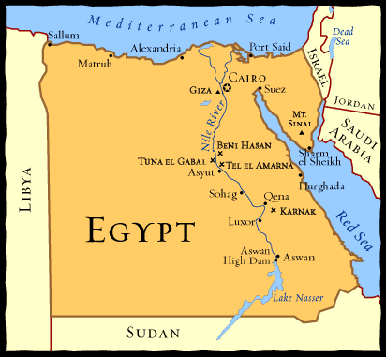
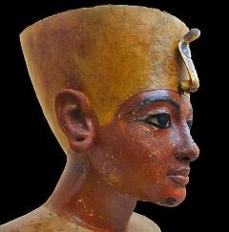
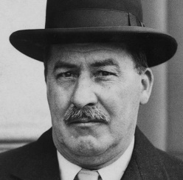
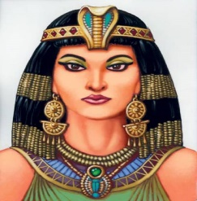
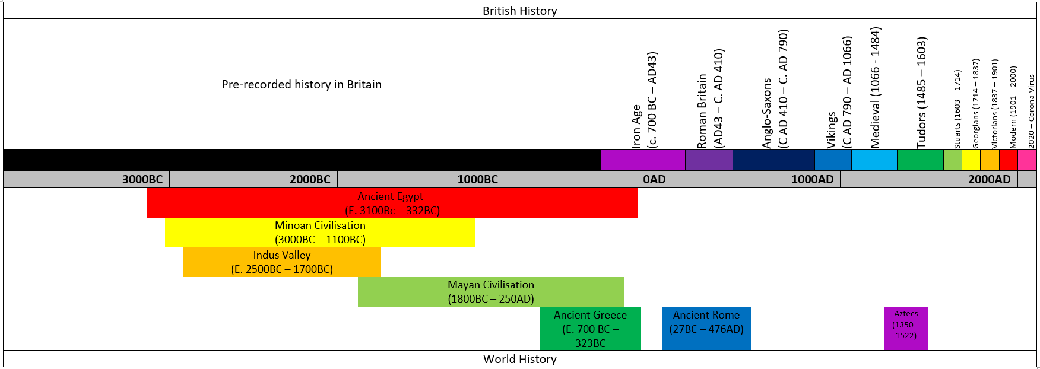
HISTORY: Ancient Egypt
Date | c7500 BC | c3500 BC | C3000 BC | c2600 BC | c2555 BC | c2200 BC | 1332-1323 BC | 196 BC | 51-30 BC
Event: | People began to build homes and farm in the Nile valley. | Hieroglyphics started to be used | The first buildings were being made of mud brick. | Pyramids started to be built | The Giza pyramids are built for King Khufu, Kharfe and Menkaure | The first ploughs are attached to oxen. | King Tutankhamen ruled | The writings on the Rosetta Stone were carved | Cleopatra VII ruled; she was the last pharaoh
Key facts
Ancient Egypt was a successful culture for over 3000 years. The Egyptians settled in north east Africa which is where the country Egypt is today. They lived in a very dry area but got their water from the River Nile (the longest river in the world) so they could grow crops. They used machines such as the shaduf to water crops. This is a farming technique still used today.. They wrote using pictures called hieroglyphics that stood for different words. The Egyptians built pyramids as places to bury their Pharaohs The Pharaohs were at the top of the hierarchy system and slaves were at the bottom. Both men and women wore make up. It was a sign of wealth. Egypt was conquered by Rome and became part of the Roman Empire. In 1922, archaeologists discovered Tutankhamun’s tomb.
Key Figures
Tutankhamun | Howard Carter
Cleopatra
Key Vocabulary
Term | Definition
Afterlife | Place where Ancient Egyptians believed they’d go after they died.
Canopic jars | Special jars that held the organs of a mummy
Hieroglyphics | A type of writing which used a combination of pictures and symbols.
Mummy | A dead body that has been preserved using embalming so that it won't rot
Papyrus- | A plant that grew on the banks of the Nile. (Used for paper, baskets & rope).
Pharaohs | Supreme ruler of all of Ancient Egypt.
River Nile- | ­A major river that runs through Egypt.
Sarcophagus | Large stone box that held a mummy’s coffin
“History is a version of past events that people have decided to agree upon.” – Napoleon Bonaparte

