Slide 1
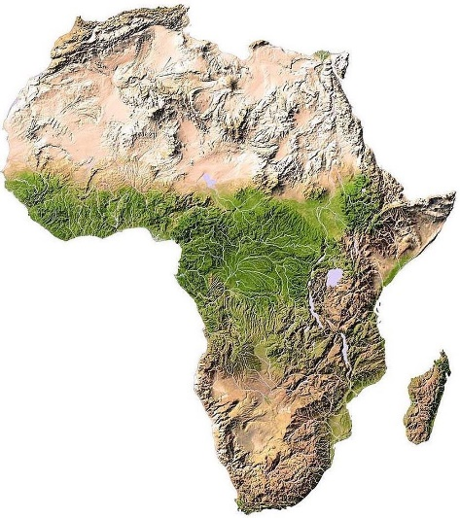
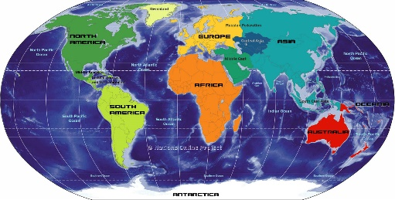
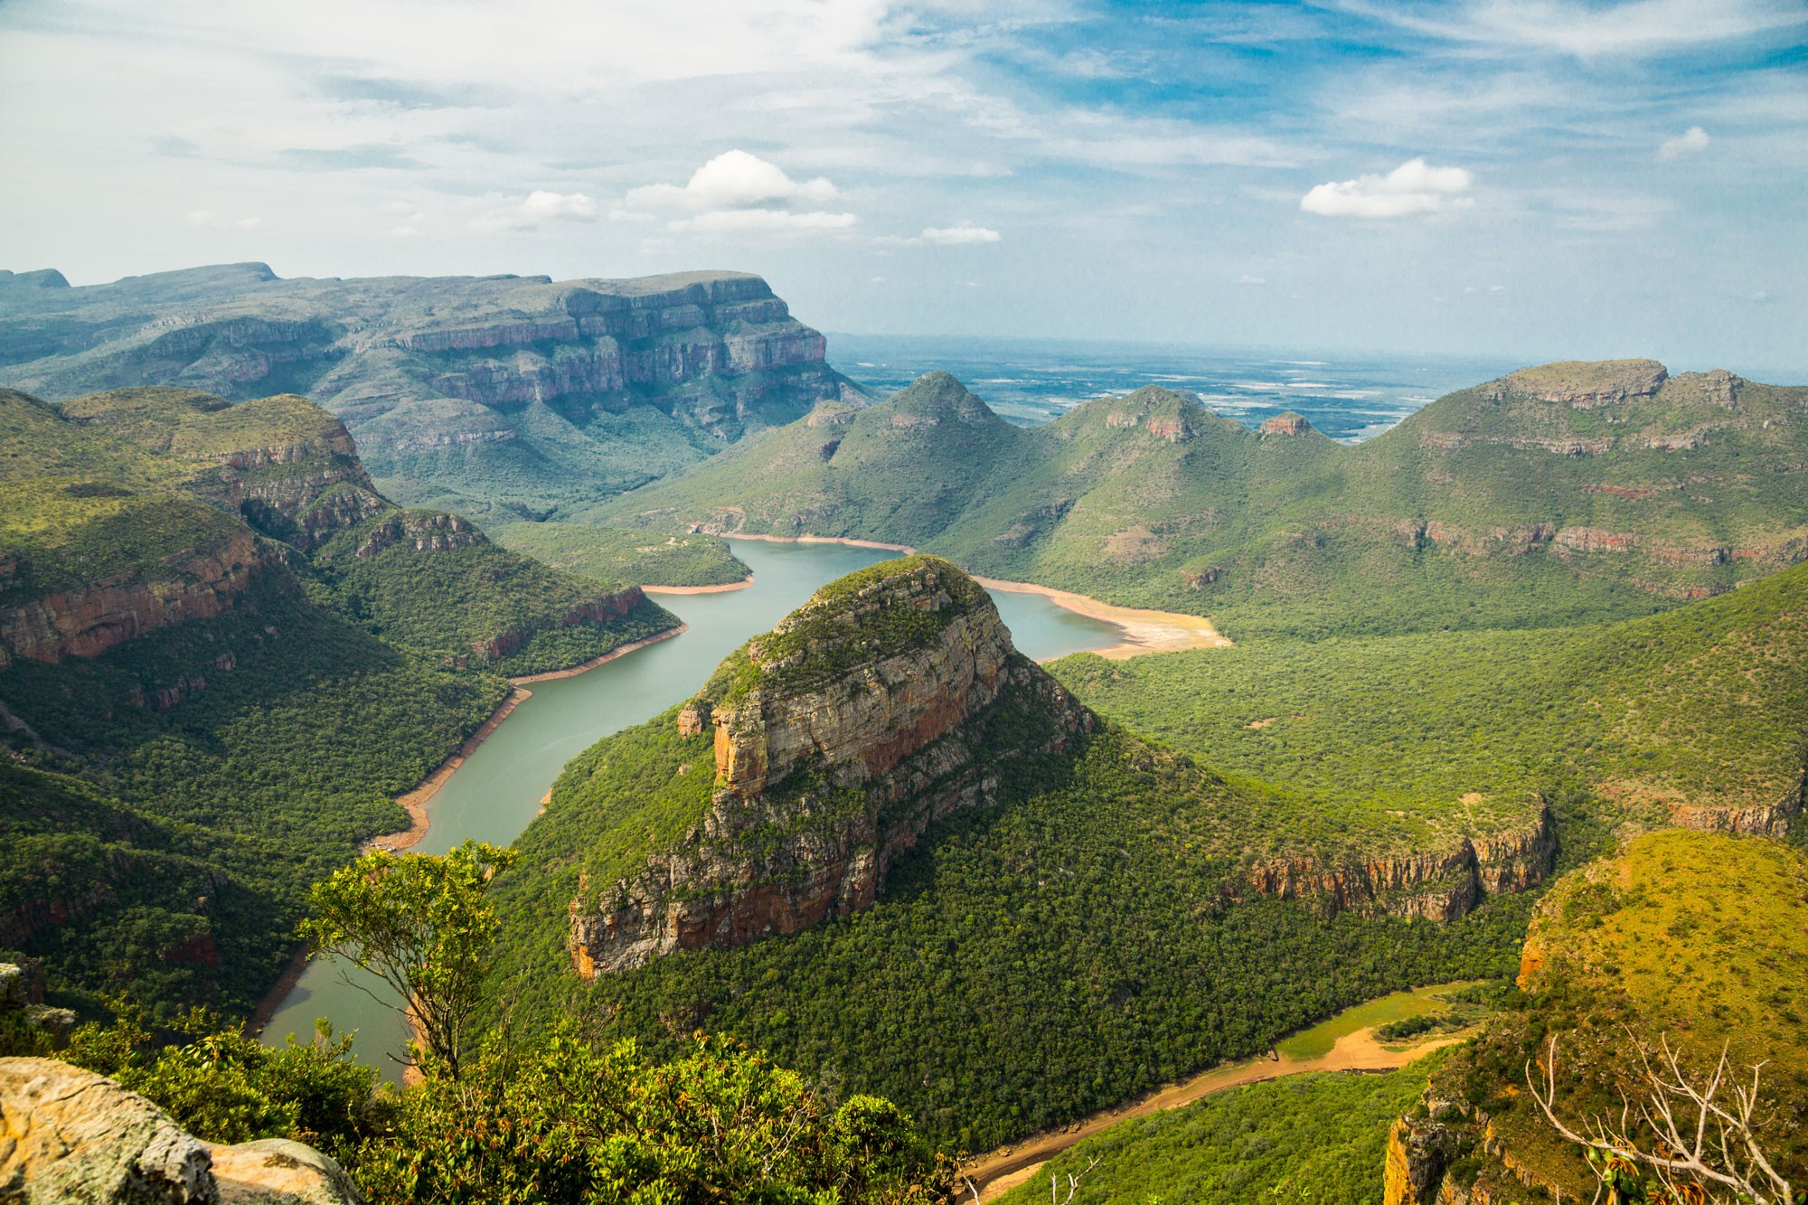
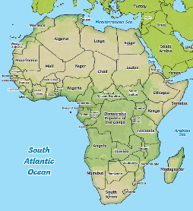
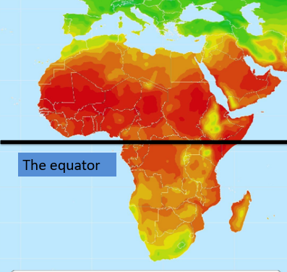
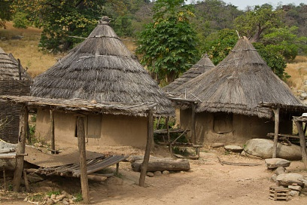
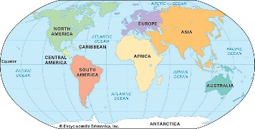
 | Geography: Africa
Human Geography | What is a continent? A continent is a very large landmass. A continent is usually separated by water or other natural features, like mountains. There are seven continents in the world | Africa: Africa is an amazing place. It is made up of a lot of countries that form the second largest continent in the world. Africa has many different regions including the Sahara desert, grasslands (known as savannas) and highlands | Population: Much of Africa’s population is distributed close to water sources. Areas such as Nigeria are closer to the sea, making it more densely populated due to the availability of a port for trade, and therefore work.
Important Skills
Locate and name the seven continents. Identify African landmarks. Identify why some areas of Africa are sparsely populated.
Key Vocabulary
Term | Definition
Continent | A continent is a very large landmass. It is usually separated by water or mountains.
Settlement | A topographical map is one that shows the physical features of the land.
Population | The whole number of people living in a country, city, or area.
Density | The number of people living in each unit of area.
Key pictures or diagrams
The Seven Continents | Topographic Map | Africa’s average Temperature Map | African Mud House
1040: First compass used to navigate (In China).
1271: Marco Polo sets off for China
1492: Columbus discovered America
1497: John and Sebastian Cabot discovered Canada
1540: Nicolaus Copernicus discovered the Solar System
1770: Captain James Cook discovered Australia
1911: Roald Amundsen led the first expedition to the South Pole
1969: Neil Armstrong was the first man to walk on the moon.
1507: First true map of the world by Martin Waldseemüller

