Slide 1
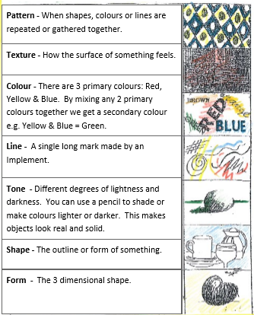

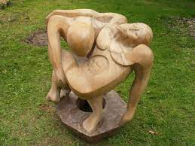
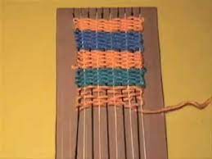
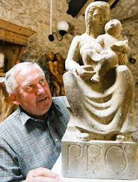
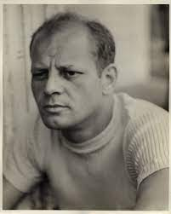
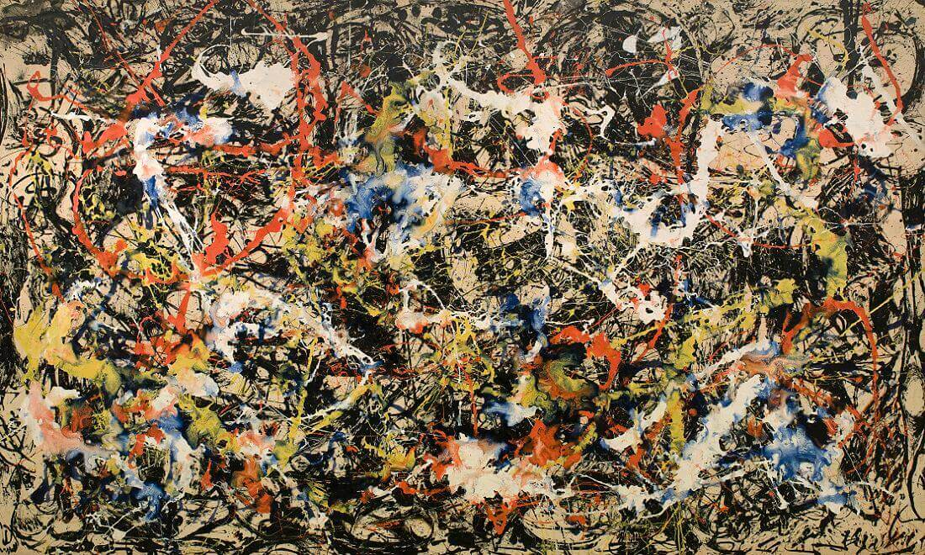
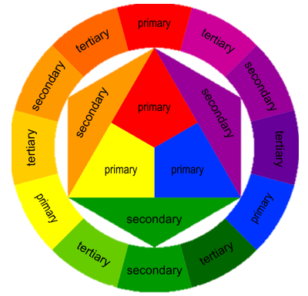
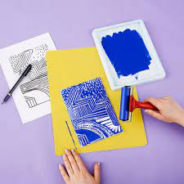
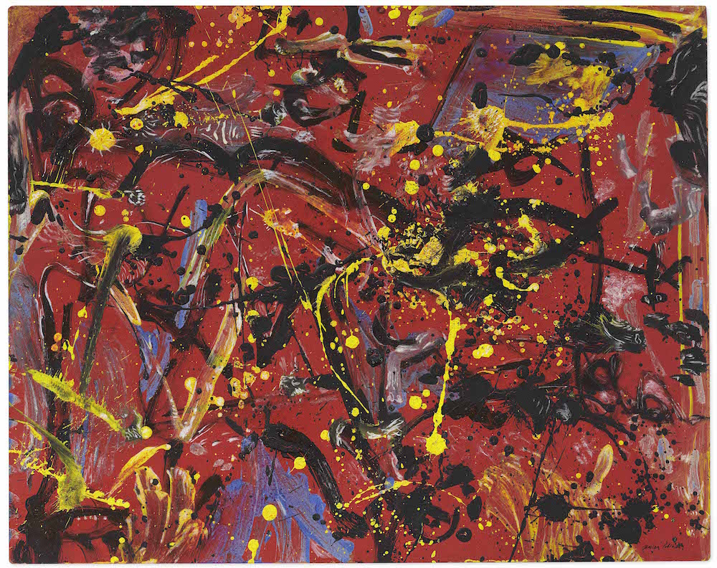
Art
Pictures
Pictures
Important Artists
Jackson Pollock | John Banting
Landscape
Printing
Sculpture
Contrast
Tone
Brush strokes
Portraiture
Still life
Weaving
Pictures
Pictures
Pictures
Focus of study | Description / detail
Create an abstract piece of art | Using Jackson Pollock as inspiration to create an abstract landscape picture using different brushstrokes
Printing | Creating a pattern/design on a polystyrene tile to print and create a picture
Weaving | Using materials and a loom to weave and make a piece of material
1150 – 1425: Gothic
1400 – 1520: Renaissance
1600 – 1700: Baroque
1765 – 1850: Neo-Classicism
1765 – 1850: Romanticism
1870 –1890: Impressionism
1907 – 1915: Cubism
1700 – 1775: Rococo
1924 – 1939: Surrealism
1946 – 1956: Abstract Expressionism
1954 – 1970: Pop art
“Art is not what you see, but what you make others see.” – Edgas Degas

