Slide 1
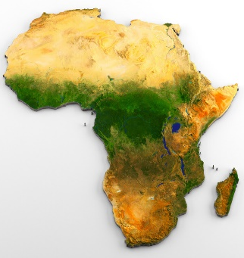
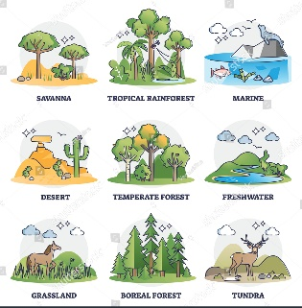
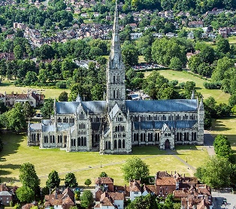

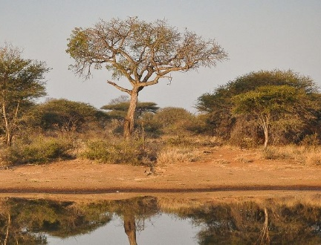
 | Geography: AFRICA
Human Geography |  |  | Show the differences between two regions Looking two different regions and comparing the human and physical differences between the two. Creating a paper figure depicting the regional differences including, rivers, settlement, climate, biomes, population. Making information leaflets about Salisbury and Timbavati. What are their populations like? What is the climate like? IS the economy different in both?
Physical Geography |  | What is physical geography? Looking at the physical geographical characteristics of Salisbury and Timbavati and comparing the two. | Looking two different regions and comparing the human and physical differences between the two. Creating a paper figure depicting the regional differences including, rivers, settlement, climate, biomes, population.
understand the difference between a continent and a country
understand what a region is and investigate the city of Salisbury and region of Timbavati.
What is human geography?
Looking at the human geographical characteristics of Salisbury and Timbavati and comparing the two.
What is a Biome and a Climate zone?
Comparing the similarities and differences between Salisbury and Timbavati.
Key pictures or diagrams
Biome | Salisbury | Population
Key Vocabulary
Term | Definition
biome | Parts of our planet that have similar climates, plants and landscapes
climate | The type of weather over a long period of time experienced by a country/area.
population | The number of people that live in a specific location.
economy | the state of a country or region in terms of the production and consumption of goods and services and the supply of money.
settlement | a place, typically one which has previously been uninhabited, where people establish a community.
region | A specific area that has common features
Human Geography Physical Geography | the branch of geography dealing with how human activity affects or is influenced by the earth's surface. the branch of geography dealing with natural features
Important atlas work
Locate the countries in Europe Locate counties and cities in an atlas and on a map Use compass points to help read and follow directions on a map Locate features using grid references Create own scale map Draw simple sketch maps
“Geography has made us neighbours.” – John F Kennedy
1040: First compass used to navigate (In China).
1271: Marco Polo sets off for China
1492: Columbus discovered America
1497: John and Sebastian Cabot discovered Canada
1540: Nicolaus Copernicus discovered the Solar System
1770: Captain James Cook discovered Australia
1911: Roald Amundsen led the first expedition to the South Pole
1969: Neil Armstrong was the first man to walk on the moon.
1507: First true map of the world by Martin Waldseemüller

