Slide 1


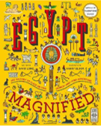

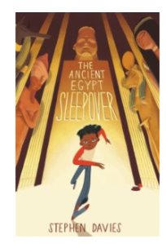
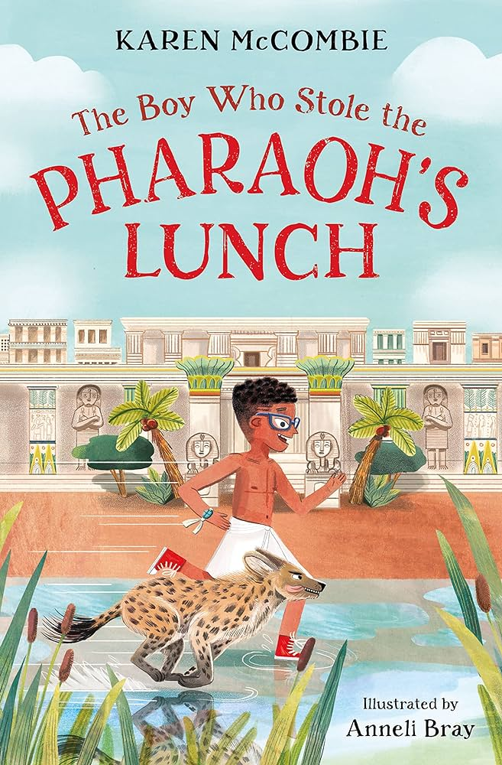
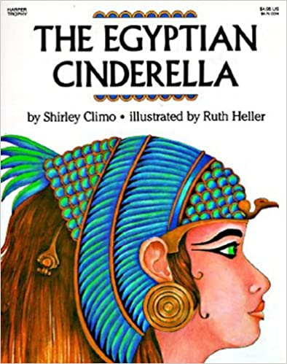


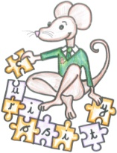


Year 3
Autumn term
1
Ready Respectful Safe
History: Ancient Egypt
Art: Drawing and colour. Sculpture
RE:
Hinduism
Geography: Africa
Climate Zones
French:
Greetings
Colours
PE:
Gymnastics
Netball
Dodgeball
Mindfulness
English
-Speech
-Narrative features – story writing
-Recount
Use materials from around your home to build a pyramid.
Research the daily life of an Egyptian.
Can you find out what Egyptians ate?
Maths
- Place Value
- Addition and subtraction
- Column Method
https://whiterosemaths.com/homelearning/year-3/
https://ncetm.org.uk/resources/42465
Key Text
How did people live in Ancient Egypt?
How is Seth curious?
How do some of the characters show greed?
Other information:
Magical Starter: Dress up as an Egyptian 5.9.24
Curriculum evening: 18.9.24 @5.30
Homework:
English: Spellings and
Reading (at least 5 times per week)
Writing Task
Maths tasks

